Slide 1

Where do Databases and Digital Forensics meet?
A Comprehensive Survey and Taxonomy
EPL646: Advanced Topics in Databases
Danilo B. Seufitelli, Michele A. Brandão, Ayane C. A. Fernandes, Kayque M. Siqueira, and Mirella M. Moro. 2023. Where do Databases and Digital Forensics meet? A Comprehensive Survey and Taxonomy. SIGMOD Rec. 52, 3 (September 2023), 18–29. https://doi.org/10.1145/3631504.3631508
Presented by Canciu Ionut - Cristian: icanci01@ucy.ac.cy
2024

Slide 2

Introduction
Growing Intersection of Fields
  Increasing relevance of the nexus between digital forensics and databases due to the surge in data volume and mobile applications on the web
Rise in Cyber Attacks
  Increase in cyber-attacks motivates the need for advanced forensic methods and enhanced database security
Importance of Digital Forensics (DF)
  Crucial for reconstructing cybercrimes and developing prevention mechanisms, focus on analysing data for crime evidence
Systematic Literature Review (SLR)
  The research uses an SLR protocol to derive insights from digital forensics, specifically targeting database-related studies within the field
Taxonomy Proposal
  A new taxonomy is proposed to categorize research at the nexus of digital forensics and databases
Research Objectives
  The main objectives – identifying how data exploration aids in DF and developing a better categorization of works at the intersection of these areas – emphasis on cyber-attacks and criminal intelligence

Slide 3
Motivation for the Study
Escalating Cybersecurity Threats
  Exponential growth in digital data
  Increase of mobile/web applications
Gap in Existing Literature
  Necessity for specialized research at the nexus of digital forensics and database management
  “There is no related work on the intersection of DB and DF besides ours”
Prospects for Advancements in Social and Technical Spheres
  Significant contributions to both the social and technical-scientific communities
  Understanding and integration of digital forensics and database management
Provide professionals with knowledge and tools
  During investigations, data may be accurately gathered, safeguarded, and examined

Slide 4
Methodology
Systematic Literature Review (SLR)
Seven-stage protocol from Kitchenham and Charters’
  Stage 1: Establish questions for investigation
  Stage 2: Identify and construct search strings/query phrases
  Stage 3: Set criteria for inclusion and general criteria for exclusion
  Stage 4: Conduct literature search
  Stage 5: Establish precise criteria for exclusion
  Stage 6: Curate literature and discern prevalent motifs
  Stage 7: Categorize publications

Slide 5
1. Research Questions
At what time and location were these studies made public?
What variety of research exists in this field?
What is the central theme of employing data analytics in digital forensic investigations?
What are the recent developments and foreseeable obstacles in this field?
Which questions in this domain have not yet been resolved?

Slide 6
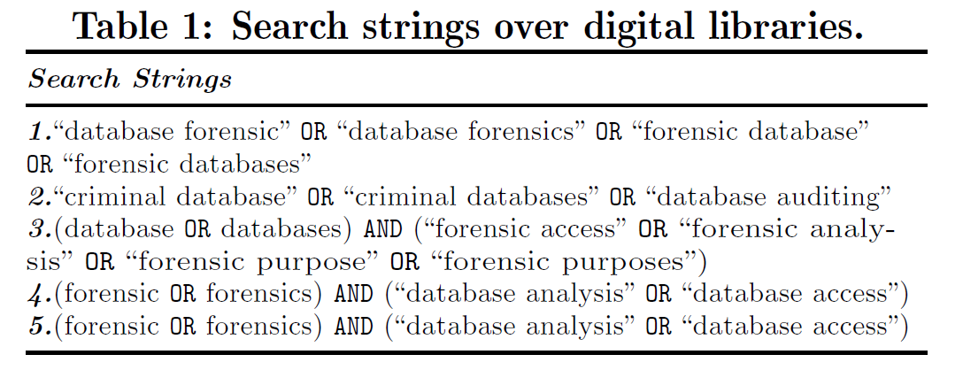
2. Search Strings
Initially: “data forens” – focusing on title, abstract, keywords

Slide 7
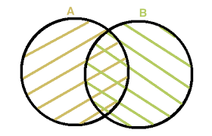
3. Inclusion/General Exclusion Criteria
Inclusion Criteria
  Databases and Digital Forensics
Exclusion Criteria
  Missing abstract
  Only abstract
  Prior iteration of a different investigation
  Not a primary study
  No access to full content
DB
DF

Slide 8
4. Conduct literature search
Digital Libraries
  Scopus (3,836)
  Science Direct (2,042)
  Web of Science (756)
  IEEE Xplore (289)
Overall: 6,923

Slide 9
5. Specific exclusion Criteria
Keep only what is in the domain of Computing and Engineering
Exclude unrelated disciplines, such as biomedicine, biology, genetic forensic science
493 relevant publications

Slide 10
6. Common Theme
Remove those that do not meet the inclusion criteria
  151 remained
Apply again the exclusion criteria
  101 remained

Slide 11
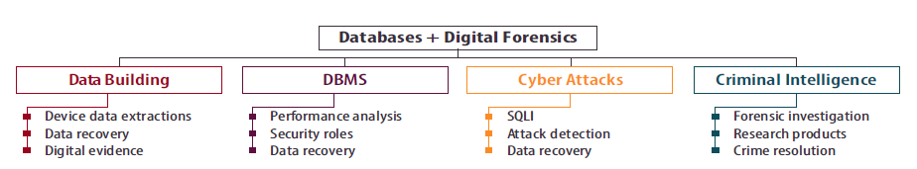
7. Proposed Classifications
SLR for 91 publications
52 categorized:
  Cyber Attacks
  Criminal Intelligence
Major classes
  DBMS
  Data Building
  Cyber Attacks
  Criminal Intelligence
Three individuals voluntarily categorized 101 documents by hand
Further analysis resulted in excluding 10 more publications

Slide 12
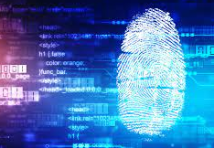
What are Forensics?
Find relationship between people, placed, events
Provide support in examining and making decisions on civil and criminal legal matters
Skills spanning various fields (such as chemistry, biology, and computing)

Slide 13
What are Digital Forensics?
“Digital forensics (sometimes known as digital forensic science) is a branch of forensic science encompassing the recovery, investigation, examination, and analysis of material found in digital devices, often in relation to mobile devices and computer crime” - Wikipedia

Slide 14
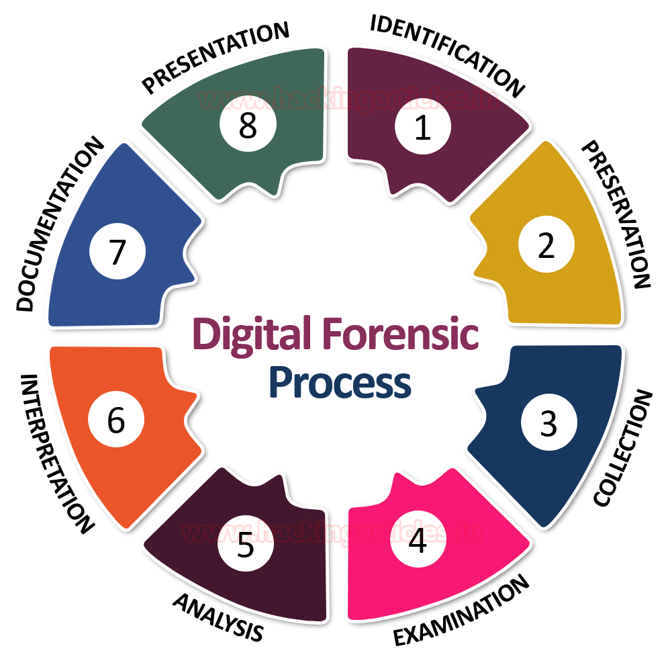
Importance of Digital Forensics in Investigating Digital Crimes
Pivotal role in the modern landscape of cybersecurity, crucial tool for investigating and mitigating digital crimes
Large range of illegal activities from data breaches to cyberterrorism
Digital forensics enables investigators to accurately analyse digital evidence, reconstruct events leading to the crime, and identify perpetrators
Methodologies and practices are essential for ensuring the integrity of evidence, fundamental for legal proceedings.
Digital forensics not only aids in resolving past offenses but also contributes significantly to developing preventive measures against potential future threats, safeguarding digital assets and reinforcing the overall cybersecurity framework
Image Credits: hackingarticles

Slide 15
Classification Summary
Data Building – solve problems with data
DBMS – usage of DBMS systems in digital forensics
Cyber Attacks – targeting databases or confidential information
Criminal Intelligence – apply data to investigate/solve digital crimes

Slide 16
Cyber Attacks
Cyber Attack Dynamics: exploit system vulnerabilities using sophisticated techniques for malicious practices like identity theft and fraud
Classification of Cyber Attacks: various cyber-attacks such as domain hijacking, network intrusion, and particularly SQL Injection (SQLi) → need for forensic analysis tools and methodologies to detect, analyse, and recover from these attacks
SQL Injection (SQLi) Explained: attackers manipulate SQL code, often through application input fields, to bypass security measures and access sensitive database information

Slide 17
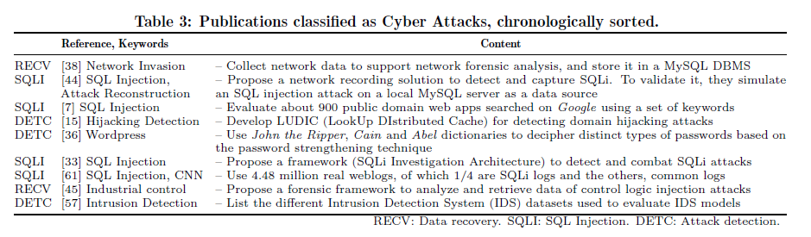
Publications on Cyber Attacks

Slide 18
Criminal Intelligence
Criminal Intelligence Focus: utilize digital forensics for database content analysis, incident investigation, and constructing timelines of illicit activities
Outcomes and Solutions: develop research products and solutions that leverage forensic and computational methods to effectively resolve digital crimes
Total 40 papers

Slide 19
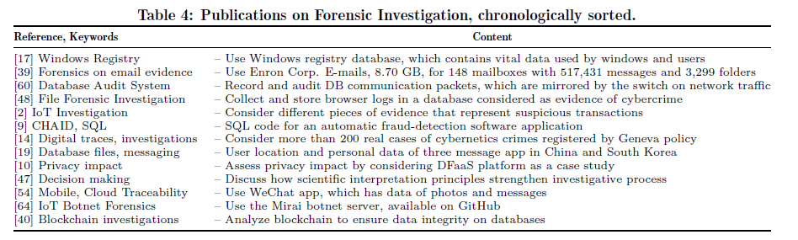
Publications on Criminal Intelligence
Forensics Investigation

Slide 20
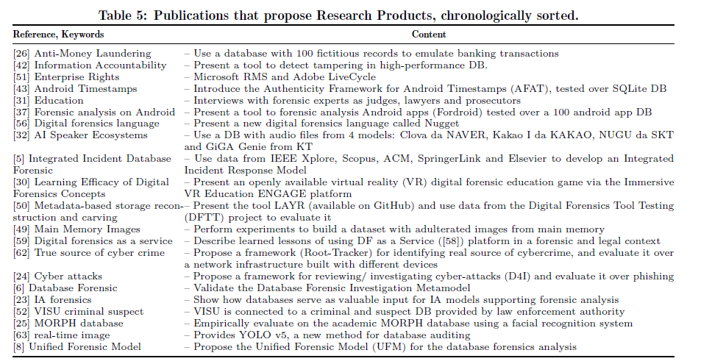
Publications on Criminal Intelligence
Research Products

Slide 21
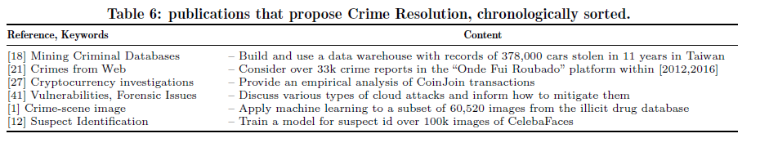
Publications on Criminal Intelligence
Crime Resolution
Notes:
Silveira and Brand˜ao [21] collect data from websites
with crime occurrences and apply clustering
analysis to discover crime patterns. They highlight
that more than 41% of the crimes were not reported,
most of which are thefts and robberies occurring at
night and dawn. Moreover, minor offenses present
different patterns of serious crimes, and crime patterns
differ in rich and poor neighborhoods.

Slide 22
Publications on Criminal Intelligence
Crime Resolution
Silveira and Brand˜ao [21] collect data from websites with crime occurrences and apply clustering analysis to discover crime patterns. They highlight that more than 41% of the crimes were not reported, most of which are thefts and robberies occurring at night and dawn. Moreover, minor offenses present different patterns of serious crimes, and crime patterns differ in rich and poor neighborhoods.

Slide 23
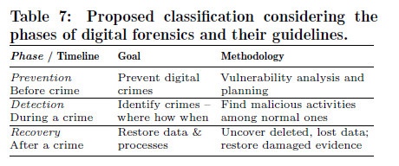
Publications by phase
Prevention – prevent cybercrime
Detection – identify evidence
Recovery – recover data and/or systems
  Restore corrupted/deleted data

Slide 24
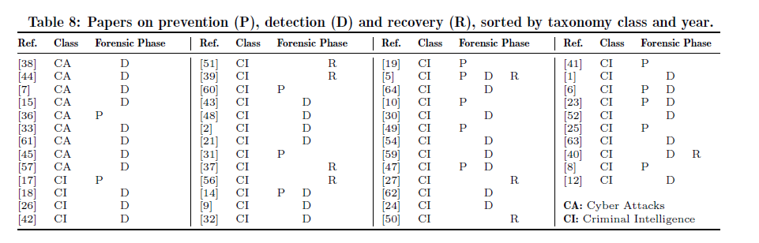
Publications by phase

Slide 25
Practical Implications for Forensics and Database Professionals
Enriched Collaboration
  Necessity for stronger collaboration between forensics experts and database professionals to develop more effective strategies for preventing, detecting, and resolving cyber threats
Innovative Forensic Tools and Techniques
  Importance of continuously innovating forensic methodologies and tools that leverage database insights, improving the accuracy and efficiency of digital crime investigations

Slide 26
Answering Research Questions
At what time and location were these studies made public?
What variety of research exists in this field?
What is the central theme of employing data analytics in digital forensic investigations?
What are the recent developments and foreseeable obstacles in this field?
Which questions in this domain have not yet been resolved?
2017 onwards
mostly quantitative
classification categories + phases
organize/store → investigation
large storage → more processing
diversity of software
new technologies → new cyberattacks

Slide 27
Conclusion
Interdisciplinary Integration: Highlighted the critical intersection between digital forensics and database management, importance in addressing contemporary digital crimes
Taxonomy Contribution: Established a comprehensive taxonomy categorizing research in the overlap of digital forensics and databases, easier navigation and understanding of the field
Identified Gaps and Trends: Uncovered significant gaps in existing literature and emerging trends, setting the stage for future research
Practical Implications: Emphasized the practical applications of the study's findings in enhancing digital crime investigations and contributing to more robust cybersecurity measures
Call to Action: Encouraged continued exploration and collaboration between digital forensics experts and database professionals to drive innovation and effectiveness in combating digital crimes

Slide 28

Thank you!!

