Slide 1

Data Processing with FPGAs on Modern Architectures
EPL646: Advanced Topics in Databases
Wenqi Jiang, Dario Korolija, and Gustavo Alonso. 2023. Data Processing with FPGAs on Modern Architectures. In Companion of the 2023 International Conference on Management of Data (SIGMOD '23). Association for Computing Machinery, New York, NY, USA, 77–82. https://doi.org/10.1145/3555041.3589410
By Markos Othonos: mothon01@ucy.ac.cy

Slide 2

Introduction
Datacenters need to manage the constantly increasing streams of data (more than 400Gbps*).
CPUs yield relatively low performance and energy efficiency compared to other solutions.
IOs still have a heavy impact on performance.
They care about MICROSECOND scale delays!
*https://community.hpe.com/t5/around-the-storage-block/data-center-transformation-the-road-to-400gbps-and-beyond/ba-p/7152221

Slide 3
Contents
What are FPGAs?
Datacenter configuration issues.
Farview
Approximate Nearest Neighbor search.
Vectie
Recommendation Systems.
Microrec
ACCL
*https://community.hpe.com/t5/around-the-storage-block/data-center-transformation-the-road-to-400gbps-and-beyond/ba-p/7152221

Slide 4
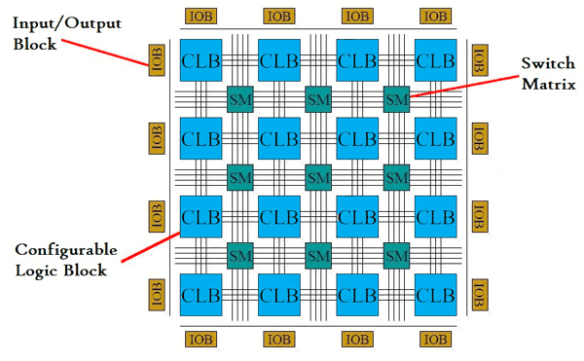
FPGA architecture
Composed of three main type of blocks.
CLBs have look up tables (ROMs) to return the result of a logical function.
SBs direct the data flow accordingly and form the final design.
IOBs, allow outside communication.
*
*https://www.quora.com/What-is-FPGA-How-does-that-work

Slide 5
FPGA benefits
FPGAs have many IOBs, allowing parallel access to many channels. (Intel stratix 10 has up to 144 transceivers!)
Line rate data processing!
Power efficient!
Reconfigurable. Potential to fabricate designs to ASICs, increasing performance and energy efficiency!
C/C++ programmability support!
Notes:
Transceivers (not to be confused with the ones in radio communication) can be used with OPTICAL FIBER communication! Each supports tens of Gbps!

Slide 6
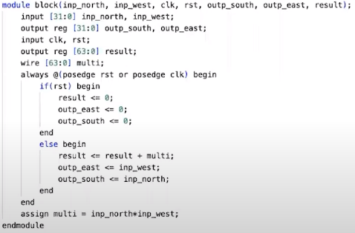
FPGA HLS Tools
*
Hardware description languages have a steep learning curve (VHDL, verilog).
Implementing a single multiply and accumulate operation needs more than 20 lines!
High level synthesis tools can help reduce this number to less than 5 lines. (of C/C++ code).
Less than 23 lines of C/C++ lines of code needed to make a matrix multiplication operation!
*https://www.youtube.com/watch?v=FDt_qxCmOkc

Slide 7
Datacenter DRAMs
Datacenter vendors load as much data as possible to the DRAMs to minimize latency.
Solutions such as loading all the data to DRAMs exacerbates data movement…
Remember, DRAM capacity is relatively expensive in cost and power.

Slide 8
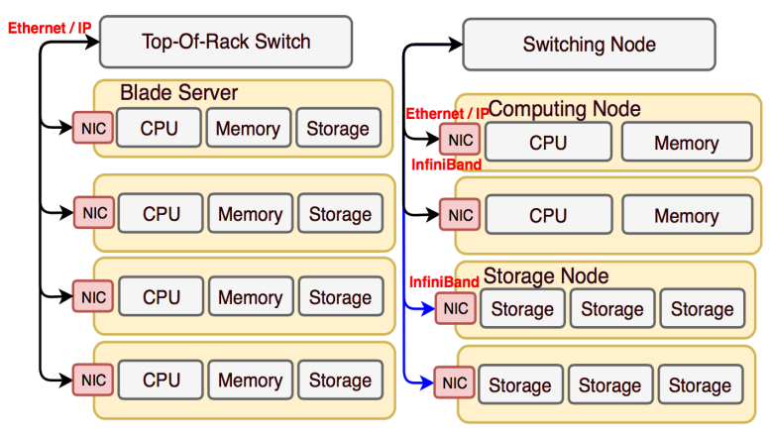
Datacenter configurations
*
Datacenters may employ strategies such as compute and storage disaggregation.
Cost-efficient scalability. (i.e we may need more storage nodes than compute nodes)
Potential bottleneck is the network – too much data to move.
Smart data movement is required!
*https://www.diva-portal.org/smash/get/diva2:1292615/FULLTEXT01.pdf
Notes:
Network problem starts when Inter-Node communication is needed.
What if required data is not in Memory, but stored?
What if we need to involve memory outside of the same compute node?

Slide 9
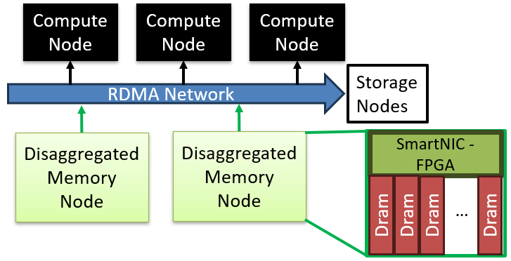
Farview
Targets to reduce network traffic in datacenters with compute and storage disaggregation.
Partially disaggregate memory from memory nodes.
Manage each memory pool using an FPGA.

Slide 10
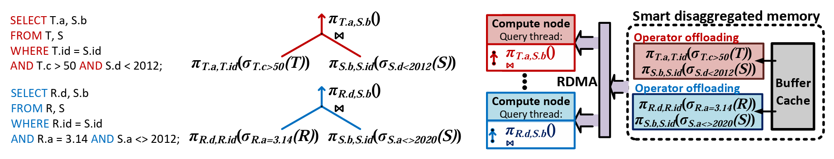
Farview
Leverage FPGAs’ line rate processing, to offload a query’s operators, while extracting data from the DRAMs.
Less data needs to travel through the network, alleviating the bottleneck concerns.
Each smart disaggregated memory module can serve multiple computer nodes, due to the usage of RDMA.
*
*Korolija, D., Koutsoukos, D., Keeton, K., Taranov, K., Milojivci'c, D., & Alonso, G. (2021). Farview: Disaggregated Memory with Operator Off-loading for Database Engines. ArXiv, abs/2106.07102.

Slide 11
ANNS
Approximated Nearest Neighbor Search – retrieve relevant data from large vector data collections.
Used in multiple search engines or recommendation systems (or even large language models).
Deals with scalability issues of NNS ( i.e. growing datasets – high dimensional vectors).
Quantizing vectors, reduces their dimensionality - more efficient storage. Trades-off accuracy for performance and resource efficiency.
Since quantized vectors take less space, they can be stored in main memory, for minimal time spent on IOs.
CPUs are bad at dequantization. (and GPUs have bad latency response)

Slide 12
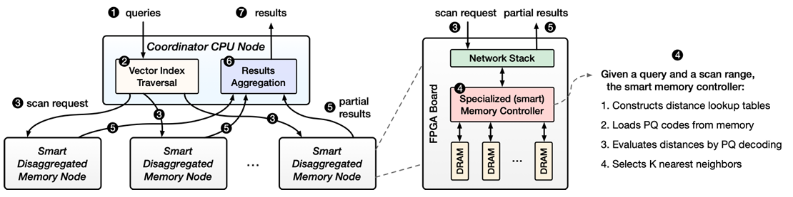
Vectie
Vectie comes with a computer node which is responsible for coordinating Smart Disaggregated Memory Nodes.
Each SDMN is equipped with an FPGA, capable of dequantizing vector codes very fast. Essentially, the ANNS task is broken down and handled from multiple SDMNs.
*
* Wenqi Jiang, Dario Korolija, and Gustavo Alonso. 2023. Data Processing with FPGAs on Modern Architectures. In Companion of the 2023 International Conference on Management of Data (SIGMOD '23). Association for Computing Machinery, New York, NY, USA, 77–82. https://doi.org/10.1145/3555041.3589410
Notes:
Stand-alone paper about vectie, was not published yet…

Slide 13
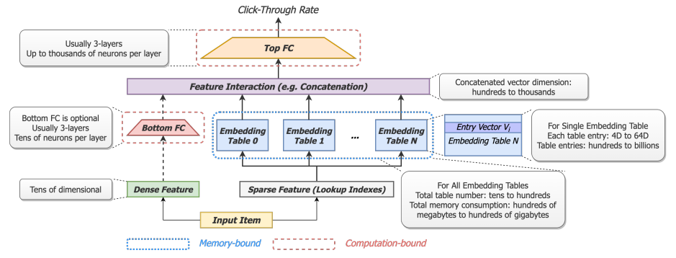
Recommendation Systems
They have both memory and computation bound processes.
Multiple embedding tables are looked at – total memory consumption may reach up to hundreds of GBs! Additionally, memory accesses may not be sequential!
There is need of very high bandwidth!
*
* Jiang, W., He, Z., Zhang, S., Preußer, T.B., Zeng, K., Feng, L., Zhang, J., Liu, T., Li, Y., Zhou, J., Zhang, C., & Alonso, G. (2021). MicroRec: Efficient Recommendation Inference by Hardware and Data Structure Solutions. Conference on Machine Learning and Systems.
Notes:
Dense features – age, gender ex.
Sparse features – location, advertisement category

Slide 14
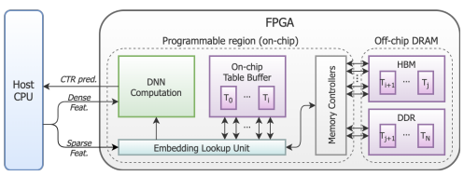
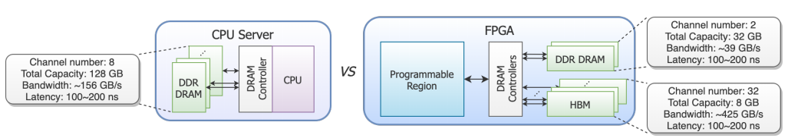
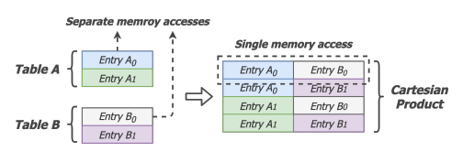
Microrec
Utilizes the numerous channels available to an FPGA. HBM is used if supported by FPGA board. Alleviates the memory access bottleneck.
Reduces memory accesses, by applying cartesian products of tables. A single memory access may retrieve multiple embedding vectors.
If applied on smaller embedding tables only, not much data will be redundant.
*
* Jiang, W., He, Z., Zhang, S., Preußer, T.B., Zeng, K., Feng, L., Zhang, J., Liu, T., Li, Y., Zhou, J., Zhang, C., & Alonso, G. (2021). MicroRec: Efficient Recommendation Inference by Hardware and Data Structure Solutions. Conference on Machine Learning and Systems.
Notes:
…

Slide 15
ACCL
FPGAs are very fast at processing. What about a cluster?
ACCL is a collective communication library like OpenMPI.
ACCL manages to gain higher throughput, and lower latency than a host-driven MPI, when messages are large. Meaning that better scalability is offered through the usage of FPGAs.
Notes:
Message size where ACCL start performing better than OpenMPI: 1MB

Slide 16
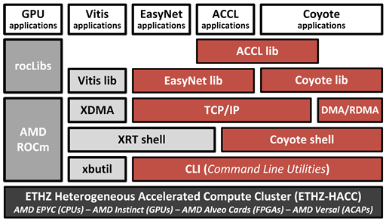
Cluster with FPGAs
*
ETHZ HACC – public computing available for academic research, with open-source tools.
Support for networking.
* Wenqi Jiang, Dario Korolija, and Gustavo Alonso. 2023. Data Processing with FPGAs on Modern Architectures. In Companion of the 2023 International Conference on Management of Data (SIGMOD '23). Association for Computing Machinery, New York, NY, USA, 77–82. https://doi.org/10.1145/3555041.3589410

Slide 17
Conclusion
FPGAs are versatile and efficient in terms of performance and energy usage.
HLS enable easier development of FPGA designs.
FPGAs can be used:
  To alleviate network bottleneck concerns in datacenters with compute and storage disaggregation.
  To alleviate memory bandwidth bottleneck concerns of memory intensive workloads.
  To perform DNN computations fast and efficiently.
  As a cluster to perform tasks more efficiently - if large message sizes.

Slide 18

Thank you!

Slide 19
EXTRA SLIDES
Notes:
These slides are readied for any potential questions that may arise

Slide 20
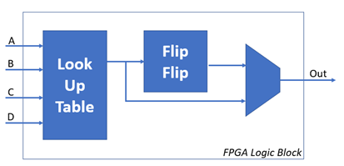
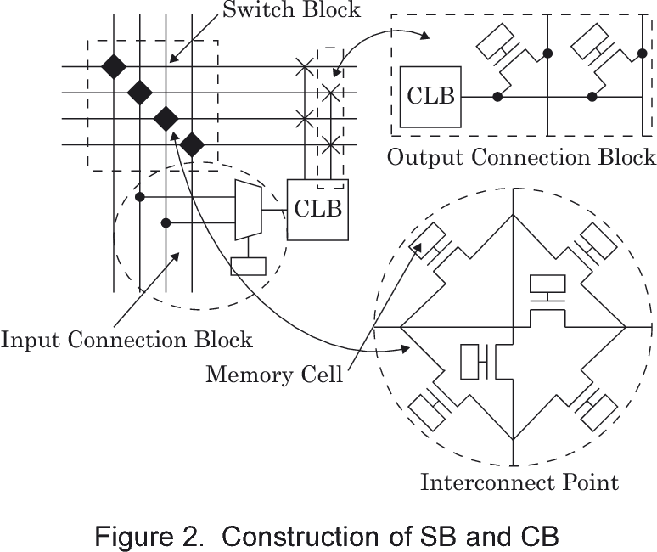
FPGA Blocks
A | B | C | D | Out
0 | 0 | 0 | 0 | 1
0 | 0 | 0 | 1 | 1
0 | 0 | 1 | 0 | 0
0 | 0 | 1 | 1 | 1
.. | .. | .. | .. | ..
.. | .. | .. | .. | ..
1 | 1 | 1 | 1 | 0

Slide 21
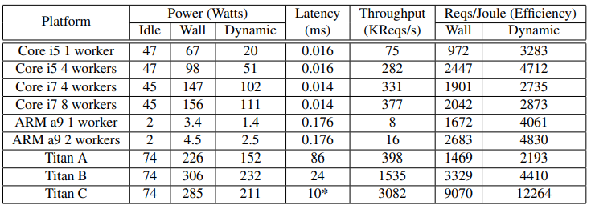
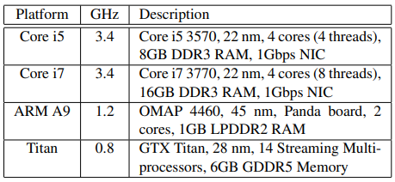
Why NOT GPUs?
Good throughput.
Good energy efficiency.
Very bad latency. In the best case: more than 600 times the latency of a CPU!
S. R. Agrawal, V. Pistol, J. Pang, J. Tran, D. Tarjan, and A. R. Lebeck, “Rhythm: Harnessing Data Parallel Hardware for Server Workloads,” in Proceedings of the 19th International Conference on Architectural Support for Programming Languages and Operating Systems, 2014.
Notes:
WORKLOAD: SPECWeb Banking benchmark

Slide 22
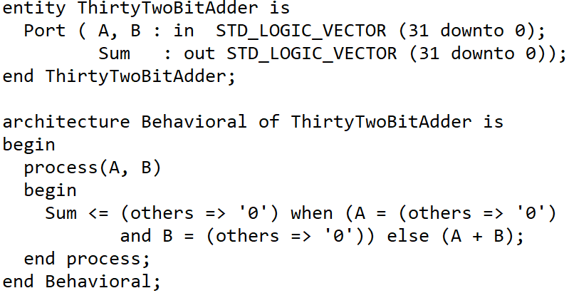
Compute Node
Compute Node
Compute Node
Storage Nodes
RDMA Network
Disaggregated Memory Node
Disaggregated Memory Node
SmartNIC - FPGA
…
Dram
Dram
Dram
Dram

