Slide 1

From Large Language Models to Databases and Back:
A Discussion on Research and Education
EPL646: Advanced Topics in Databases
Fatemeh Nargesian, Abolfazl Asudeh, and H. V. Jagadish. 2022. In Proceedings of the 2022 International Conference on Management of Data (SIGMOD '22). Association for Computing Machinery, New York, NY, USA, 2458–2464. https://doi.org/10.1145/3514221.3522567
By Stelios Karagiorgis: skarag03@ucy.ac.cy

Slide 2

What is a Large Language Model (LLM)
A Large Language Model (LLM) is an Artificial Intelligence (AI) system
LLMs are built on machine learning
It designed to process and understand natural language
LLMs are trained on massive amounts of text data, often including the entire internet or a large subset of it
Notes:
Large data sets
Machine learning
Του δίνουμε αρκετά παραδείγματα έτσι ώστε να είναι σε θέση να αναγνωρίσει την ανθρώπινη γλώσσα ή πιο δύσκολα δεδομένα
Κάνουν ένα μεγάλο αριθμό από εργασίες
Μία από τις πιο γνωστές χρήσεις είναι η εφαρμογή της τεχνητής νοημοσύνης: όταν του κάνεις μια ερώτηση, μπορεί να παράγει κείμενο ως απάντηση.

Slide 3
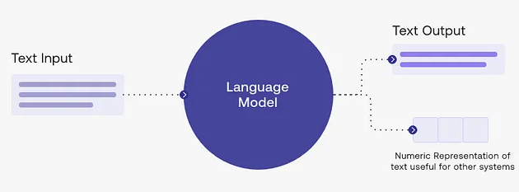
How does it work?
Pre-training Phase: the model is trained on a large amount of text data, such as Wikipedia
Fine-tuning Phase: the model is fine-tuned for specific tasks like language translation, summarization, or question answering.
User Interaction: When text is inputted by a user, the LLM processes this input and generates a response.
Notes:
Τα LLM χρησιμοποιούν έναν τύπο του machine learning που ονομάζεται deep learning
To deep learning μπορεί ουσιαστικά να εκπαιδεύσει τον εαυτό του να αναγνωρίζει διακρίσεις χωρίς ανθρώπινη παρέμβαση, αν και κάποια ανθρώπινη βελτίωση(fine-tuning) είναι συνήθως απαραίτητη

Slide 4
Introduction
Integration of LLMs in DB Research
Opportunities and Challenges
Role of ChatGPT
Impact on Education
LLMs in Data Science Research
Challenges and Solutions

Slide 5
LLM and DBs
Increasing Attention: for their potential in Natural Language Processing (NLP) and generating high-quality text
Concerns: Reliability in knowledge extraction from LLMs raise concerns
Advancements: DB research and data science have improved problem-solving in areas like merchandise recommendation and hazard prevention
Effectiveness: Helpful in data preparation, labeling, text mining, keyword extraction, and sentiment analysis
Education: LLMs can provide students with a wealth of knowledge and practical skills
ChatGPT Overview: A GPT-based model capable of generating versatile text content, with limitations in originality, plagiarism, and up-to-dateness
Notes:
Επεξεργασία φυσικής γλώσσας (NLP) και να δημιουργούν κείμενο υψηλής ποιότητας
Ανησυχίες σχετικά με την αξιοπιστία της εξαγωγής γνώσης
Μπορούν να εντοπίσουν και να διορθώσουν γραμματικά λάθη
Η ακρίβεια της εξαγόμενης γνώσης δεν είναι εγγυημένη
Η έρευνα των Βάσεων Δεδομένων μπορεί να χρησιμοποιηθεί για τη βελτίωση της αποτελεσματικότητας του LLM

Slide 6
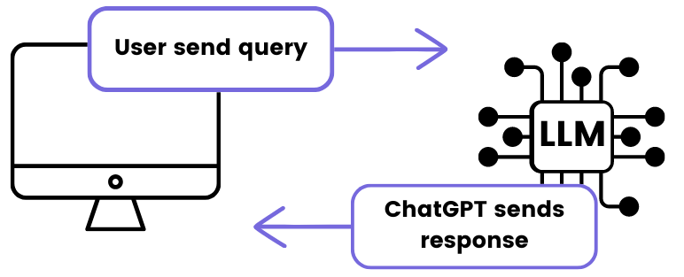
LLM and DBs - ChatGPT
ChatGPT Overview:
  A popular LLM
  GPT-3.5, released in November 2022
  Trained on diverse texts from 2020, capable of generating essays, poems, and code
  Recognized for its accurate and fluent natural language production
  A newer version, GPT-4, was launched in March 2023 for paid users
Capabilities:
  Can translate languages, summarize texts, and simulate human-like conversations
Drawbacks:
  Lacks originality, raising concerns about plagiarism and privacy
  May not offer timely or up-to-date information due to training on data before 2021
  Struggles with complex math or advanced tasks
  Outputs might include incorrect or outdated info, necessitating cautious use

Slide 7
PROS And CONS of LLMs - PROS
LLMs Enhance Data Science Research: enable data scientists to concentrate on high-level creative thinking, big-picture analysis, and original idea generation
ChatGPT for Various Tasks: Data scientists use ChatGPT for summarizing texts, learning about new topics, brainstorming, improving writing and coding skills, and translating code between programming languages
Educational Reform: Incorporating ChatGPT into computer science and data science education can provide opportunities for students to engage in high-level thinking, coding, and technical writing
Notes:
Οι αριθμομηχανές και οι επεξεργαστές κειμένου είναι χρήσιμα εργαλεία για τους ανθρώπους
Ομοίως, οι data scientists μπορούν να χρησιμοποιήσουν το ChatGPT για την έρευνά τους

Slide 8
PROS And CONS of LLMs - CONS
Limitations and Ethical Considerations: The knowledge of an LLM is limited to its training data, which can introduce biases and ethical concerns, highlighting the need for learning techniques that mitigate these issues
Privacy Concerns: Training LLMs with public data and user interactions raises privacy issues, necessitating the development of privacy-preserving schemes like differential privacy
Notes:
Ένα LLM γνωρίζει μόνο τι έχει διδαχθεί, κάτι που μπορεί να προκαλέσει μεροληπτικά ή αθέμιτα αποτελέσματα
Υπάρχει κίνδυνος να αποκαλυφθούν ιδιωτικά πράγματα
Θα πρέπει να χρησιμοποιήσουμε ειδικές μεθόδους απορρήτου για να το αποτρέψουμε αυτό

Slide 9
What Can LLM Do For DBs?
Approximate Results: Ideal for inexact data/query processing, like approximate query processing and data integration, but not for exact processing tasks such as query rewriting
DB Research for LLMs: Focus on supplying high-quality data for training LLMs, creating a symbiotic relationship between DB systems and LLMs
Text-to-SQL Applications: Using LLMs to convert natural language queries into SQL statements, with the potential to improve accuracy and user interaction
DB Research for LLMs: Focus on supplying high-quality data for training LLMs, creating a symbiotic relationship between DB systems and LLMs
Notes:
Προσεγγιστικές απαντήσεις: Τα LLM είναι καλά για εργασίες ακατέργαστων δεδομένων, αλλά όχι για ακριβείς.
Δεδομένα για LLM: Η λήψη καλών δεδομένων για LLM βοηθάει τόσο τις βάσεις δεδομένων όσο και το AI να συνεργάζονται καλύτερα.
LLMs για SQL: Τα LLM μπορούν να μετατρέψουν ερωτήσεις σε ερωτήματα βάσης δεδομένων, τα οποία μπορεί να κάνουν τα πράγματα πιο ακριβή και πιο εύχρηστα.
Ποιότητα δεδομένων: Είναι σημαντικό να χρησιμοποιείτε high-quality δεδομένα για την εκπαίδευση των LLM για την καλύτερη συνεργασία με συστήματα βάσεων δεδομένων.

Slide 10
LLMs Need Reasoning
LLMs and Data Integration:
  Data integration involves schema mapping, data deduplication, and schema and data fusion
  Traditional data integration tasks don't require retraining and can handle new incoming data efficiently
LLMs must include information about data origins, structure, and extra details during their learning
They also need to consider privacy rules when collecting and combining data
Notes:
Η αντιστοίχιση σχήματος, η αφαίρεση διπλών δεδομένων που περιλαμβάνουν την εξέταση ενημερωμένων πηγών δεδομένων, καθώς και προσωπικών δεδομένων

Slide 11
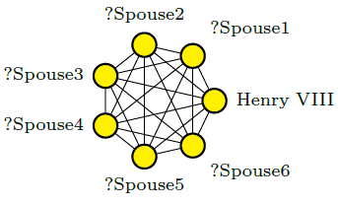
LLMs Need Reasoning – LLMs and Graphs
Graphs are a great source of knowledge
Graphs can be seen as high-quality and trustworthy integrated information
Graphs, such as Wikidata and DBPedia, offer high-quality knowledge that LLMs can leverage
Knowledge graphs help improve how LLMs understand and respond to questions by organizing data in an easy-to-follow structure.

Slide 12
LLMs Need Reasoning – LLMs and Graphs
Merging LLM outputs with graph data can enhance LLM performance by blending machine learning with traditional, logic-based thinking
LLMs don't have a system for updating or correcting information like knowledge graphs do
LLM-generated content can help improve knowledge graphs, especially for answering questions, by using graph attention networks
Notes:
Η συνένωση αποτελεσμάτων LLM με δεδομένα γράφων μπορεί να βελτιώσει την απόδοση των LLM
Τα LLM δεν διαθέτουν σύστημα για την ενημέρωση ή διόρθωση πληροφοριών όπως οι γράφων

Slide 13
LLMs as a Research Assistant
Helping with Scientific Writing
  ChatGPT can assist in refining scientific texts, including structure improvement and title suggestions
  It aids in articulating research ideas more clearly
Assisting with Data Analytics
  Can write code for data analytics tasks, such as exploratory data analysis (EDA), data cleaning, and model selection
  Saves time by automating routine tasks, allowing focus on more complex data analytics aspects.
Limitation of Hallucination in LLMs
  Content Accuracy: LLMs may generate plausible but incorrect content, posing challenges in research integrity.
  Solution: Integrating ChatGPT with knowledge graphs could verify the accuracy of generated information against existing data.

Slide 14
LLMs as a Research Assistant - Ethical and Legal Issues
LLMs can reflect biases from their training data and risk generating plagiarized content
Risks of privacy breaches if sensitive information is inputted
Generating copyrighted material without authorization could have legal implications
Requires authors to reveal if they used AI tools in their publications, focusing on using them ethically and responsibly
Notes:
Κινδυνεύουν να δημιουργήσουν περιεχόμενο που λογοκλοπής
Αν εισαχθούν ευαίσθητες πληροφορίες, υπάρχει κίνδυνος διαρροής τους.
Η παραγωγή περιεχομένου που καλύπτεται από πνευματικά δικαιώματα χωρίς άδεια μπορεί να έχει νομικές συνέπειες

Slide 15
LLMs for Education
Concerns: Students use ChatGPT for exams, it passing legal tests
Teaching Approach: Include LLMs in courses to explain them and show their pros and cons.
Evaluating LLMs: Teach students to check LLMs' accuracy like they would with other tools.

Slide 16
LLMs for Education - LLMs for Teachers
LLMs are being utilized to grade students' work
This use prompts concerns about the reliability and fairness of the grading
LLMs are also assisting educators in creating teaching materials
It's crucial that teachers maintain control to ensure they can direct the educational process and make manual adjustments to LLM-generated results
Additionally, LLMs have potential applications in predicting which students may leave school early

Slide 17
LLMs for Education - LLMs in Various Educational Roles
As Learners: Encourages students to view LLMs as peers for mutual learning
For Educational Stakeholders: Use LLMs:
  To help with group projects
  Teaching help
  Grading
  Making lessons
Fairness and Accuracy: Check LLMs carefully for bias and mistakes, and use data to find where errors come from

Slide 18
Conclusion
DBs vs. LLMs: Databases hold data for search and study. LLMs work with text to solve language issues but may not always give right or full answers
Advantages and Limitations: LLMs can aid in data discovery, cleaning, integration, and visualization, benefiting both data science and education
Optimistic View: LLMs are seen as tools that can handle many data science tasks and improve education.
Pessimistic View: Concerns include LLMs struggling with data modeling and analytics, potentially harming learning skills, and raising issues like bias, plagiarism, and privacy.
Caution Advised: Users should critically evaluate AI-generated results

Slide 19

Thank you!

Slide 20
References
What is a large language model (LLM)? https://www.cloudflare.com/learning/ai/what-is-large-language-model/
How Large Language Models work? https://medium.com/data-science-at-microsoft/how-large-language-models-work-91c362f5b78f
Sihem Amer-Yahia, Angela Bonifati, Lei Chen, Guoliang Li, Kyuseok Shim, Jianliang Xu, and Xiaochun Yang. 2023. From Large Language Models to Databases and Back: A Discussion on Research and Education. SIGMOD Rec. 52, 3 (September 2023), 49–56. https://doi.org/10.1145/3631504.3631518

