Slide 1

Deploying a steered query optimizer in Production at Microsoft
Demetris Kaizer
EPL 646

Slide 2


Roadmap
Introduction
Background
Implementation Details
Experiments
Conclusion

Slide 3

Introduction

Slide 4

Introduction
The PROBLEM:
General purpose query optimization is not working. Why?
Are build for all users/scenarios
Generic benchmarking doesn’t represent real customer workloads

Slide 5

There is a need for specialize cloud-based query optimizers.
Introduction

Slide 6


Introduction
Recent work proposed Machine Learning
Neo
Proposed to replace the entire query optimizer with a learned one
Not possible in real systems
BAO
Proposed to steer the optimizer towards better plans
Using rule hints to navigate the search space
This paper proposes to use these ideas to production.

Slide 7
Introduction
Previous approaches used many rule hints to steer the optimizer. This hard to explain/understand what helped.
Experimentation costs are huge. Large systems hard to sample.
Unseen search space can lead to performance regression because estimated cost is not accurate
THE Problems!

Slide 8
Cost effective
Explainable
Safe
THE Solution!
THE MAIN IDEA!
break the steering into small explainable steps
Q0-Advisor

Slide 9
Background

Slide 10
Terminology
Terminology
Flighting | A/B Test Infastracture to run job
Token | The number of concurrent containers used by each job
Vertices | The total amount of tokens used to execute a job.
PNhours | The sum of the total CPU and I/O over all vertices

Slide 11
Background
SCOPE:
A large, distributed processing system Petabytes of data processing
SQL like scripting language
Scope scripts are refered as jobs
Scope Characteristics
More than 60% of scope jobs are recuring
We can use historic data

Slide 12
Background
Scope Rule-based optimizer:
256 Rules,
4 Categories (implement rules, required, off-by-default, on-by-default)
Rule Signature:
A bit vector representation of which rules directly contributes
Job Span:
A set containing rules that when enabled / disabled can affect the query plan.

Slide 13
Background
Q0-Advisor
Recommends better search paths via rule hints
Offline Pipeline
Leverage post telemetry to explore better query plans
Design Principles of Q0-Advisor
Single rule flip
Trained contextual bandit from historical data
Learn rule configuration from the estimated cost of the scope optimizer
Avoids regression by “flighting” a small number of jobs

Slide 14
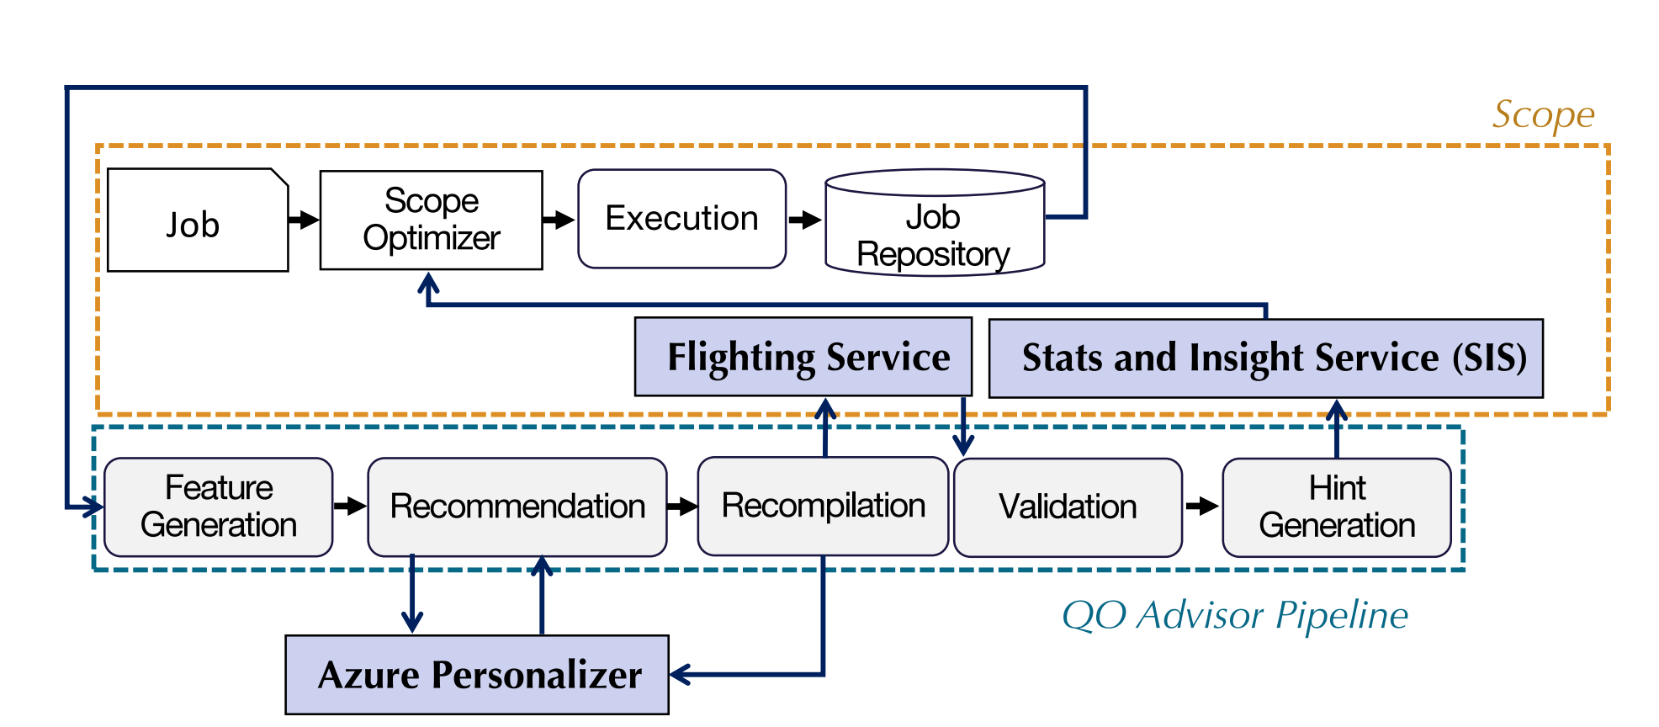
Q0 Pipeline Overview

Slide 15
Q0 Pipeline Overview
Recommendation
Leverages the concept of Rule Signature (B) and Job Span (S).
There are 2^B possible actions → very large
But better use S that can affect the plan
Limiting the search space to a single bit deviations -> 1 + S possible actions (S typically is 10)
Validation
Uses Estimates Costs and Flighting to avoid regressions
Decides whether to accept or reject the plan

Slide 16
Implementation Details

Slide 17
Learning Principles
Introduction to Contextual Bandit
Extension of supervised learning
For problems where enumeration is impractical
Evaluates only actions made by the learning algorithm

Slide 18
Feature Generation
Job Span generation
The span algorithm implements an heuristics search whereby only new rules having effect on the final plan can be discovered.
Feature Aggregation
Each job executes a script which can contain one or more queries.
Example Features:
PN hours, latency, total containers used

Slide 19
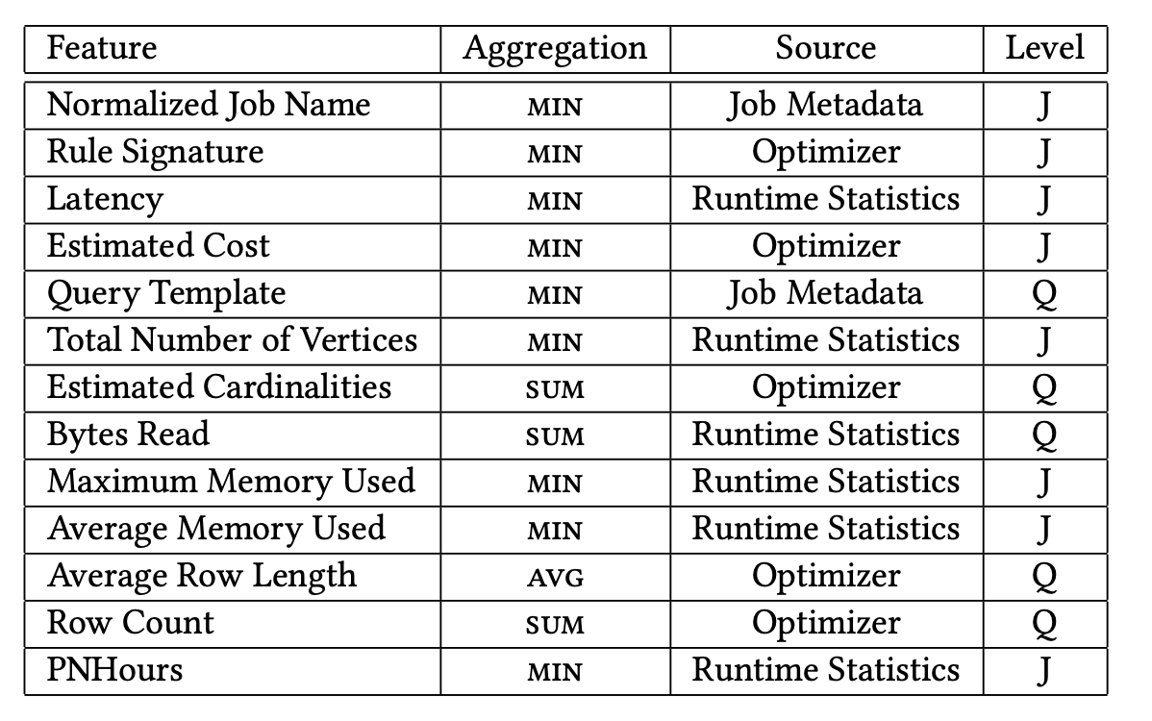
Example Aggregated Features

Slide 20
Experiments

Slide 21
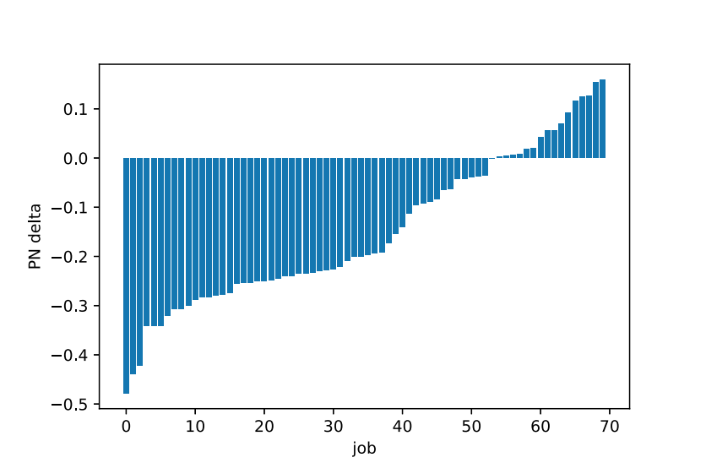
Job PN Delta
PNhours improvements 50% - best case
PNhours regression 15% - worst case

Slide 22
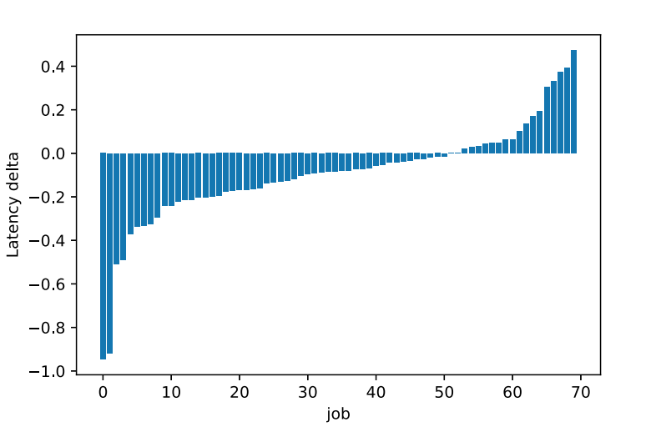
Job Latency Delta
Improve latency by 90% - best case.
Regression by 45% - worst case.

Slide 23
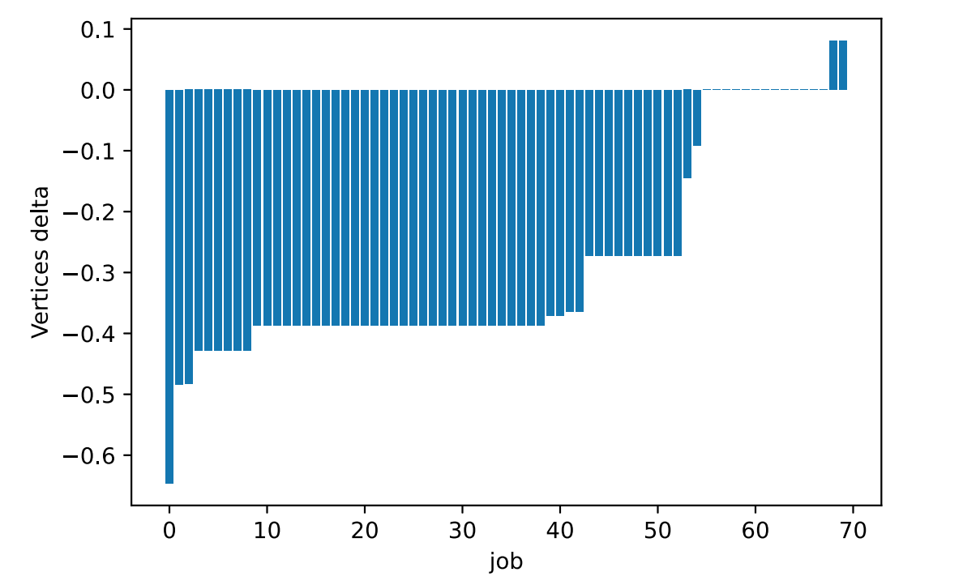
Job Vertices Delta
- Regression of 10% in the worst case.
- Improves vertices utilization by more than 60%.

Slide 24
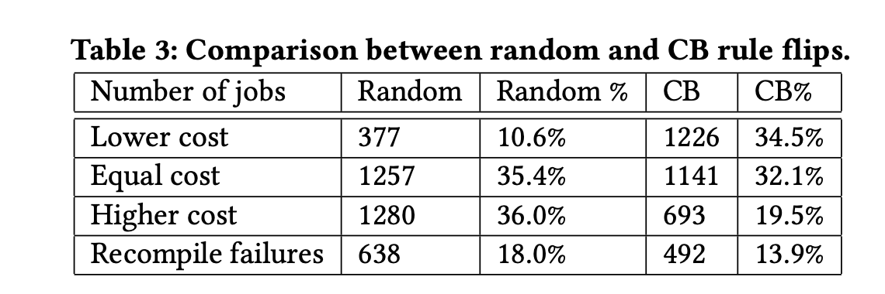
Random vs Contextual Bandit

Slide 25
Lessons Learned
Research to practice trade-offs
Generating new rules configurations requires large resources
Simplicity first
Arbitrary complex rule configurations difficult to debug

Slide 26

Conclussions
QO-Advisor introduced
Improved query optimization in SCOPE
Runs offline daily and deployed across production SCOPE clusters

Slide 27
Thank you!

