Slide 1

Adaptive Energy-Control for In-Memory Database Systems
EPL646: Advanced Topics in Databases
Adaptive Energy-Control for In-Memory Database Systems. Thomas Kissinger, Dirk Habich, Wolfgang Lehner. 2015. In Proceedings of the 2018 ACM SIGMOD International Conference on Management of Data (SIGMOD '18).
By: Pedro Silva (psilva01@cs.ucy.ac.cy)
Catarina Carvalho (cpatri01@cs.ucy.ac.cy)
Joanna Georgiou (jgeorg02@cs.ucy.ac.cy)
https://www2.cs.ucy.ac.cy/~dzeina/courses/epl646

Slide 2
Presentation Outline (Indicative)
Introduction
Energy-Control in Current Mainstream Servers
Architectural Overview
Energy Profiles
Energy-Control Loop
Related Work
End-to-End Evaluation
Conclusions / Future Work
https://www2.cs.ucy.ac.cy/~dzeina/courses/epl646

Slide 3
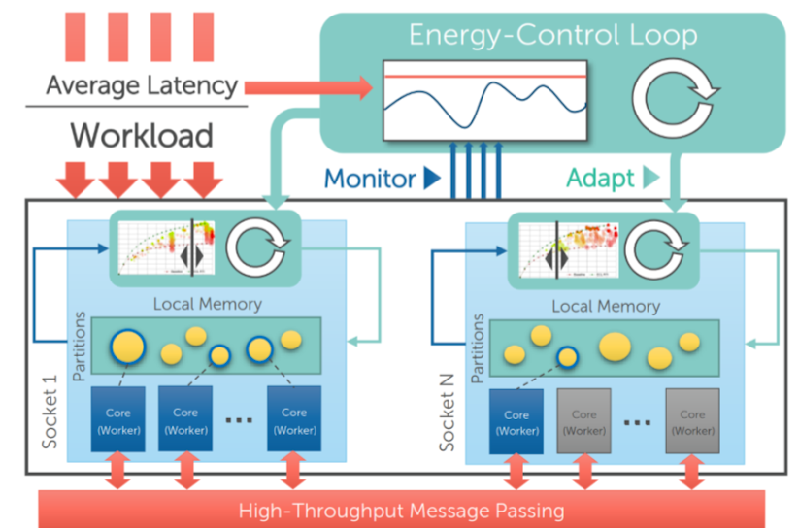
Introduction
Ever-increasing data volume
Non-Uniform Memory Access (NUMA)
Result: Separate memory domains per processor remotely accessible via an interconnect network
Problem: Besides from limiting their further scalability, the resulting energy consumption amounts to a significant and increasing fraction of the worldwide energy draw
Solution: Increasing the energy efficiency and energy proportionality
Advancements were achieved by adding a rich set of energy control knobs
Energy-Control Loop (ECL):
  Socket-Level ECLs: Responsible for configuring the socket-local hardware components
  System-Level ECLs: Keeps track of current query latencies and uses a best-effort strategy to stay within a user-defined latency limit
https://www2.cs.ucy.ac.cy/~dzeina/courses/epl646

Slide 4

Energy-Control in current mainstream servers
To analyze the energy optimization potential, as well as performance and power characteristics of a current system we are going to focus on two main system particular details:
Available energy-control features
Energy-related decisions that are made by the CPU
Tested system specifications:
  2-socket server-class system
  Intel XeonE5-2690 v3 CPUs (Haswell-EP generation)
  256 GB DDR 4 RAM
  Each CPU consists of 12 physical cores
  24 hardware threads with HyperThreading enabled
  Fully integrated voltage regulators (FIVR)
  Each processor features a separate uncore clock
https://www2.cs.ucy.ac.cy/~dzeina/courses/epl646

Slide 5

Energy-Control in current mainstream servers
CPU energy control features:
Energy-efficient turbo (EET)
Energy performance bias (EPB)
To measure the energy consumption of the system was used:
    LMG 450 power meter that is attached to the power supply unit
    Per-processor integrated RAPL counters
https://www2.cs.ucy.ac.cy/~dzeina/courses/epl646

Slide 6

Static and Dynamic Power Consumption
The objective of the experiment was to understand which components of the system draw which amount of power in idle mode (static power draw) and under full load (dynamic power draw)
To do so, at first it was measured the power values from the external power meter, which is attached to the power supply unit as well as the internal RAPL counters
To get the system under full load it was used the Firestarter tool
The main conclusions were:
  The static power consumption of the bare server system is only about 18% of the peak power
  The largest amount of the dynamic power is consumed by CPU and DRAM
https://www2.cs.ucy.ac.cy/~dzeina/courses/epl646

Slide 7
C-States and P-States
On modern CPUs, single cores or the entire processor can be power-gated to save energy, to two main states:
  C-States - If the core or processor is not being utilized
  P-States - If the core or processor is being utilized but can be run in a more energy-efficient way at the cost of reduced performance
In the experiment the core clocks and uncore clock were set in different frequencies to evaluate the impact of the C-States and P-States in the system
The main conclusions were:
  Most of the power costs incur when the first core is activated
  Activating an additional core causes a much lower power draw
  Activating HyperThread siblings comes at almost no cost
  There’s a correlation in power consumption with the uncore clock
https://www2.cs.ucy.ac.cy/~dzeina/courses/epl646

Slide 8
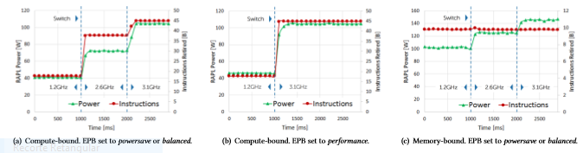
CPU-Driven Energy Management
In this experiment it was analyzed the decision quality of the CPU to manage the core and uncore frequencies on its own through the energy-performance bias (EPB)
The EPB influences the energy-efficient turbo (EET) and can be set to three states:
  Powersave
  Balanced
  Performance
The only influence detected in the EET by the EPB was a one second delay in powersave or balanced mode where in that the delay the power to achieve the instructed performance was lower than supposed to
https://www2.cs.ucy.ac.cy/~dzeina/courses/epl646

Slide 9
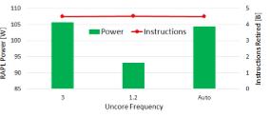
CPU-Driven Energy Management
While evaluating the uncore frequency scaling (UFS) decisions all cores were running at maximum frequency
The UFS decides to use the 3.0 GHz instead of the 1.2 GHz, frequency that in this system achieves a better performance due to constraints of other system specifications
The main conclusion were:
  There are opportunities to save power on current hardware
  Power saving can be achieved by appropriately configuring the energy-control knobs of the hardware, which influence performance and power consumption
https://www2.cs.ucy.ac.cy/~dzeina/courses/epl646

Slide 10
Architecture
Data-Oriented Architecture: Antagonist to the traditional transaction-oriented architecture, faces issues of energy consumption
Goal: overcome the scalability limitations
Data Objects: Partitioned exclusively accessed by threads
Static Mapping: Data partitions that are statically mapped to specific threads
data become unavailable when threads are disabled.
Load Balancing: Static Mapping Odd Utilization of resources
Polling Based Messaging: Avoid adding scheduling costs and system calls.
Threads never enter a sleep state.
Elasticity Extensions: Get rid of static assignment between thread and data
partitions.
Data Balancing happens delayed & more energy
& more synchronization costs
https://www2.cs.ucy.ac.cy/~dzeina/courses/epl646

Slide 11
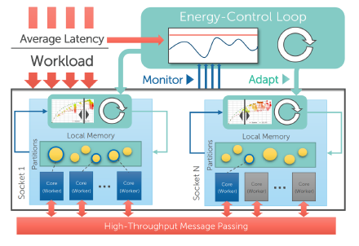
Architecture
Until Now: point - to - point connections between threads.
Elasticity Extensions: Get rid of static assignment between thread and data partitions.
Hierarchical message passing that operates on the
Intra- and inter- socket level.
Elastically grow / shrink the No. threads &
implicity solved the load balancing within a
single socket
Intra - Socket (single socket): messages for the same data partitions are buffered and queued. Threads continuously:
Dequeue message batches for a data partition
Take ownership of the entire partition
Process the messages
Release the partition.
Inter - Socket (communication between sockets): handled by a communication thread per socket that buffers messages and executes the actual message transfer to the communication thread.
https://www2.cs.ucy.ac.cy/~dzeina/courses/epl646

Slide 12
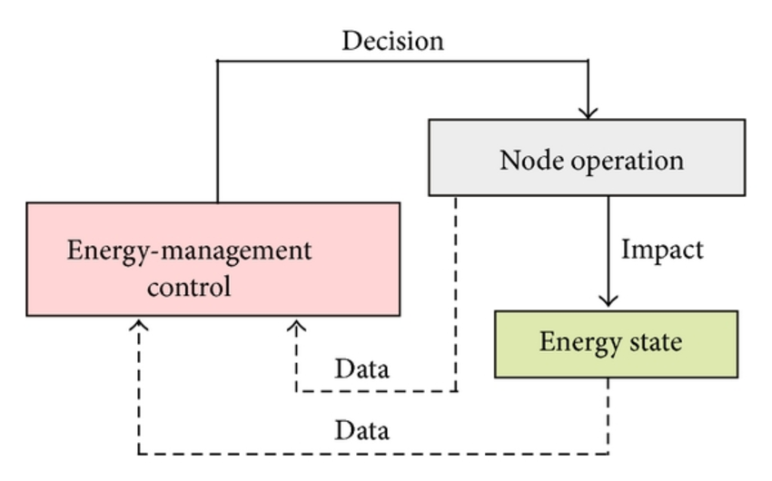
Architecture
ECL (Energy Control Loop) Integration: is organized
hierarchically into one socket-level ECL.
Socket Level ECL: is responsible for:
  Detecting the current performance demand
  Applying for the most energy-efficient hardware Configuration for this demand
  Maintaining the energy profile in case of a changing workload
  Monitor the current average query latency
  Obey a user-defined latency limit.
https://www2.cs.ucy.ac.cy/~dzeina/courses/epl646

Slide 13

Energy Profiles
Energy Profiles:
  Describes performance and energy efficiency trade-offs
  Basic component of each socket - level ECL
  Aggregated different energy - control features to configurations
Configurations: Represents a specific system state in
terms of hardware energy - control settings.
  It comprises:
    The set of active hardware threads on a processor
    The core frequencies of the active physical cores
    The uncore frequency of the processor
During evaluation process it is enriched with the following information:
  The power consumption of the socket
  The performance score
  The energy efficiency
https://www2.cs.ucy.ac.cy/~dzeina/courses/epl646

Slide 14
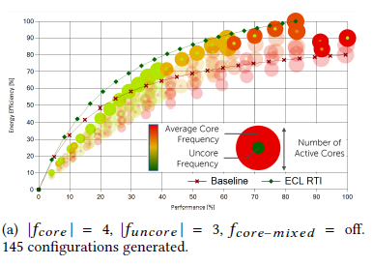
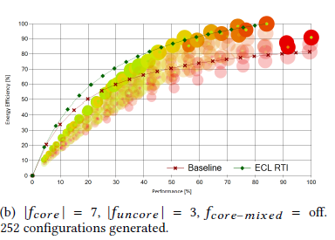
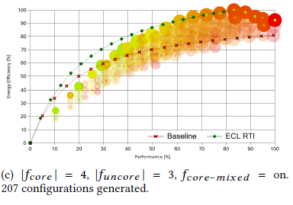
Energy Profile Generation
Configuration Generator: responsible for finding a set of configurations that cover different hardware configuration states to explore most of the types of configurations
Configuration Parameters: used to calculate all unique configurations taking to homogeneity of the individual cores
  Fcore → no. of different frequencies
  Funcore → no. of distinct uncore frequencies
  Fcore-mixed → the usage of mixed core frequencies
  Cmax → the maximum number of of generated configurations
https://www2.cs.ucy.ac.cy/~dzeina/courses/epl646

Slide 15

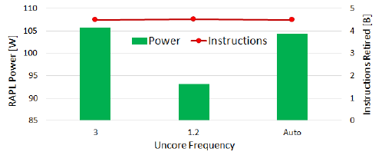
Energy Profile Generation
Energy Profile Granularity:
  The lowest frequencies are the most energy - efficient for low performance levels until their performance potential is exhausted
Race - to - idle (RTI): database systems without energy - control mechanisms, they use all available cores the highest frequency as long as work is available
  ECL - RTI line: (More energy - efficient way) using RTI strategy that switches between idle mode and the most energy - efficient configuration
Increasing |fcore| to 7 or enabling fcore - mixed: not significantly
improving the energy profile causes it to include more configurations more costly to maintain in
case of a workload change
https://www2.cs.ucy.ac.cy/~dzeina/courses/epl646

Slide 16
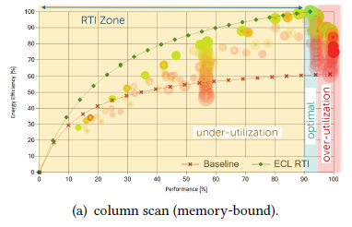
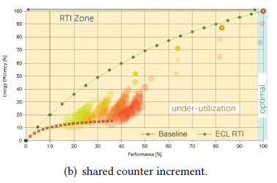
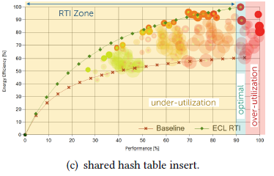
Energy Profile - Workload Dependency
depends on
Performance level of configuration current workload of the DBMS
Problem: real - world energy profiles look much different than the predicted ones
When it Happens: When hardware resources increase /
for in - memory DBMS: at the memory controller or shared cache lines
Energy profile for the memory - bound workload:
For demonstration of the effect of memory controller contention
(a) Problem: High core frequencies → bottlenecks
Solution: Workload where all threads automatically
increment a single value
Energy Saving: 40 %
(a)
https://www2.cs.ucy.ac.cy/~dzeina/courses/epl646

Slide 17
Energy Profile - Workload Dependency
Energy profile for the memory - bound workload:
For demonstration of the effect of memory controller contention
(b) Problem: the most performing and most energy - efficient configuration uses only two hardware threads at turbo frequency with the lowest uncore frequency.
Energy Saving: 90 %
Query Response Benefit: 200%
(c) Conducted using: a workload where multiple threads insert values into a shared hash table
Problem: same effects as previously at a small scale
Energy Saving: 42%
Query Response Benefit: 8%
(b)
(c)
https://www2.cs.ucy.ac.cy/~dzeina/courses/epl646

Slide 18

Energy Profile - Conclusions
Energy profile can change without logical reason or cause for different workloads
They proved that:
Choosing the right configuration can significantly improve the following:
  energy efficiency
  Performance
  response time.
https://www2.cs.ucy.ac.cy/~dzeina/courses/epl646

Slide 19

Energy Profiles - Ruling Zones
Ruling zones for the socket - level ECL that influence the control strategy:
Optimal Zone
Under - Utilization Zone
Over - Utilization Zone
https://www2.cs.ucy.ac.cy/~dzeina/courses/epl646

Slide 20

Energy Profiles - Ruling Zones
Optimal Zone:
Hosts only the most energy - efficient configuration
Most energy savings are experienced in the socket-level ECL
stays in this zone
https://www2.cs.ucy.ac.cy/~dzeina/courses/epl646

Slide 21

Energy Profiles - Ruling Zones
Under - Utilization Zone:
Hosts all configurations left to the most energy - efficient configuration
Most of the time is spent here → energy efficiency of the configurations is mostly significantly lower compared to the optimal zone
Applied the ECL RTI method → the socket-level ECL is frequently switching between idle mode and the optimal zone
ECL RTI energy savings: 40 % for very low
performance levels and decreases the higher
performance level
https://www2.cs.ucy.ac.cy/~dzeina/courses/epl646

Slide 22

Energy Profiles - Ruling Zones
Over - Utilization Zone:
Hosts all configurations right to the most energy - efficient configuration
Configurations of this zone are only applied if the optimal zone doesn’t provide enough performance to control the current load
Range of all zones depend on the energy profile & workload
https://www2.cs.ucy.ac.cy/~dzeina/courses/epl646

Slide 23
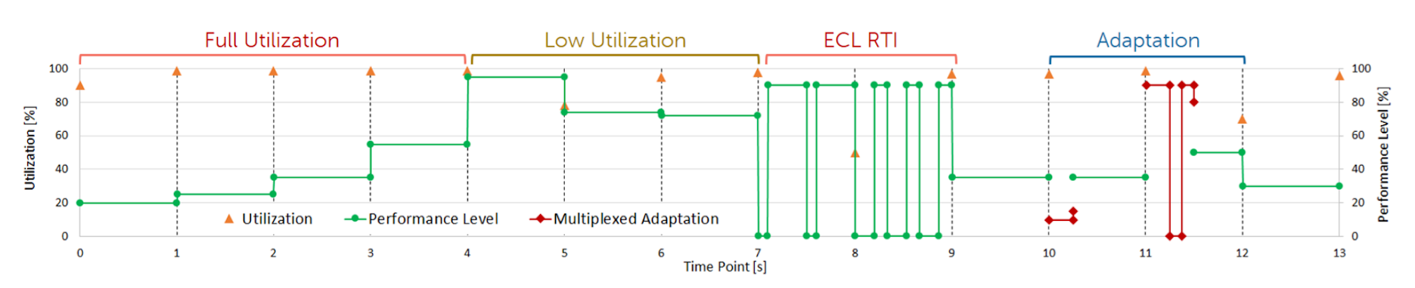
Socket-Level ECL
Lowest available unit for measurements is a single processor (socket).
Rule the energy tuning features.
There are as many active socket-level ECLs as processors available on the platform.
Each socket-level ECL uses and maintains its own energy profile to achieve a high accuracy.
Needs to quickly respond to load changes and is therefore executed periodically at the scale of a second or less.
https://www2.cs.ucy.ac.cy/~dzeina/courses/epl646

Slide 24

Socket-Level ECL
Utilization Controller: Responsible for determining the current performance level demand of the DBMS on the respective processor.
The utilization can only be measured relative to the amount of active worker threads.
Uses a discovery strategy that exponentially increases the performance level in each socket-level ECL.
https://www2.cs.ucy.ac.cy/~dzeina/courses/epl646

Slide 25

Socket-Level ECL
Race-To-Idle(RTI)Controller: leverages the information reported by the utilization controller and decides whether to use a race-to-idle strategy or not.
Reasons for applying:
  Partially compensate the high costs for activating the first core on a socket.
  Emulate any performance level for which no configuration is known by the energy profile.
Negative side effect: The query response time is negatively affected if the system resides for a long time in idle mode.
The RTI controllers of different socket-level ECLs try to synchronize idle times.
https://www2.cs.ucy.ac.cy/~dzeina/courses/epl646

Slide 26

Socket-Level ECL
Energy Profile Maintenance: The socket-level ECL needs to quickly adapt the energy profile in case of a changing workload. It is important how fast configurations can be reevaluated at runtime.
  Online Adaptation: Measures the power and performance metrics using the respective performance counters and updates the configuration in the energy profile.
    Advantage: No overhead is generated and currently used configurations are highly accurate.
    Drawback: Only configurations are maintained which are reported by the energy profile to be the most energy-efficient ones.
https://www2.cs.ucy.ac.cy/~dzeina/courses/epl646

Slide 27

Socket-Level ECL
Energy Profile Maintenance:
  Multiplex Adaptation: Complements the online adaptation and is triggered as soon as a high drift in configuration accuracy is detected and reevaluates all stale configurations of the energy profile.
    Uses time-division multiplexing.
  Both energy profile maintenance work hand in hand and exhibit a different behaviour.
https://www2.cs.ucy.ac.cy/~dzeina/courses/epl646

Slide 28

System-Level ECL
Manages metrics that are only globally available.
Goal: Use the best effort strategy based on the user-defined maximum response time.
It is able to estimate the time until the latency limit is violated.
Time is provided for all socket-level ECLs:
  1. Adjust the aggressiveness.
  2. Adjust the RTI usage.
https://www2.cs.ucy.ac.cy/~dzeina/courses/epl646

Slide 29

Architectural Dependencies
The basic concept of the ECL is applicable to transaction-oriented database systems.
  Spinlocks.
  Cross-socket interferences.
Energy savings.
https://www2.cs.ucy.ac.cy/~dzeina/courses/epl646

Slide 30

End - to - End Evaluation
Evaluation on:
The ability of ECL to adapt to changing database loads while obeying a latency constraint
The overall energy savings for many
profiles & workloads
Energy profile adaptation
mechanisms in case of
workload change
https://www2.cs.ucy.ac.cy/~dzeina/courses/epl646

Slide 31
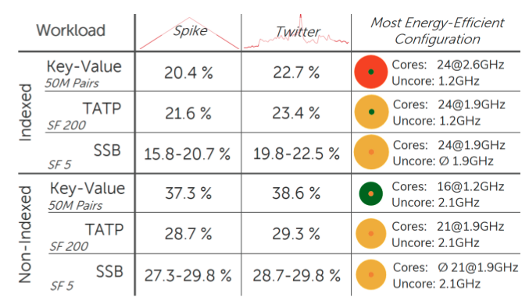
End - to - End Evaluation
Workload and Load Profiles:
Workload → specifies the queries as it is done by standard database benchmarks.
Employed: the TATP (OLTP), SSB (OLAP) [17], and a
custom key-value store benchmark
Load Profiles that define the number of queries per second sent to the database system over time.
Employed: the spike profile
https://www2.cs.ucy.ac.cy/~dzeina/courses/epl646

Slide 32

End - to - End Evaluation
Load Adaptation and Query Latency:
Evaluation for:
  the behavior of the ECL in case of
a changing database load
  the power draw
  the query latencies over time.
For all experiments used:
  non-indexed key-value store workload and different load profiles
https://www2.cs.ucy.ac.cy/~dzeina/courses/epl646

Slide 33
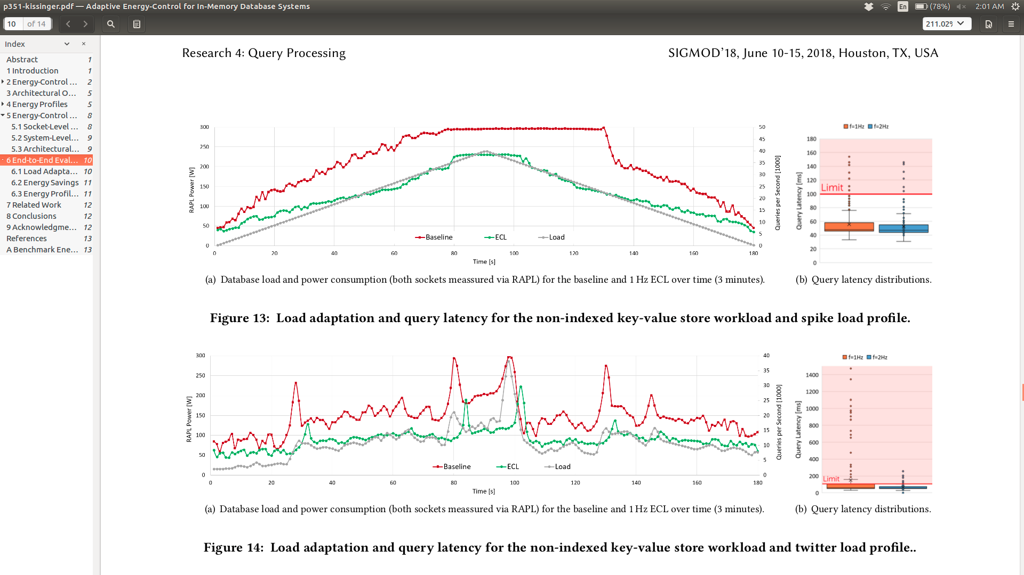
End - to - End Evaluation
Load Adaptation and Query Latency (Spike Load Profile):
Observations:
ECL never draws the baseline
ECL significantly improves
energy proportionality,
especially in load situations: 50 %
80 s: spike load profile generates an overload situation → system receives
more queries than it can handle.
Baseline stays for 50 s in the overload state, while
ECL resides for 20 s there → still draws less power.
Response time limit violations happened only within the overload situation.
Increased ECL base frequency slightly improves the query latencies.
https://www2.cs.ucy.ac.cy/~dzeina/courses/epl646

Slide 34
End - to - End Evaluation
Load Adaptation and Query Latency (Twitter Load Profile):
Sudden load peaks
Frequently alternating between
increasing and decreasing the
system load
Observations:
  ECL draws < the baseline
  ECL takes more time to adapt the hardware configuration to the
sudden load peaks
  Outliers caused by sudden load peaks → Solution → increasing the ECL base frequency to 2 Hz
https://www2.cs.ucy.ac.cy/~dzeina/courses/epl646

Slide 35
End - to - End Evaluation
Energy Savings:
One of the objectives of this study was to find a way to increase the energy efficiency of a DBMS, meaning a decreased overall energy consumption
The main conclusions were:
  The most energy savings were made with non-indexed workloads
  The measured energy savings for indexed workloads reach from 15.8% to 23.4%
  The SSB benchmark requires in average a higher uncore clock, because of the increased data volume that needs to be shipped between partitions
https://www2.cs.ucy.ac.cy/~dzeina/courses/epl646

Slide 36
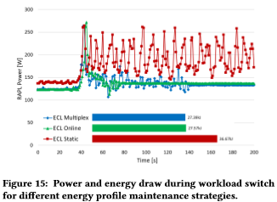
End - to - End Evaluation
Energy Profile Adaptation:
While the previous experiments assume a static workload, in this topic it was study the energy profile adaptations caused by changing workloads
The main conclusions were:
  Choosing the right configuration can significantly improve energy efficiency, performance and response time
  The active energy profile maintenance at run time is critical for a static workload and especially for changing workloads.
The work load switch happens at 40s
https://www2.cs.ucy.ac.cy/~dzeina/courses/epl646

Slide 37
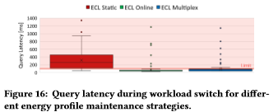
End - to - End Evaluation
Energy Profile Adaptation:
ECL static setting without any energy profile adaptation draws significantly more energy and is mostly not able to stay within the query response time limit
In contrast,the ECL online and ECL multiplex settings consume about 25% less power and are able to stay within the response time limit
https://www2.cs.ucy.ac.cy/~dzeina/courses/epl646

Slide 38
Related Work
The energy efficiency of database servers is a critical research topic, because the scalability of database servers is limited by the“energy wall”.
Energy analysis:
  Early works started with analyzing the potential of DVFS to increase the energy efficiency of a database server
  The conclusion was that this approach is not feasible,because of the high static power consumption of the hardware that was available at that time and optimizations are only feasible at cluster level.
  Software optimizations can significantly improve energy efficiency of a DBMS by considering energy as an additional optimization goal
https://www2.cs.ucy.ac.cy/~dzeina/courses/epl646

Slide 39
Related Work
Fine-grained scheduling mechanisms are able to further improve the DBMS energy efficiency
Although that through the study of other research papers they manage to gather important information, those conclusions were made by testing outdated hardware
Active Energy-Control:
  In the context of distributed database systems, several approaches tried to achieve energy proportionality by dynamically powering individual servers down or up
  Because of the high costs for moving data and power cycling single servers, those approaches are only applicable as long term solutions and negatively affect energy efficiency, since data movement consumes a high amount of energy and scale-up architectures usually exhibit a better performance compared to scale-out solutions.
https://www2.cs.ucy.ac.cy/~dzeina/courses/epl646

Slide 40

Related Work
Within a single database server, some works dealt with adding energy as an additional optimization criteria to the query optimizer of the MySQL or Postgres DBMS by creating energy and performance models
They achieve a 20% power saving but the response time wasn't the ideal
As before, although some useful conclusions were made through others papers study almost every conclusion mad in that papers was poor due to the fact of outdated hardware
https://www2.cs.ucy.ac.cy/~dzeina/courses/epl646

Slide 41

Conclusion
Energy is the key-limiter for the scalability of scale-up database systems.
ECL is a holistic software-based approach for adaptive energy-control.
Energy savings of up to about 40%.
https://www2.cs.ucy.ac.cy/~dzeina/courses/epl646
Notes:
6

Slide 42
References
[1] [n. d.]. Inauguration Day on Twitter. ([n. d.]). [Online] https://blog.twitter.com/2009/inauguration-day-on-twitter.
[2] Luiz André Barroso and Urs Hölzle. 2007. The Case for Energy-Proportional Computing. IEEE Computer 40, 12 (2007), 33–37. https://doi.org/10.1109/MC. 2007.443
[3] M Bhandaru et al. [n. d.]. Dynamically controlling interconnect frequency in a processor. [Online]: http://www.google.com/patents/ WO2013137862A1?cl=en.
[4] Richard E. Brown, Eric R. Masanet, Bruce Nordman, William F. Tschudi, Arman Shehabi, John Stanley, Jonathan G. Koomey, Dale A. Sartor, and Peter T. Chan. 2008. Report to Congress on Server and Data Center Energy Efficiency: Public Law 109-431. (06/2008 2008).
[5] Sebastian Götz et al. 2014. Energy-Efficient Databases Using Sweet Spot Frequencies. In UCC. https://doi.org/10.1109/UCC.2014.142
[6] Daniel Hackenberg et al. 2013. Introducing FIRESTARTER: A Processor Stress Test Utility. In IGCC. https://doi.org/10.1109/IGCC.2013.6604507
https://www2.cs.ucy.ac.cy/~dzeina/courses/epl646

Slide 43
References
[7] Daniel Hackenberg et al. 2015. An Energy Efficiency Feature Survey of the Intel Haswell Processor. In IPDPS. https://doi.org/10.1109/IPDPSW.2015.70
[8] Stavros Harizopoulos et al. 2009. Energy Efficiency: The New Holy Grail of Data Management Systems Research. In CIDR.
[9] IBM Software Group Information Management . [n. d.]. Telecom Application Transaction Processing (TATP) Benchmark. http://tatpbenchmark.sourceforge. net/TATP_Description.pdf
[10] Intel. 2016. Intel 64 and IA-32 Architectures Software Developer’s Guide. 3B, 2 (2016), 31 – 39. [Online] http://www. intel.com/content/dam/www/public/us/en/documents/manuals/ 64-ia-32-architectures-software-developer-vol-3b-part-2-manual.pdf.
[11] Tim Kiefer, Benjamin Schlegel, and Wolfgang Lehner. 2013. Experimental Evaluation of NUMA Effects on Database Management Systems. In BTW. 185–204.
https://www2.cs.ucy.ac.cy/~dzeina/courses/epl646

Slide 44
References
[12] Thomas Kissinger et al. 2014. ERIS: A NUMA-Aware In-Memory Storage Engine for Analytical Workloads. In ADMS. http://www.adms-conf.org/2014/adms14_ kissinger.pdf
[13] Mustafa Korkmaz et al. 2015. Towards Dynamic Green-Sizing for Database Servers. In ADMS. http://www.adms-conf.org/2014/adms15_korkmaz.pdf
[14] Willis Lang et al. 2011. Rethinking Query Processing for Energy Efficiency: Slowing Down to Win the Race. IEEE Data Eng. Bull. (2011).
[15] Willis Lang et al. 2012. Towards Energy-Efficient Database Cluster Design. VLDB (2012).
[16] David Lo et al. 2014. Towards Energy Proportionality for Large-Scale LatencyCritical Workloads. In ACM/IEEE. https://doi.org/10.1109/ISCA.2014.6853237
[17] Pat O’Neil, Betty O’Neil, and Xuedong Chen. [n. d.]. Star Schema Benchmark. https://www.cs.umb.edu/~poneil/StarSchemaB.PDF
[18] Ippokratis Pandis et al. 2010. Data-Oriented Transaction Execution. PVLDB (2010). http://www.comp.nus.edu.sg/~vldb2010/proceedings/files/papers/R83.pdf
https://www2.cs.ucy.ac.cy/~dzeina/courses/epl646

Slide 45
References
[19] Meikel Poess et al. 2008. Energy Cost, the Key Challenge of Today’s Data Centers: A Power Consumption Analysis of TPC-C Results. VLDB (2008).
[20] Danica Porobic, Erietta Liarou, Pinar Tözün, and Anastasia Ailamaki. 2014. ATraPos: Adaptive Transaction Processing on Hardware Islands. In IEEE 30th International Conference on Data Engineering, Chicago, ICDE 2014, IL, USA, March 31 - April 4, 2014. 688–699. https://doi.org/10.1109/ICDE.2014.6816692
[21] Danica Porobic, Ippokratis Pandis, Miguel Branco, Pinar Tözün, and Anastasia Ailamaki. 2012. OLTP on Hardware Islands. PVLDB 5, 11 (2012), 1447–1458. http://vldb.org/pvldb/vol5/p1447_danicaporobic_vldb2012.pdf
[22] Iraklis Psaroudakis et al. 2014. Dynamic Fine-Grained Scheduling for EnergyEfficient Main-Memory Queries. In DaMoN. https://doi.org/10.1145/2619228. 2619229
[23] Iraklis Psaroudakis, Tobias Scheuer, Norman May, Abdelkader Sellami, and Anastasia Ailamaki. 2016. Adaptive NUMA-aware data placement and task scheduling for analytical workloads in main-memory column-stores. PVLDB 10, 2 (2016), 37–48. http://www.vldb.org/pvldb/vol10/p37-psaroudakis.pdf
https://www2.cs.ucy.ac.cy/~dzeina/courses/epl646

Slide 46
References
[24] Daniel Schall et al. 2013. Energy-proportional Query Execution using a Cluster of Wimpy Nodes. In DaMoN.
[25] Arman Shehabi, Sarah Josephine Smith, Dale A. Sartor, Richard E. Brown, Magnus Herrlin, Jonathan G. Koomey, Eric R. Masanet, Nathaniel Horner, Inês Lima Azevedo, and William Lintner. 2016. United States Data Center Energy Usage Report. (06/2016 2016).
[26] Dimitris Tsirogiannis et al. 2010. Analyzing the Energy Efficiency of a Database Server. In SIGMOD.
[27] Yi-Cheng Tu et al. 2014. A System for Energy-Efficient Data Management. SIGMOD Record (2014). https://doi.org/10.1145/2627692.2627696
[28] Zichen Xu et al. 2010. Exploring Power-Performance Tradeoffs in Database Systems. In ICDE.
[29] Zichen Xu et al. 2012. PET: Reducing Database Energy Cost via Query Optimization. VLDB (2012).
[30] Zichen Xu et al. 2013. Power-Aware Throughput Control for Database Management Systems. In ICAC. https://www.usenix.org/conference/icac13/ technical-sessions/presentation/xu_zichen
https://www2.cs.ucy.ac.cy/~dzeina/courses/epl646

