Slide 1
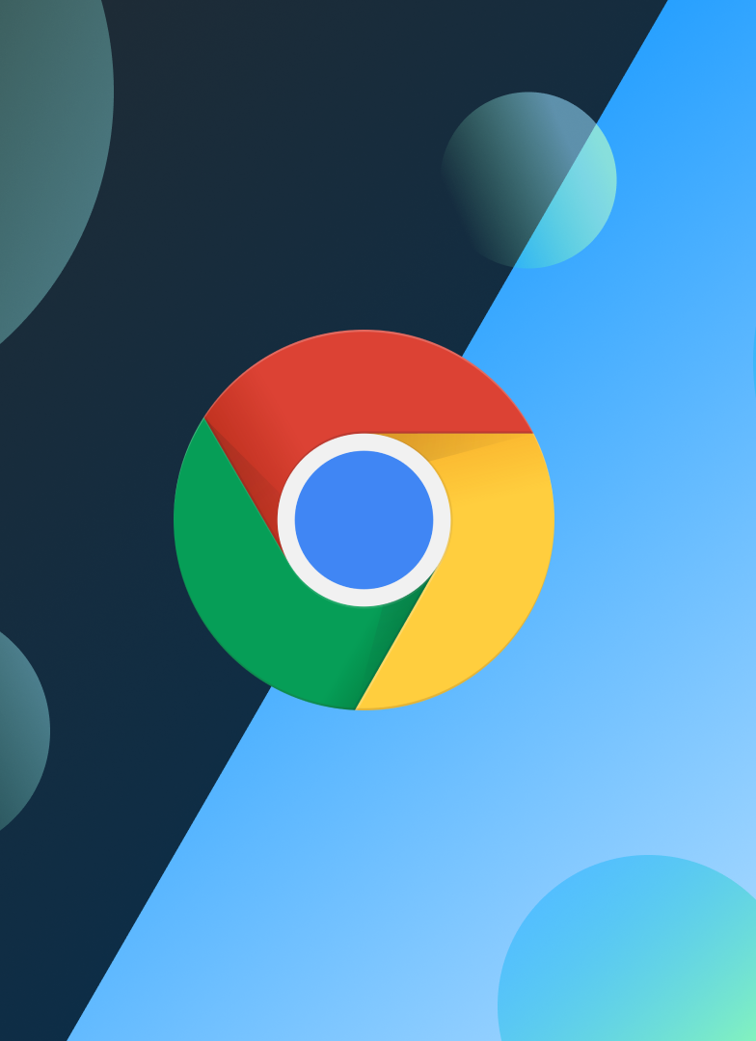

CHROME OS
Marina Hadjimylou
EPL421
University of Cyprus
Winter Semester 2024

Slide 2


Content
Introduction
History
Comparison
Advantages/Disadvantages
Installation
User Interface
Using Linux
Visual Package Management
Software Development
VS Code for the Web
Google Ecosystem
Conclusion
References

Slide 3
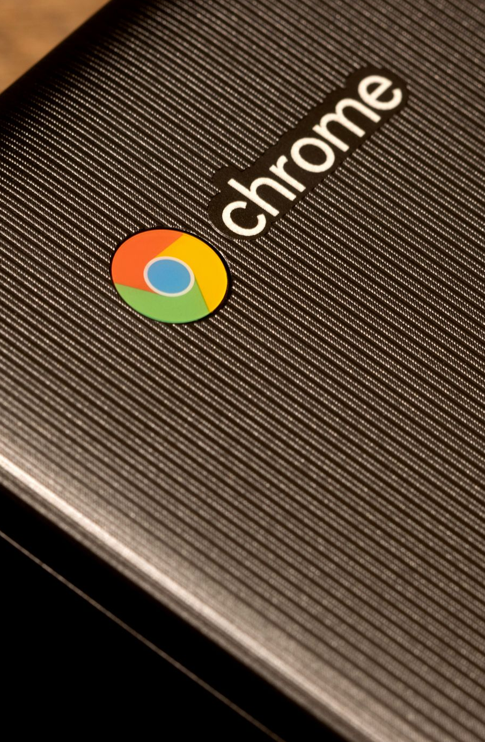
Introduction
ChromeOS (also written as chromeOS and previously known as Chrome OS) is a Linux-based operating system created by Google. It is built on the open-source ChromiumOS platform and primarily features the Google Chrome web browser as its main user interface.
ChromeOS runs on devices like Chromebooks and Chromeboxes, and it supports Progressive Web Applications (PWAs), Android apps from the Google Play Store, and Linux applications.
Notes:
Προοδευτικές Εφαρμογές Ιστού (PWAs)
Ορισμός:
Οι Προοδευτικές Εφαρμογές Ιστού (PWAs) είναι εφαρμογές ιστού που λειτουργούν όπως οι εγγενείς (native) εφαρμογές, αλλά εγκαθίστανται μέσω του προγράμματος περιήγησης και μπορούν να λειτουργούν offline.

Slide 4
HISTORY
2009 - 2010 : Early Development
2011 – 2012 : First Chromebooks
2011: The first Chromebooks were released from Acer and Samsung, with Netflix and Citrix support for media streaming and remote desktop access.
2013 – 2014 : Brand Expansion and App Ecosystem Integration
2013: Google released the high-end Chromebook Pixel, while ChromeOS device sales saw major growth.
2020 – 2021 : Market Growth and Technical Advancements
2023 -Today : UI Refinement and Ecosystem Integration
2020: ChromeOS devices surpassed Apple Macs in global sales, marking a significant milestone in the platform's success.
2023: ChromeOS introduced Material Design updates to its interface, making it more consistent across devices and improving the overall user experience.
2009: Google released ChromeOS's source code as the ChromiumOS project, and an early demo showed a fast boot and browser-like interface.
2014: ChromeOS began supporting Android apps through Google Play and Google targeted businesses with significant discounts to capitalize on the end of Windows XP support.
2021: ChromeOS transitioned its embedded controller to a Zephyr-based real-time operating system, improving system performance and flexibility.
2010: The ChromiumOS project transitioned to Gentoo for more flexibility, and the Cr-48 Chromebook was launched as part of a pilot program to gather feedback from users.
2012: Affordable Chromebooks with ARM and Intel processors were introduced, and ChromeOS's user interface was revamped with a taskbar and window manager (“Aura”)
2024: ChromeOS further refined its Material Design integration, improving synchronization with Android and other Google services for a more seamless user experience.

Slide 5
COMPARISON
 | ChromeOS | Windows | macOS
Device Variety | Chromebooks and ChromeOS devices | Devices from multiple brands | Apple hardware
Ease of Use | Simple, Android-like | Requires familiarity | User-friendly for Apple's ecosystem
Application Support | Lightweight apps, Android, and Linux | Heavy apps and games | Comprehensive app support
Storage | Cloud-based | Local and external | Local and iCloud
Battery Life | Long-lasting | Shorter | Long-lasting
Security | Built-in virus protection | High risk of malware | Robust security features
Installation | Pre-installed on Chromebooks | Long and manual setup | Pre-installed on Apple devices
Integration | Works well with Google services | Compatible with many devices | Apple ecosystem integration
Target Users | Students, casual users | Power users, gamers, enterprise use | Professionals, those in Apple's ecosystem
Cost | Affordable | Varies | Higher-priced
Performance | Optimized for simple tasks | Good for demanding tasks | Consistent and reliable

Slide 6
ADVANTAGES / DISADVANTAGES
ADVANTAGES
DISADVANTAGES
Security: Based on Linux kernel, resistant to viruses and malware.
Simplicity: Minimalistic interface for easy navigation.
Automatic Updates: Updates regularly and automatically, reducing user effort.
Affordability: Chromebooks are cost-effective compared to traditional laptops.
Ease of Use: User-friendly, with a focus on web and cloud applications.
Accessibility: Widely used in education due to affordability and simplicity.
Internet Dependency: Heavily reliant on internet for functionality.
Limited Applications: Fewer application options compared to Windows/macOS.
Performance: Not ideal for demanding tasks like graphic design or video editing.
Update Control: Users cannot decide when updates occur.
Customization: Minimal customization options compared to other OSs.

Slide 7
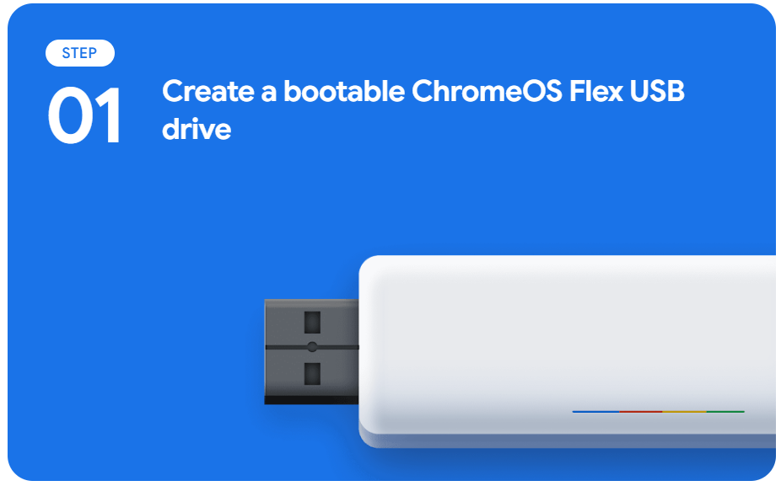
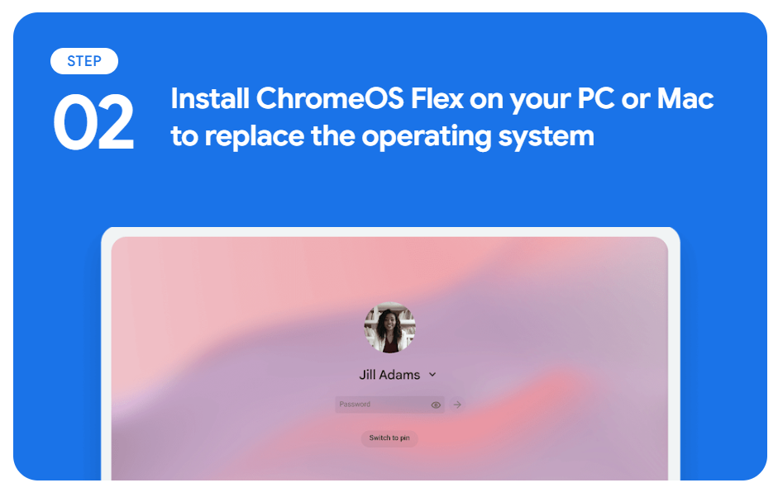
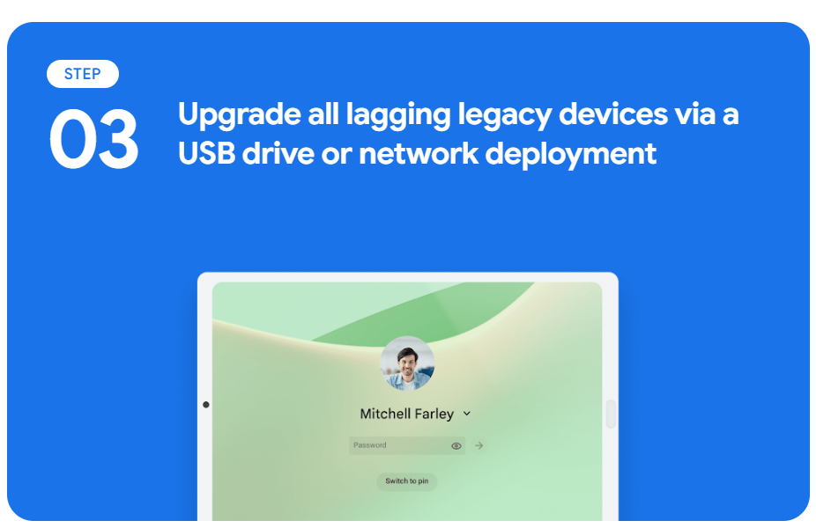
INSTALLATION
ChromeOS is pre-installed in Chromebooks and Chromeboxes exclusively.
For other devices, Google offers ChromeOS flex, a version of ChromeOS designed to be installed on existing Windows PCs and Macs, extending the life of aging hardware by converting them into Chromebooks or Chromeboxes. Unfortunately, it is limited to only a few certified devices and has some differences compared to ChromeOS.

Slide 8
Prepare for installation
Before we start with step 1, we must check if our device is certified by Google to use ChromeOS Flex.
The list with the certified devices is here : Certified models list
What we need:
Device to Create USB Installer
  Use a device running ChromeOS, Windows, Mac, or Linux.
  If using the Chromebook Recovery Utility, ensure Chrome browser is installed and updated.
USB Drive
  Minimum 8 GB capacity (all data will be erased).
  Avoid using Sandisk drives due to compatibility issues.
Target Device (Installation Device)
  Windows, Mac, or Linux device meeting these minimum requirements:
    Architecture: Intel or AMD x86-64-bit compatible.
    RAM: At least 4 GB.
    Storage: At least 16 GB of internal storage.
    Boot: Must support USB boot.
    BIOS Access: Full administrator access may be needed.

Slide 9
Create usb installer
On your device, download the latest ChromeOS Flex Installer.
Use your preferred decompression tool to unzip the file.
Insert your USB drive. Be sure to remove all other removable media.
Create the installer. If you’re using a third-party utility, refer to product documentation. If you’re using dd command-line utility on a Linux device:
  Open a terminal or command line.
  Use the command to write the image to USB:
  sudo dd if=image_name.bin of=/dev/sdN bs=4M status=progress
    image_name.bin—The name of the downloaded installer file
    /dev/sdN—The USB drive
Visit the Installation Guide for more information

Slide 10
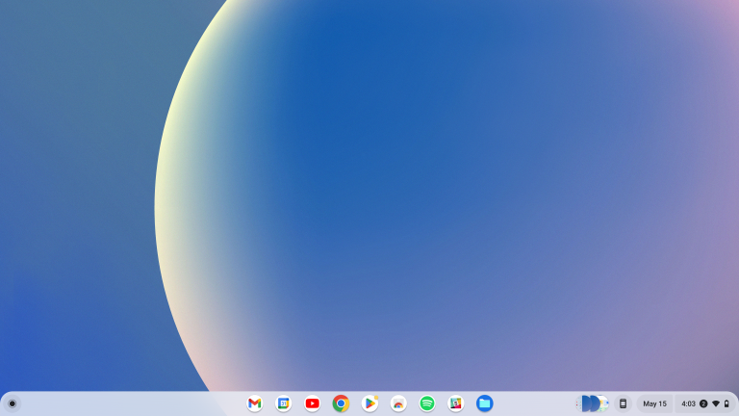
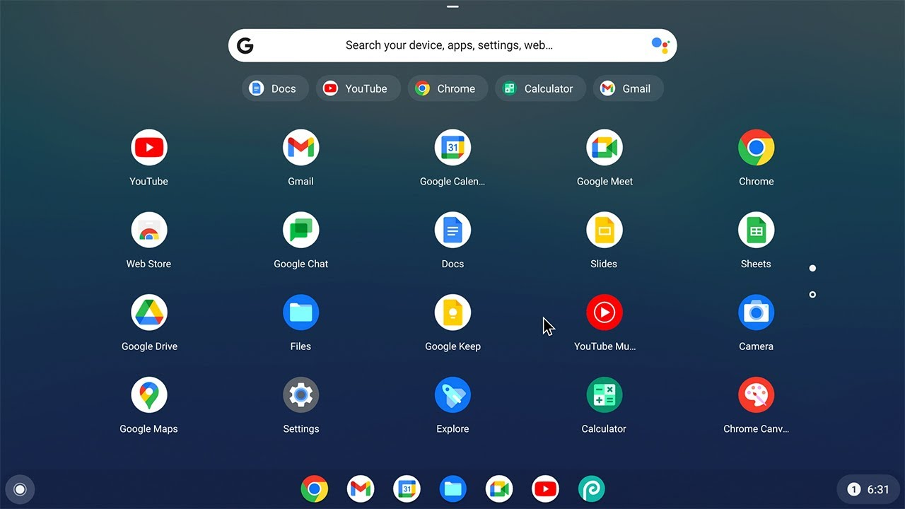
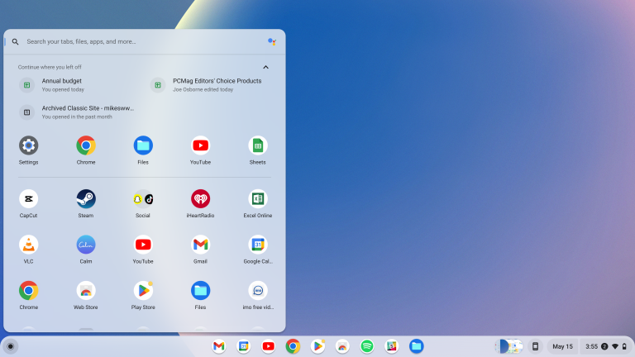
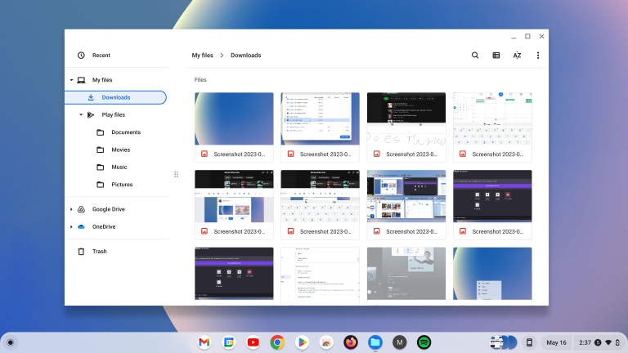
User interface

Slide 11
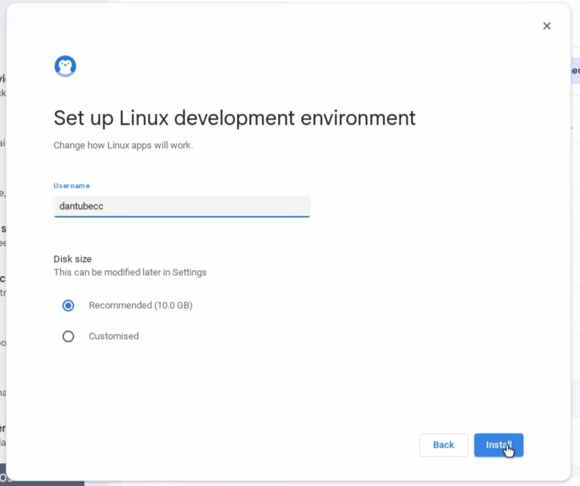
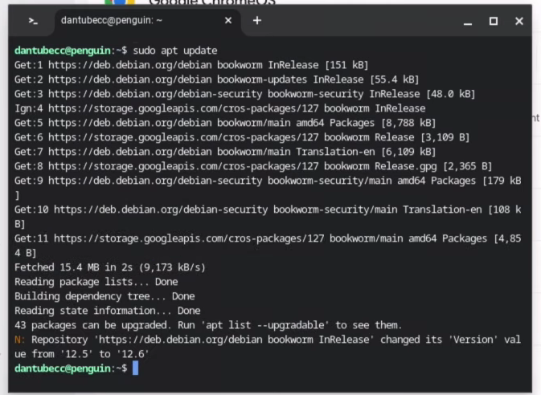
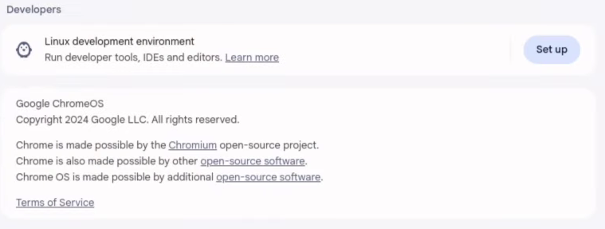
USING LINUX
Linux on ChromeOS is almost the same as in other Operating Systems. Their only difference is found during the installation.
ChromeOS is a Linux-operating system meaning that Linux is a pre-existing feature. To use it you only need to enable it in the settings.

Slide 12

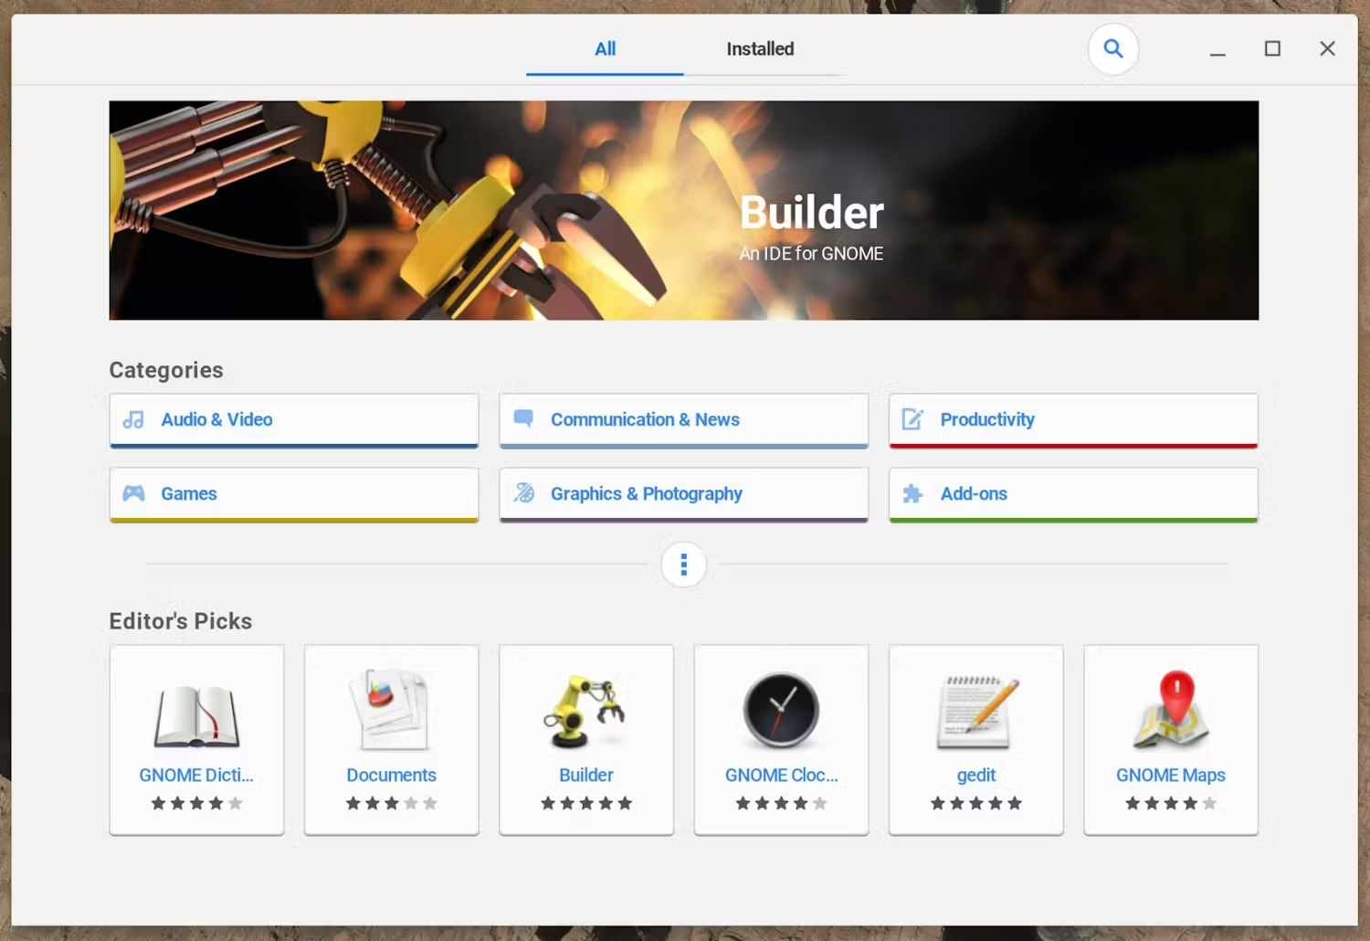
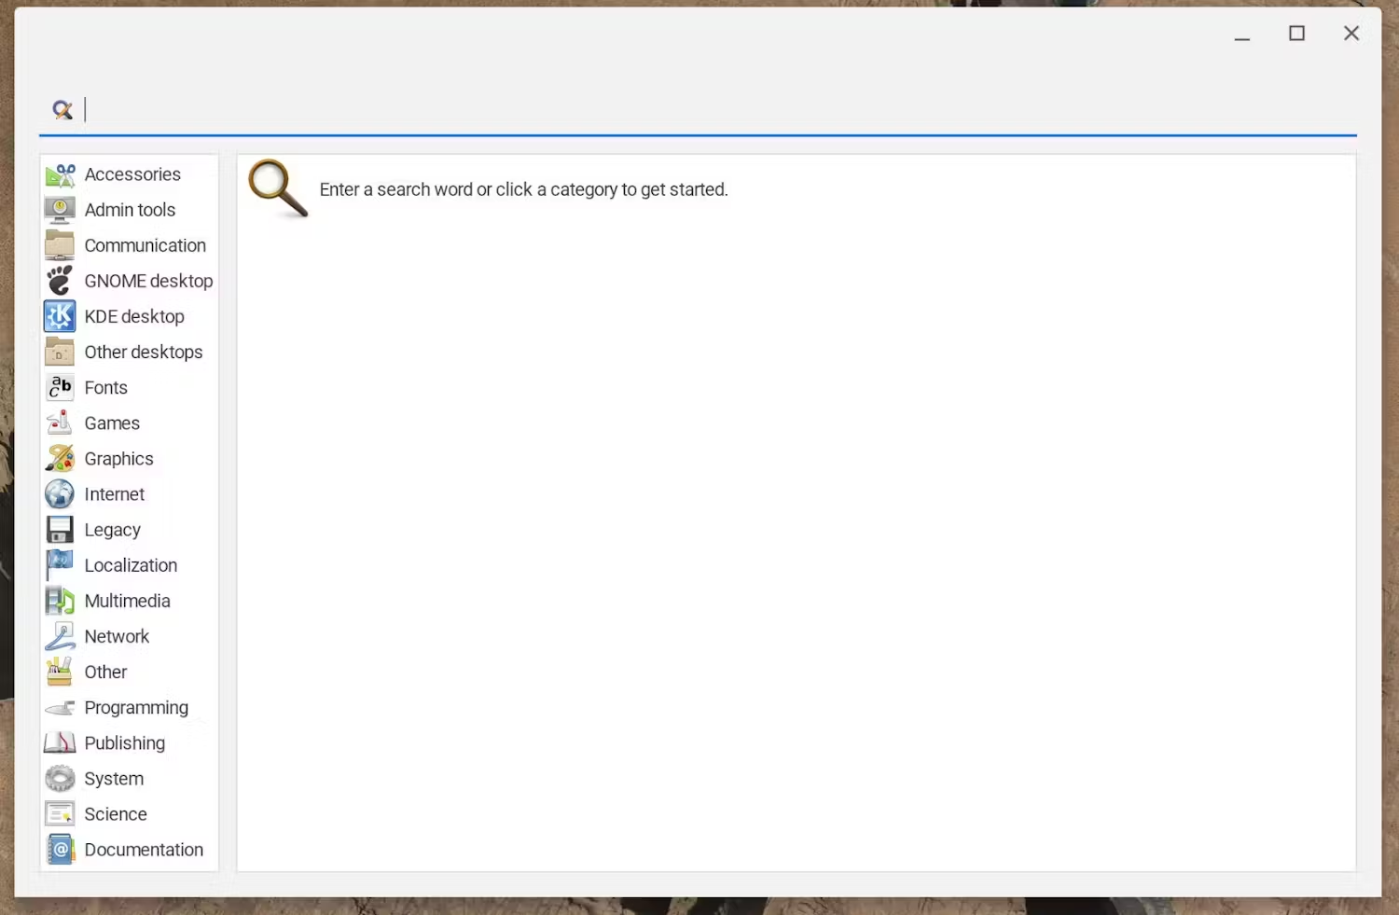
Visual package management
You can install Linux apps through the terminal : sudo apt install …
Or
Through a visual package management:

Slide 13
SOFTWARE DEVELOPMENT
When using a Chromebook for development, the inability to install traditional desktop IDEs can seem like a limitation. However, developers can effectively use cloud-based IDEs*.
VS Code for the Web: Cloud-based version of VS Code
Google Apps Script: Preferred for Javascript Developers
AWS Cloud9: Supports over 40 languages
*All cloud-based IDEs have limitations compared to their desktop version.
When cloud-based IDEs are not enough, Linux is also an option. It allows to install locally applications like Eclipse Java IDE, Git and Docker.

Slide 14
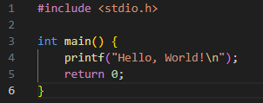
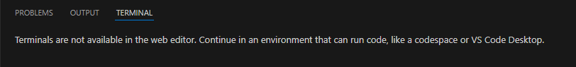
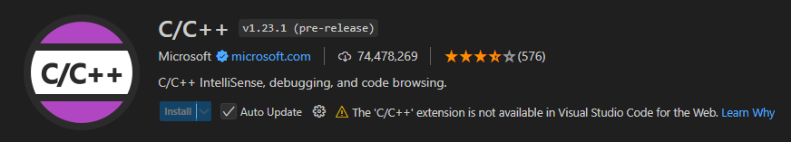
VS CODE FOR THE WEB
Try 1 with C
Problems that occurred:

Slide 15
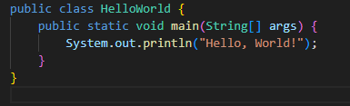

VS CODE FOR THE WEB
Try 2 with Java

Slide 16
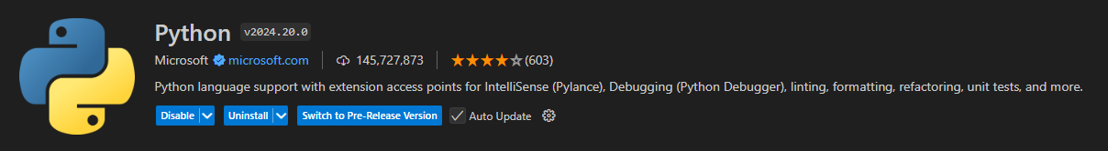

VS CODE FOR THE WEB
Try 3 with Python

Slide 17
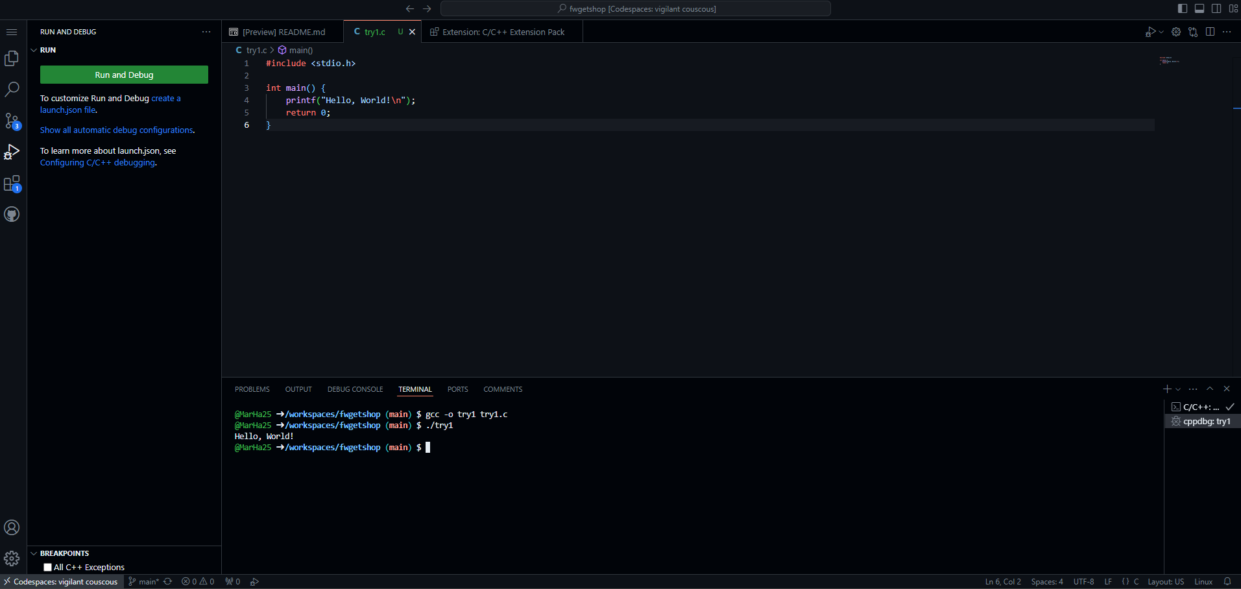
VS CODE FOR THE WEB
Debugging and Compiling is not supported on VS Code for the Web on its own. To run and compile code it must be linked with Github through https://vscode.dev/github/<organization>/<repo> and then create a Codespace.

Slide 18
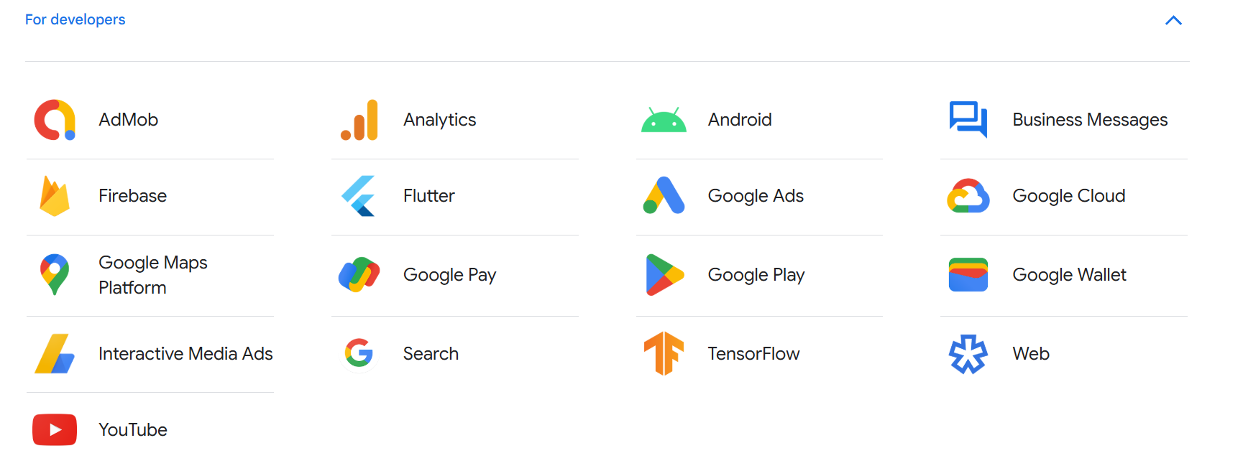
Google APPS FOR DEVELOPERS

Slide 19
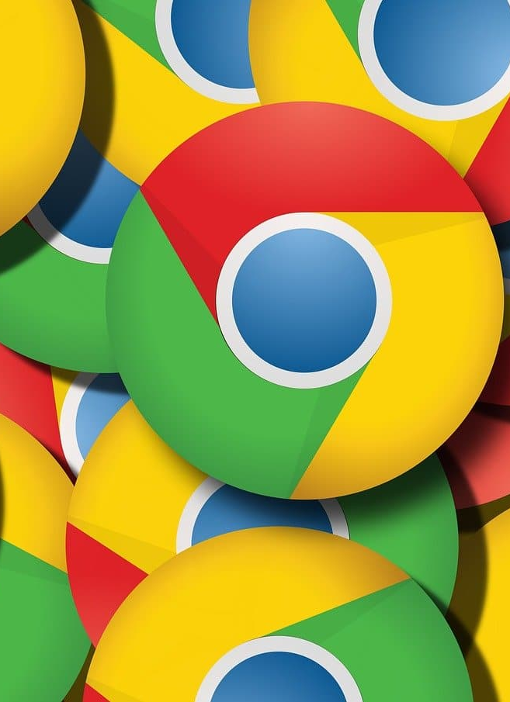
Conclusion: ChromeOS for Developers
ChromeOS offers a lightweight, secure, and cloud-focused environment, making it ideal for web development and lightweight tasks.
With features like Linux (Crostini) and cloud-based IDEs, it supports a range of development tools such as Node.js, Python, and Git.
However, its limited support for native software and resource-heavy applications can be a drawback for more complex development tasks, such as mobile app development or graphic-intensive projects.
In short, Chrome OS is a strong choice for web-focused developers or beginners but may not meet the needs of developers requiring advanced tools or high-performance environments.

Slide 20
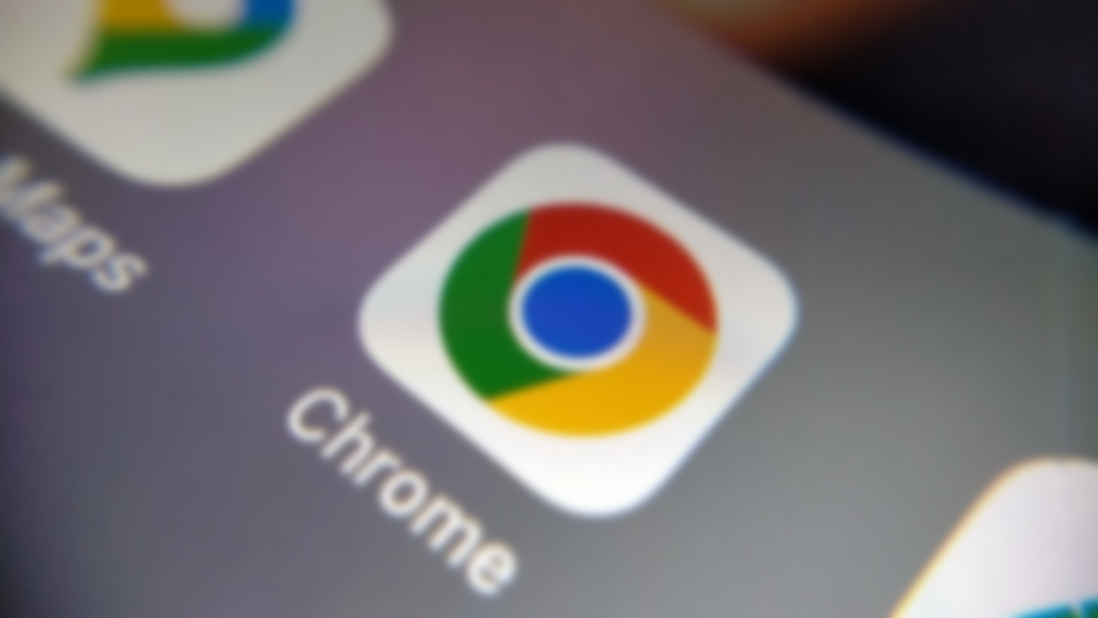
Thank you!

Slide 21
REFERENCES
https://en.wikipedia.org/wiki/ChromeOS
https://www.zdnet.com/article/7-reasons-why-a-chromebook-is-the-best-laptop-for-most-people/
https://www.parallels.com/tips/chrome-os/vs-windows/?srsltid=AfmBOoqhR85Yuy4- MdXR1g4NpThORTHvPxJnnKPCr81EmJZEdcIqBTkt
https://www.geeksforgeeks.org/difference-between-macos-and-chrome-os/
https://www.javatpoint.com/what-is-google-chrome-operating-system
https://support.google.com/chromeosflex/answer/11552529?hl=en&sjid=2618297365801039927-EU&visit_id=638679110580813754-859105273&ref_topic=11551271&rd=1
https://chromeos.dev/en
https://code.visualstudio.com/docs/editor/vscode-web
https://developers.google.com/
https://about.google/products/

