Slide 1


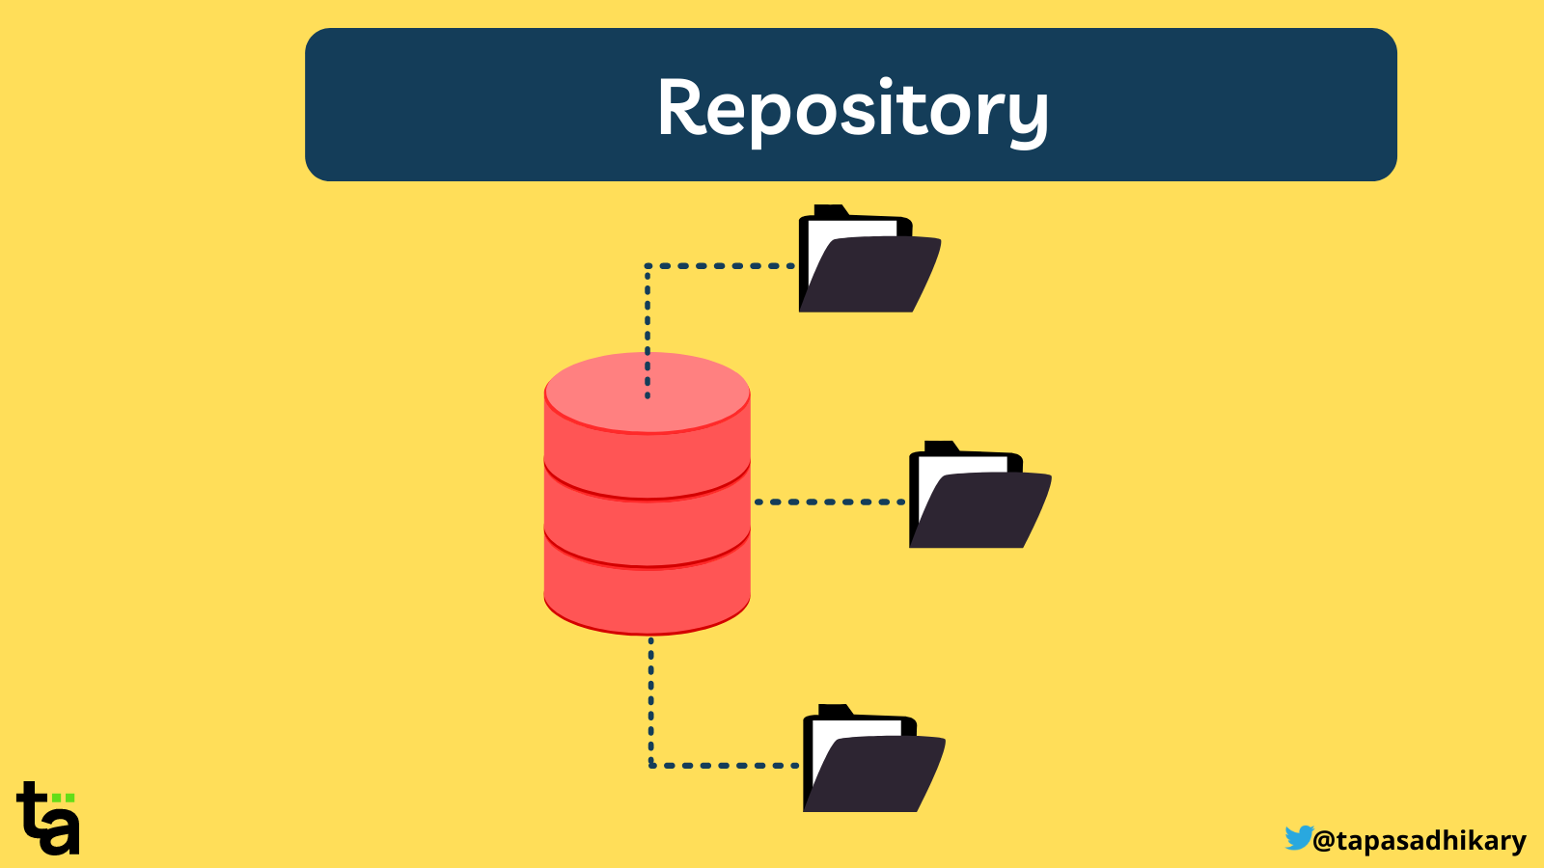
Exploring Mac Repository Managements
Understanding Repositories
Γιώργος Πεττεμερίδης
Χρίστος Ζαχαριάδης
Date:28/11/2023
A repository is a central file storage location, often used for storing, managing, and disseminating code or data.
Some key functions are version control, collaboration and backup.
In macOS, repositories are essential for developers and users managing software packages and source code.

Slide 2



Understanding Repositories
Most well-known Mac Repository Managements
Exploring Mac Repository Managements
A repository is a central file storage location, often used for storing, managing, and disseminating code or data.
In macOS, repositories are essential for developers and users managing software packages and source code.
Γιώργος Πεττεμερίδης
Χρίστος Ζαχαριάδης
Date: 25/11/2023
NIX
HOMEBREW
MacPorts

Slide 3
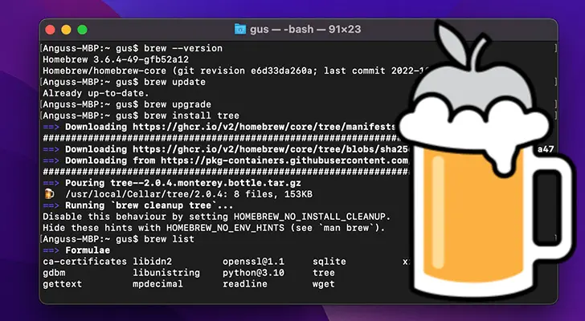
Most well-known Mac Repository Managements
Understanding Repositories
Homebrew: The Missing Package Manager for macOS
The role of homebrew is to simplify software installation and management on macOS.
“Homebrew installs the stuff you need that Apple (or your Linux system) didn’t.”
Homebrew was created by Max Howell
A repository is a central file storage location, often used for storing, managing, and disseminating code or data.
Some key functions are version control, collaboration and backup.
In macOS, repositories are essential for developers and users managing software packages and source code.
NIX
HOMEBREW
MacPorts

Slide 4
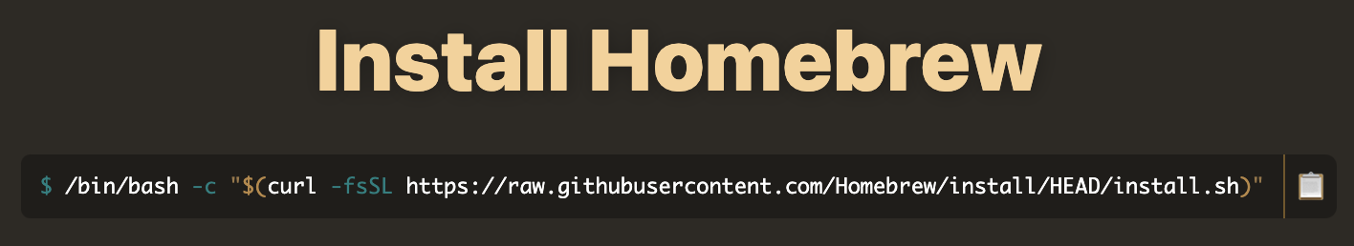
Homebrew: The Missing Package Manager for macOS
Pros
User-Friendly: Easy to install and use
Large Software Library: Vast array of packages available for various needs.
Community-Driven: Strong community support and open for contributions.
Seamless macOS Integration: Designed specifically for macOS, ensuring smooth operation.
5.Supports GUI Applications: Through Homebrew Cask, extends to graphical applications.
6.Regular Updates: Easy to update and upgrade packages.
Most well-known Mac Repository Managements
The role of homebrew is to simplify the process of installing software on macOS.
“Homebrew installs the stuff you need that Apple (or your Linux system) didn’t.”
Max Howell is the creator of Homebrew.
How to install Homebew:
Cons
Complex Dependency Management: Can have issues with conflicting dependencies.
Homebrew Dependency: Homebrew depends on system libraries. This can result to a lot of conflicts. (/user/local)
Relies on Ruby: Dependency on Ruby for operation.
Security Risks: Minor risk of malicious code in community-supplied packages.
Performance Overhead: Especially during updates or extensive searches.
NIX
HOMEBREW
MacPorts

Slide 5
Homebrew: The Missing Package Manager for macOS
Pros
Easy to install and use.
Has a large library of software.
Strong community support and open for contributions.
Designed specifically for macOS, ensuring smooth operation.
Regular Updates: Easy to update and upgrade packages.
Cons
Homebrew depends on system libraries. This can result to a lot of conflicts. (/user/local)
Relies on Ruby: Dependency on Ruby for operation.
Security Risks: Risk of malicious code in community-supplied packages.
Requiring more computing resources than it is optimal (Especially during updates or extensive searches).
MacPorts
Homebrew
The role of homebrew is to simplify software installation and management on macOS.
“Homebrew installs the stuff you need that Apple (or your Linux system) didn’t.”
Homebrew was created by Max Howell
Homebrew is favoured for its simplicity and ease of use.
Homebrew is suitable for most users and developers who want a straightforward package management experience.
MacPorts, is preferred by those who need greater control over software installations and who value the isolation and stability it provides, even if it requires more configuration and management effort.
Only available on Mac

Slide 6
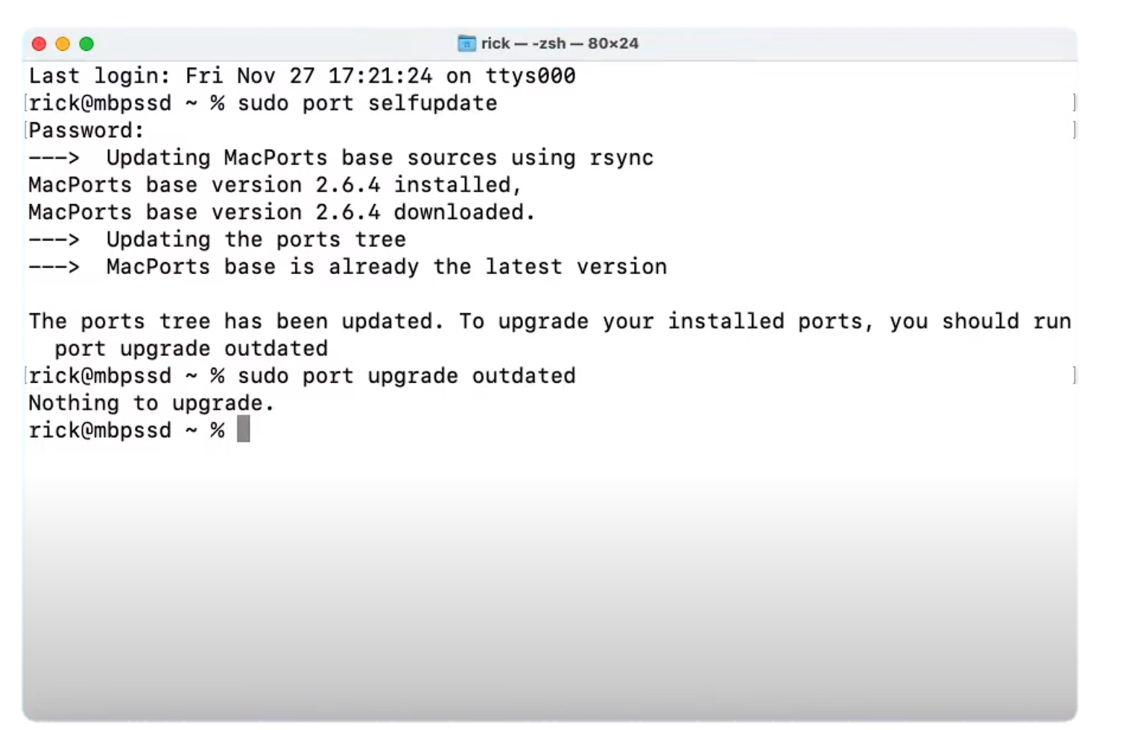
Pros of MacPorts:
More control: MacPorts often provides more versions of each package, making it appealing to users who want more control over their installation of their software packages.
MacPorts installs software in a separate directory (/opt/local), minimizing the risk of interfering with system libraries and tools included with macOS.
Cons of MacPorts:
Slower Installation Process: Attempts to install its own copies of any libraries.
Disk Space Usage: Since any dependencies are installed again then it will take up more disk space.
MacPorts
MacPorts
Homebrew
MacPorts is a package installer (like Homebrew) that simplifies the process of installing, and managing Unix software on macOS
MacPorts can be essentially split into two primary components: the foundational framework, referred to as MacPorts base, and the collection of ports that are available for use.
A port within MacPorts is defined by a set of details in a that outlines an application, its attributes, and all necessary files or specific directions needed for its installation.
Homebrew is favoured for its simplicity and ease of use.
Homebrew is suitable for most users and developers who want a straightforward package management experience.
MacPorts, is preferred by those who need greater control over software installations and who value the isolation and stability it provides, even if it requires more configuration and management effort.
Only available on Mac

Slide 7
Pros & Cons
MacPorts
Pros of MacPorts:
Support: MacPorts has excellent support for legacy versions of macOS. Homebrew only supports the OS's that are currently supported by Apple, which usually means the last three releases.
MacPorts installs software in a separate directory (/opt/local), minimizing the risk of interfering with system libraries and tools included with macOS.
Cons of MacPorts:
Slower Installation Process: Ignores many of the system libraries and softwares that already available in Mac OS X and pull its own one instead.
Disk Space Usage: Since any dependencies are installed again then it will take up more disk space.
Needs Xcode
MacPorts is a package installer (like Homebrew) that simplifies the process of installing, and managing Unix software on macOS
MacPorts may be conceptually divided into two main parts: the infrastructure, known as MacPorts base, and the set of available ports.
A MacPorts port is a set of specifications contained in a Portfile that defines an application, its characteristics, and any files or special instructions required to install it.

Slide 8
Key differences between homebrew and macPorts.
MacPorts
Homebrew
MacPorts
Homebrew is easier and simpler to use than MacPorts.
Homebrew is suitable for most users and developers.
Available on Mac and Linux.
MacPorts, is preferred by those who need greater control over software installations.
MacPorts is preferred by those who value the isolation and stability it provides.
Only available on Mac.
MacPorts is a package installer (like Homebrew) that simplifies the process of installing, and managing Unix software on macOS
MacPorts may be conceptually divided into two main parts: the infrastructure, known as MacPorts base, and the set of available ports.
A MacPorts port is a set of specifications contained in a Portfile that defines an application, its characteristics, and any files or special instructions required to install it.

Slide 9

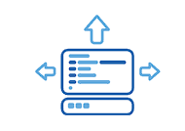

Command examples.
1. Development Environment Setup
- Example: Install Python 3.8 and GCC for a consistent development setup.
- Command(MacPorts): sudo port install python38 gcc
-Command(Brew): brew install python@3.8 gcc
2. System Administration and Networking
- Example: Use MacPorts to install Wireshark for network analysis.
- Command(MacPorts): sudo port install wireshark
-Command(Brew): brew install –cask wireshark
3. Open-source Software Installation
- Example: Access and manage a broad range of open-source software like the Vim editor.
- Command(MacPorts): sudo port install vim
-Command(Brew): brew install vim
4. Hobbyist Projects and Personal Use
- Example: Install retro gaming emulators for leisure.
- Command(MacPorts): sudo port install retroarch
-Command(Brew): brew install retroarch
Reproducible | Declarative | Reliable
Nix builds packages in isolation from each other. This ensures that they are reproducible and don't have undeclared dependencies, so if a package works on one machine, it will also work on another. | Nix makes it trivial to share development and build environments for your projects, regardless of what programming languages and tools you’re using. | Nix ensures that installing or upgrading one package cannot break other packages. It allows you to roll back to previous versions, and ensures that no package is in an inconsistent state during an upgrade.

Slide 10
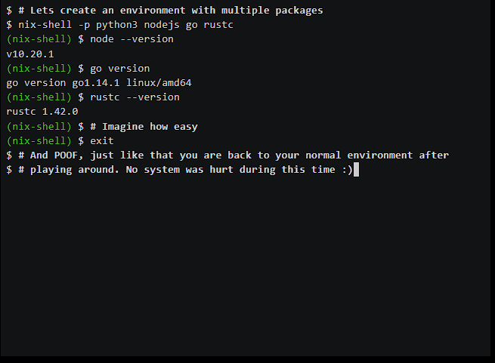
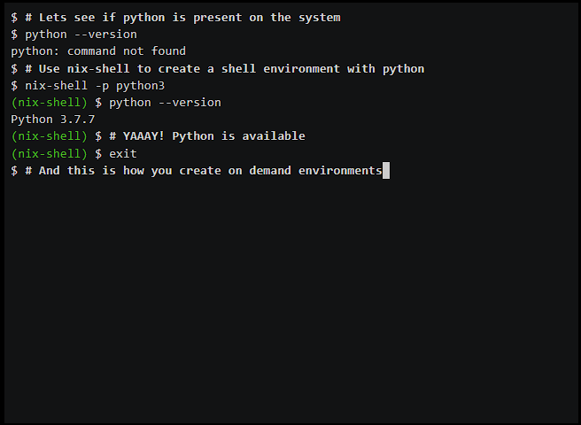
Introduction to NIX
Multiple languages, one tool | Nix-shell with python
Nix employs a distinctive method for managing packages and configuring systems. It facilitates the creation of systems that are consistent, defined through declarations, and dependable.
Reproducible | Declarative | Reliable
Nix builds packages in isolation from each other. This ensures that they are reproducible and don't have undeclared dependencies, so if a package works on one machine, it will also work on another. | Nix makes it trivial to share development and build environments for your projects, regardless of what programming languages and tools you’re using. | Nix ensures that installing or upgrading one package cannot break other packages. It allows you to roll back to previous versions and ensures that no package is in a different state during an upgrade.

Slide 11
Nix Installations
LINUX
Multi-user:
sh <(curl -L https://nixos.org/nix/install) –daemon
Single-user:
sh <(curl -L https://nixos.org/nix/install) –no-daemon
MacOS
Multi-user:
sh <(curl -L https://nixos.org/nix/install)

Slide 12

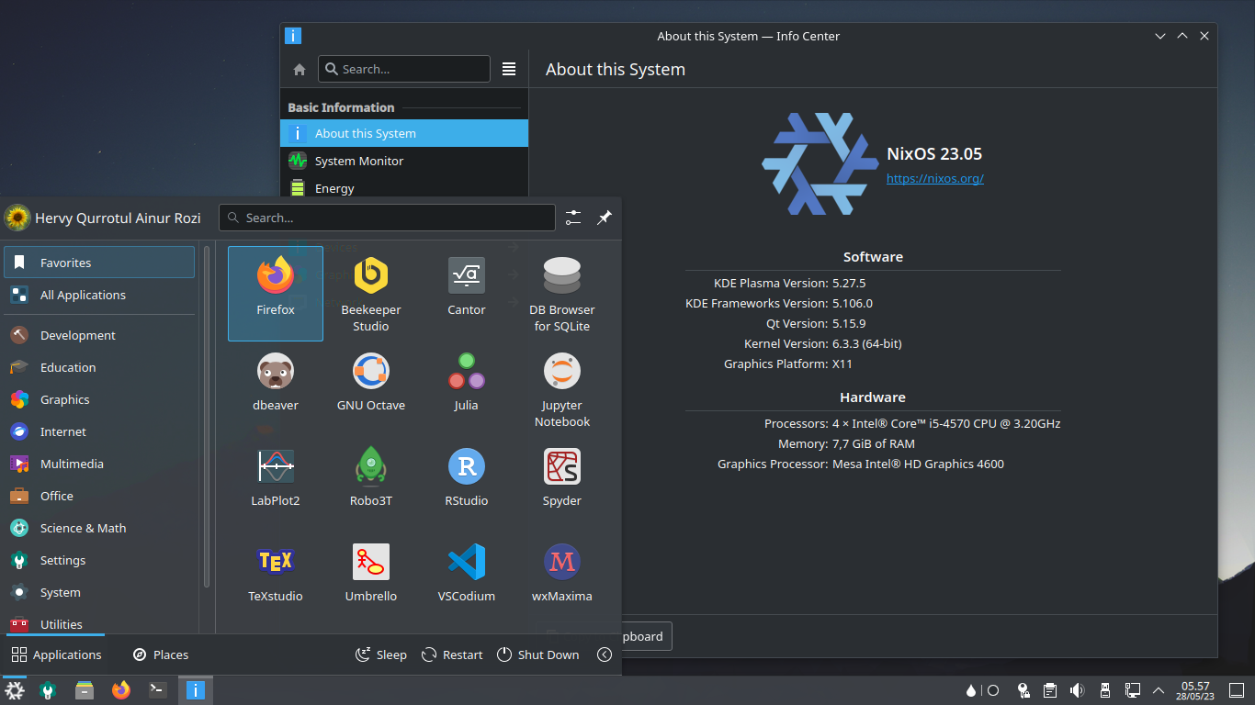
Examples
Multiple languages, one tool | Nix-shell with python
Reproducible | Declarative | Reliable
Nix builds packages in isolation from each other. This ensures that they are reproducible and don't have undeclared dependencies, so if a package works on one machine, it will also work on another. | Nix makes it trivial to share development and build environments for your projects, regardless of what programming languages and tools you’re using. | Nix ensures that installing or upgrading one package cannot break other packages. It allows you to roll back to previous versions, and ensures that no package is in an inconsistent state during an upgrade.

Slide 13
NixOS is a Linux distribution that is founded upon the Nix package manager.
System Customization Capability: The system allows for easy customization through simple configuration adjustments. Safety is emphasized during these modifications, and the process of changing between various desktop environments, like GNOME, KDE, i3, and sway, is uncomplicated and usually without significant issues.
Rollback Capability: The system offers a rollback feature that permits users to revert to any former state of the system. This function underlines the stability and reliability of Nix as a package management system since it allows for easy undoing of changes.

Slide 14
Key differences between Nix and Homebrew/MacPorts.
Nix: works on both macOS and Linux.
Nix: Supports atomic upgrades and rollbacks, allowing users to easily revert to previous versions
Nix: Appeals to users and developers who need a high degree of control over their software environment, especially for complex projects or in scenarios where consistency across systems is crucial.
Nix: Can be used in a multi-user setup, allowing different users to have different sets of installed packages without interference. This is particularly useful in shared or server environments.
MacPorts works only on macOS, and homebrew offers some support for Linux
Homebrew/MacPorts: While they offer version management, they don't have the same robust rollback capabilities as Nix.
Homebrew/MacPorts: Target more general users and developers on macOS, with Homebrew focusing on ease of use and MacPorts offering more control for specialized needs
Homebrew/MacPorts: Generally designed for single-user scenarios on a given system.

Slide 15
In summary
Homebrew:
Homebrew is User-friendly with minimal configuration needed
Homebrew is closely integrated with macOS
Installs packages without needing sudo
MacPorts:
Requires sudo for installations, adding more security
Emphasize in isolations of the packages
Suitable for experienced users
Offers more control over installations
Nix:
Provides an isolated environment for each package to prevent conflicts
Nix supports reverting to older versions
Nix is ideal for Developers and system administrators who need high control, and consistency

Slide 16

Thank you
Χρίστος Ζαχαριάδης
Γιώργος Πεττεμερίδης

