Slide 1
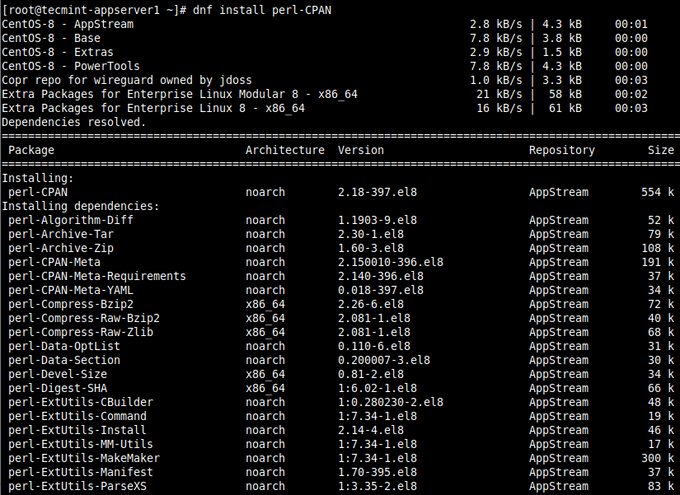

PERL &
CPAN
An insight into a flexible alternative
Presented by:
Markos Fikardos
Alexandros Modestou

Slide 2
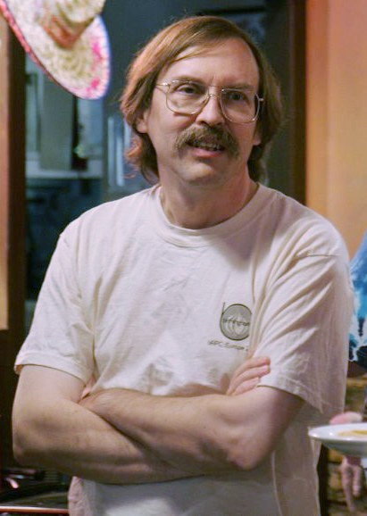
Born in 1954. Raised in Los Angeles, California
Didn’t initially Study Computer Science
The three Virtues of a Programmer:
Laziness
Impatience
Hubris

Slide 3
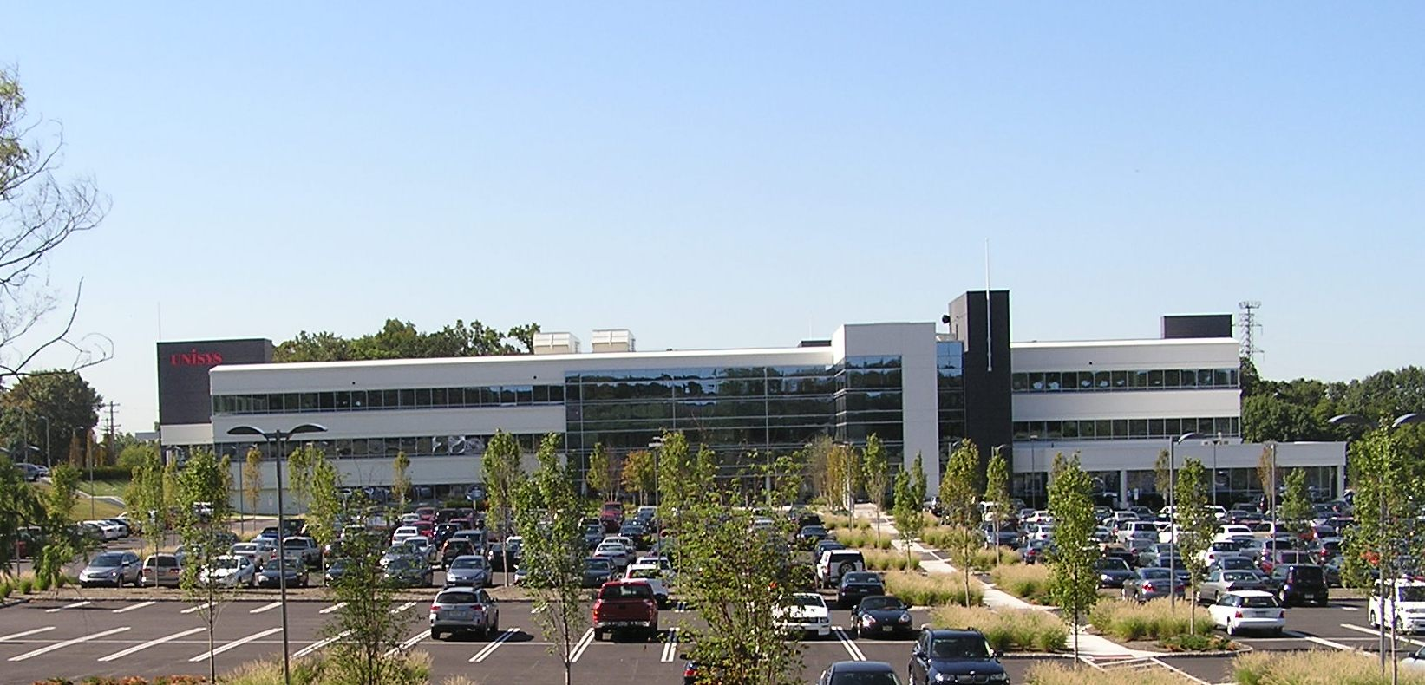
WALL’S TIME AT UNISYS
Larry Wall, former Unisys System Administrator, faced text processing challenges with limited tools. Struggling to cope, he envisioned a more powerful language for text manipulation, leading to the creation to Perl.

Slide 4

As such, Perl has evolved into something much more than just a simple Text Manipulation Language

Slide 5
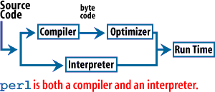
How does it work:
Perl is an interpreted language, meaning it doesn’t convert into Machine Code
Instead converts to ByteCode, a form of low-level instructions

Slide 6
Perl Pros:
Text Processing and Regular Expressions
Flexibility and Expressiveness
Comprehensive Perl Archive Network (CPAN)
Cross-Platform Compatibility (LINUX, Windows, MacOS etc)

Slide 7
Perl Cons:
Readability and Maintainability
Learning Curve
Rough Object-Oriented Features
Not as Modern

Slide 8
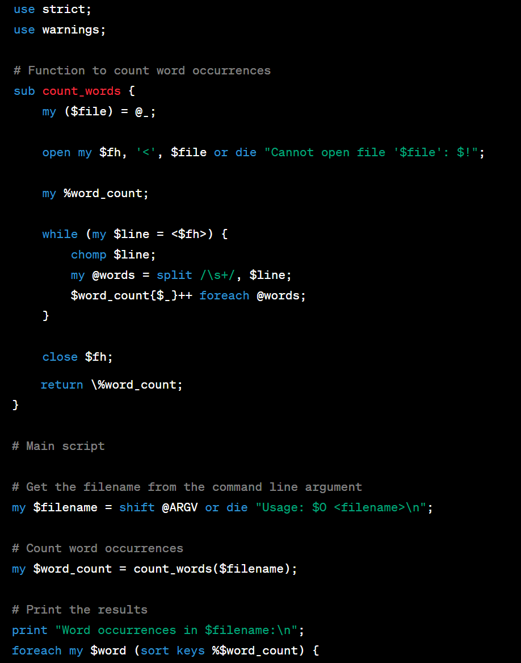
EXAMPLE:
Script on screen now counts word occurrences in a text file. It reads the filename from the command line, processes the file using a hash for word frequency, and outputs a formatted list of words and occurrences.

Slide 9
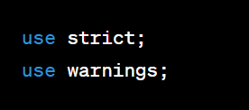
//Similar to #includes
//Includes external modules
//Will expand upon this further

Slide 10
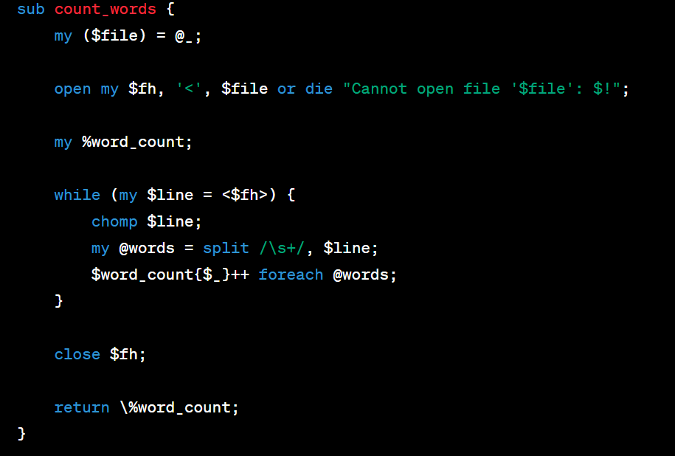
//Sub mirrors that of functions

Slide 11


//my VARIABLE

Slide 12
Scalar Variables ($)
Array Variables (@)
Hash Variables (%)
Filehandle Variables (*)

Slide 13
//my VARIABLE

Slide 14
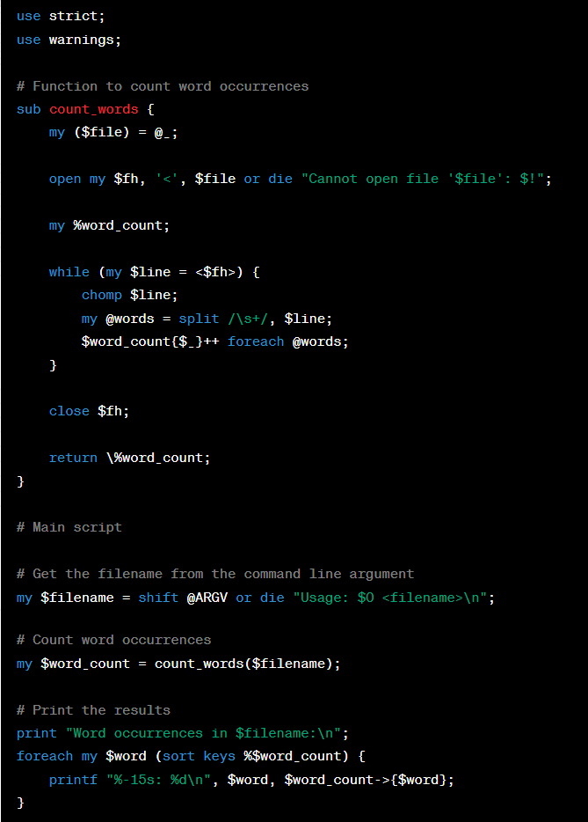
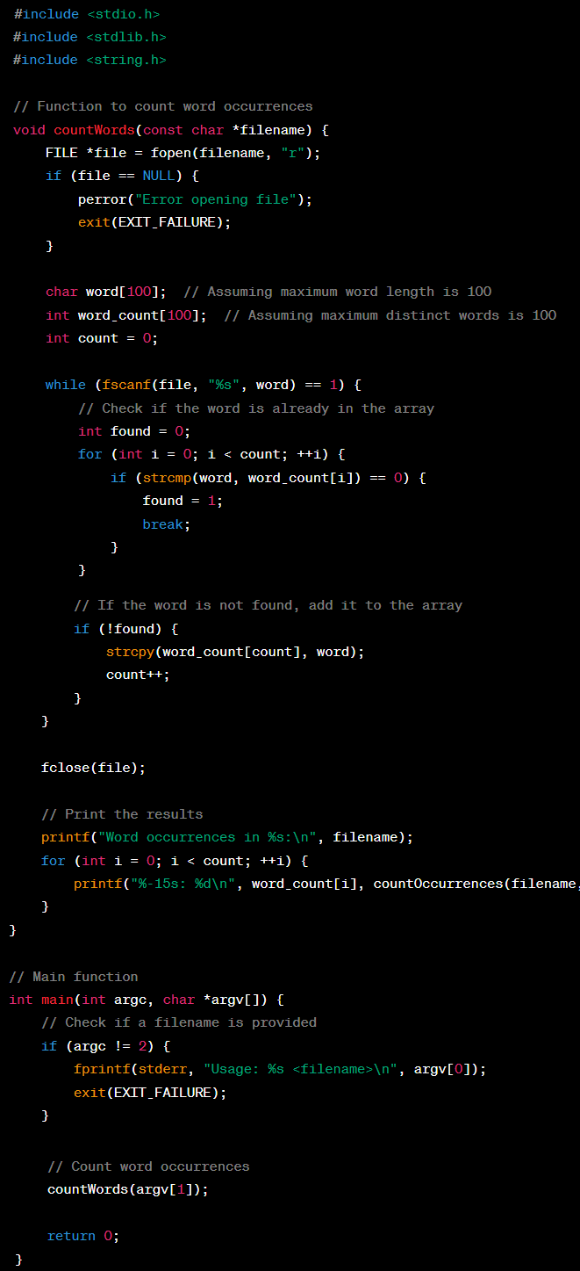

Slide 15
TIMTOWDI
“There is more than One Way to Do It”
A general rule of thumb in coding, but ever prominent in Perl

Slide 16
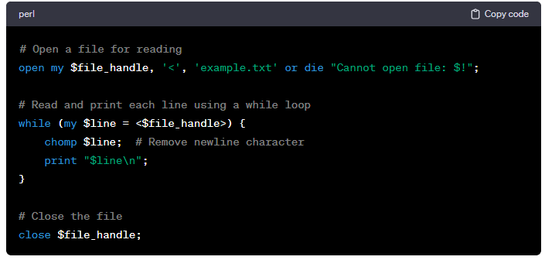
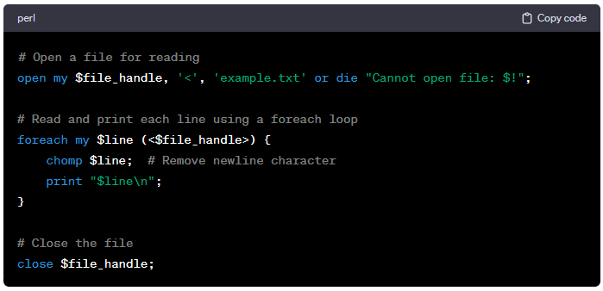

Slide 17
Evolution of Perl
Proving itself as a flexible language

Slide 18

Web Development
Dynamic web pages
Form Submission handling
CGI Scripts

Slide 19
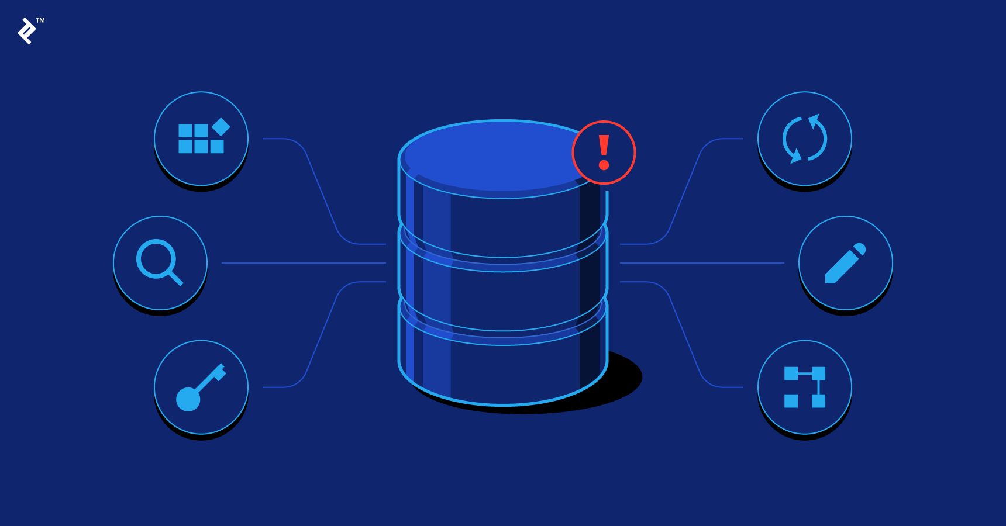
Databases
Data Manipulation
Software interaction with:
MySQL
PostgreSQL

Slide 20
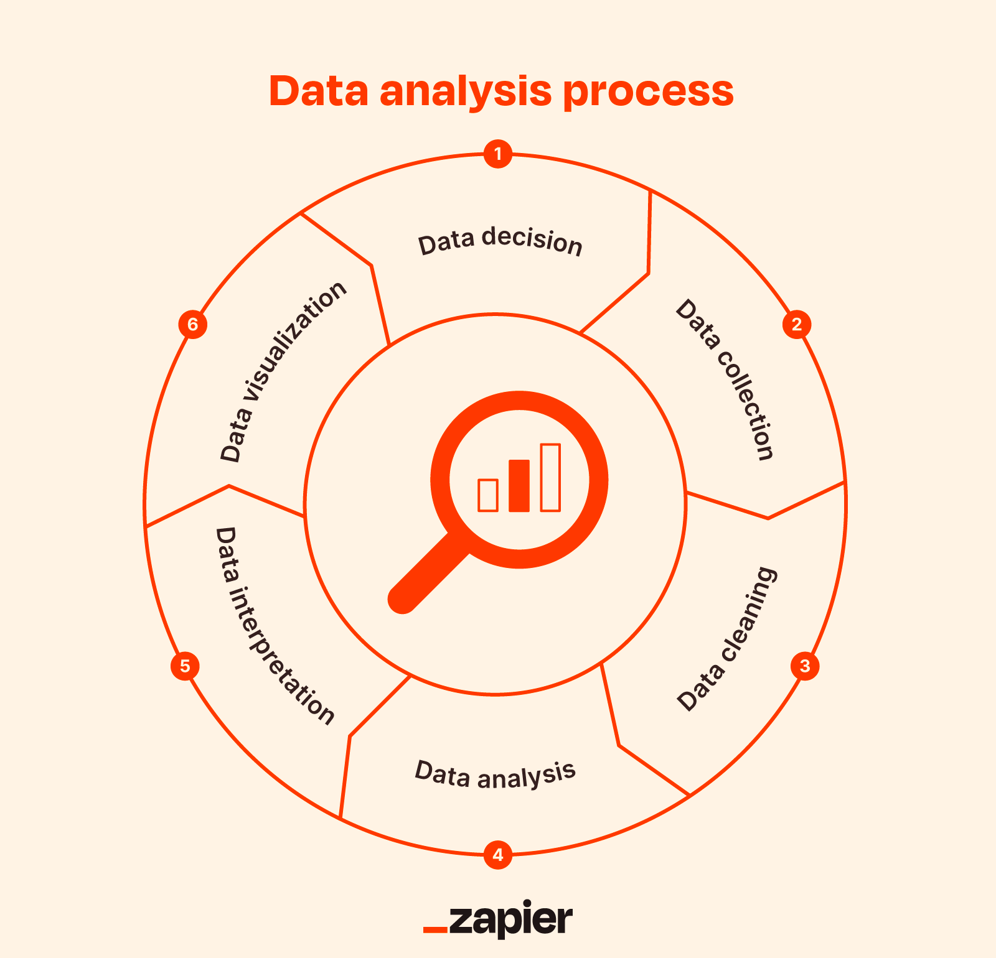
Data Processing & Analysis
Aggregating data
Transforming data
Summarizing data

Slide 21
What is CPAN?

Slide 22
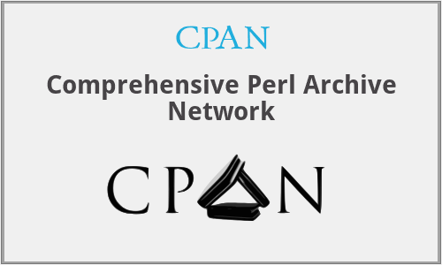
Dynamic hub of over 200,000
Modules
Community Driver
Swift code review before
Catalogued
Elevates the Coding Experience

Slide 23
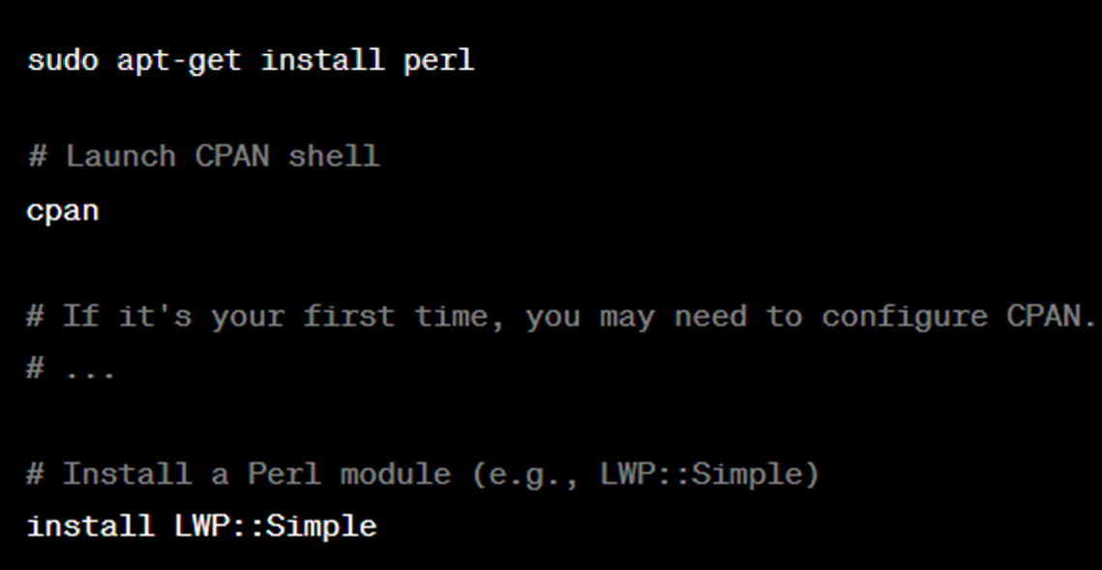
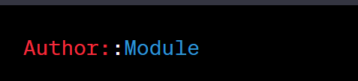
Hierarchical Namespace System
EXAMPLE: An author with the ID 'ABC' would have their directory under A/AB/ABC
CPAN Shell is installed automatically with Perl

Slide 24
Moose
DBI
Database Interface
object-oriented framework
Mojolicious
Text::CSV
Modern, Feature-rich web framework
Comma-Separated Values

Slide 25

Moose
an object-oriented framework that injects modernity and flexibility into Perl
simplifies the creation of classes and objects, employing a declarative syntax for attributes, type constraints, and method modifiers

Slide 26
DBI
database-independent layer, offering a consistent interface for Perl programs to connect with various database management systems. Its versatility spans database connectivity, query execution

Slide 27
Text::CSV
Simplifies the parsing and generation of Comma-Separated Values (CSV) files, a common task in data exchange and storage. Its ease of use and comprehensive functionality make it a go-to solution for handling CSV data with precision.

Slide 28
Mojolicious
modern and feature-rich web framework. Mojolicious empowers developers to craft dynamic web applications effortlessly. With its built-in web server and a plethora of tools for routing, templating, and testing, Mojolicious accelerates the development of robust and scalable web solutions

Slide 29
Conclusion

Slide 30

Thank you for listening
Sources:
https://web.archive.org/web/20180228231349/http://blog.builtinperl.com/post/the-man-behind-the-perl---things-you-might-not-know-about-larry-wall
https://perldoc.perl.org/perlintro
https://perlmaven.com/object-oriented-perl-using-moose
https://metacpan.org/pod/DBI
https://metacpan.org/pod/Text::CSV
https://docs.mojolicious.org/
chat.openai.com

