Slide 1




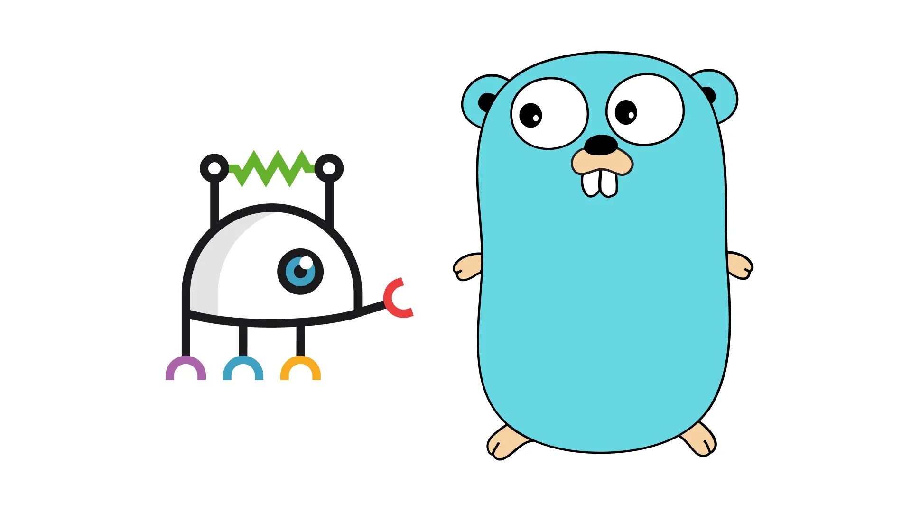
Go Docker Kubernetes
Andronikos Charalambous
Christina Hadjizorzi
Joanna Georgiou

Slide 2

Contents
Introduction
Go
  Why Go
  Who is using Go
Docker
  Docker workflow
  Virtual machines vs Containers
Kubernetes
  Intro to Kubernetes
  Kubernetes Features
Implementation
Demo

Slide 3


Introduction
Architecture with:
  Go
  Docker
  Kubernetes
This architecture used for cloud computing
  Efficient
  Scalability

Slide 4

Go
Designed by Google (Robert Griesemer, Rob Pike, Ken Thompson)
First Release 2009
Developed for high performance and fast development
Open Source Programming Language
Simple, Reliable, Efficient
Easy to write programs that get the most out of multicore and networked machines

Slide 5
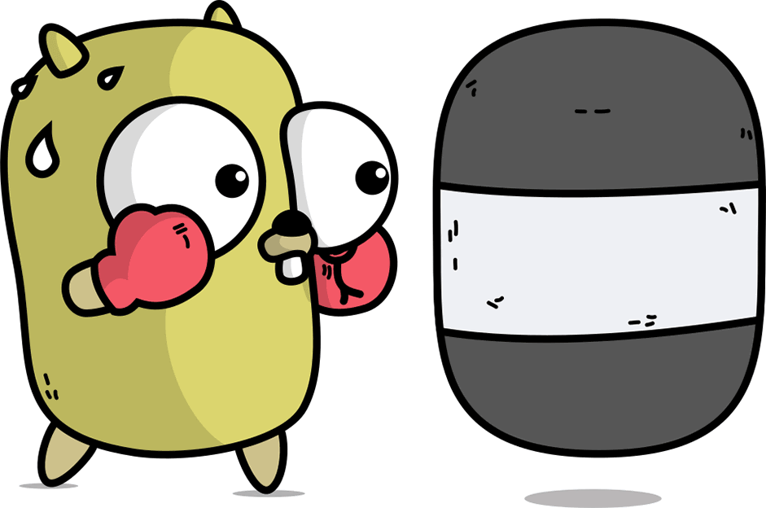
Why Go
Compiled Language
Goroutines
Channels
Concurrency
Cross Platform
Own Runtime
Built-in Framework for Testing and Profiling
Garbage Collection

Slide 6
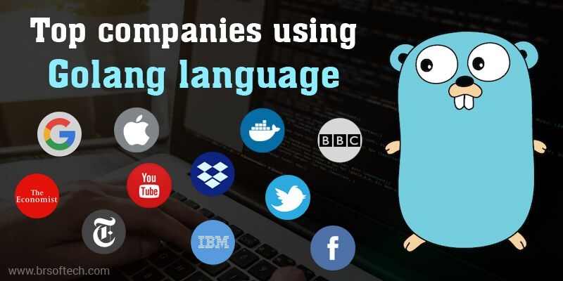

Slide 7
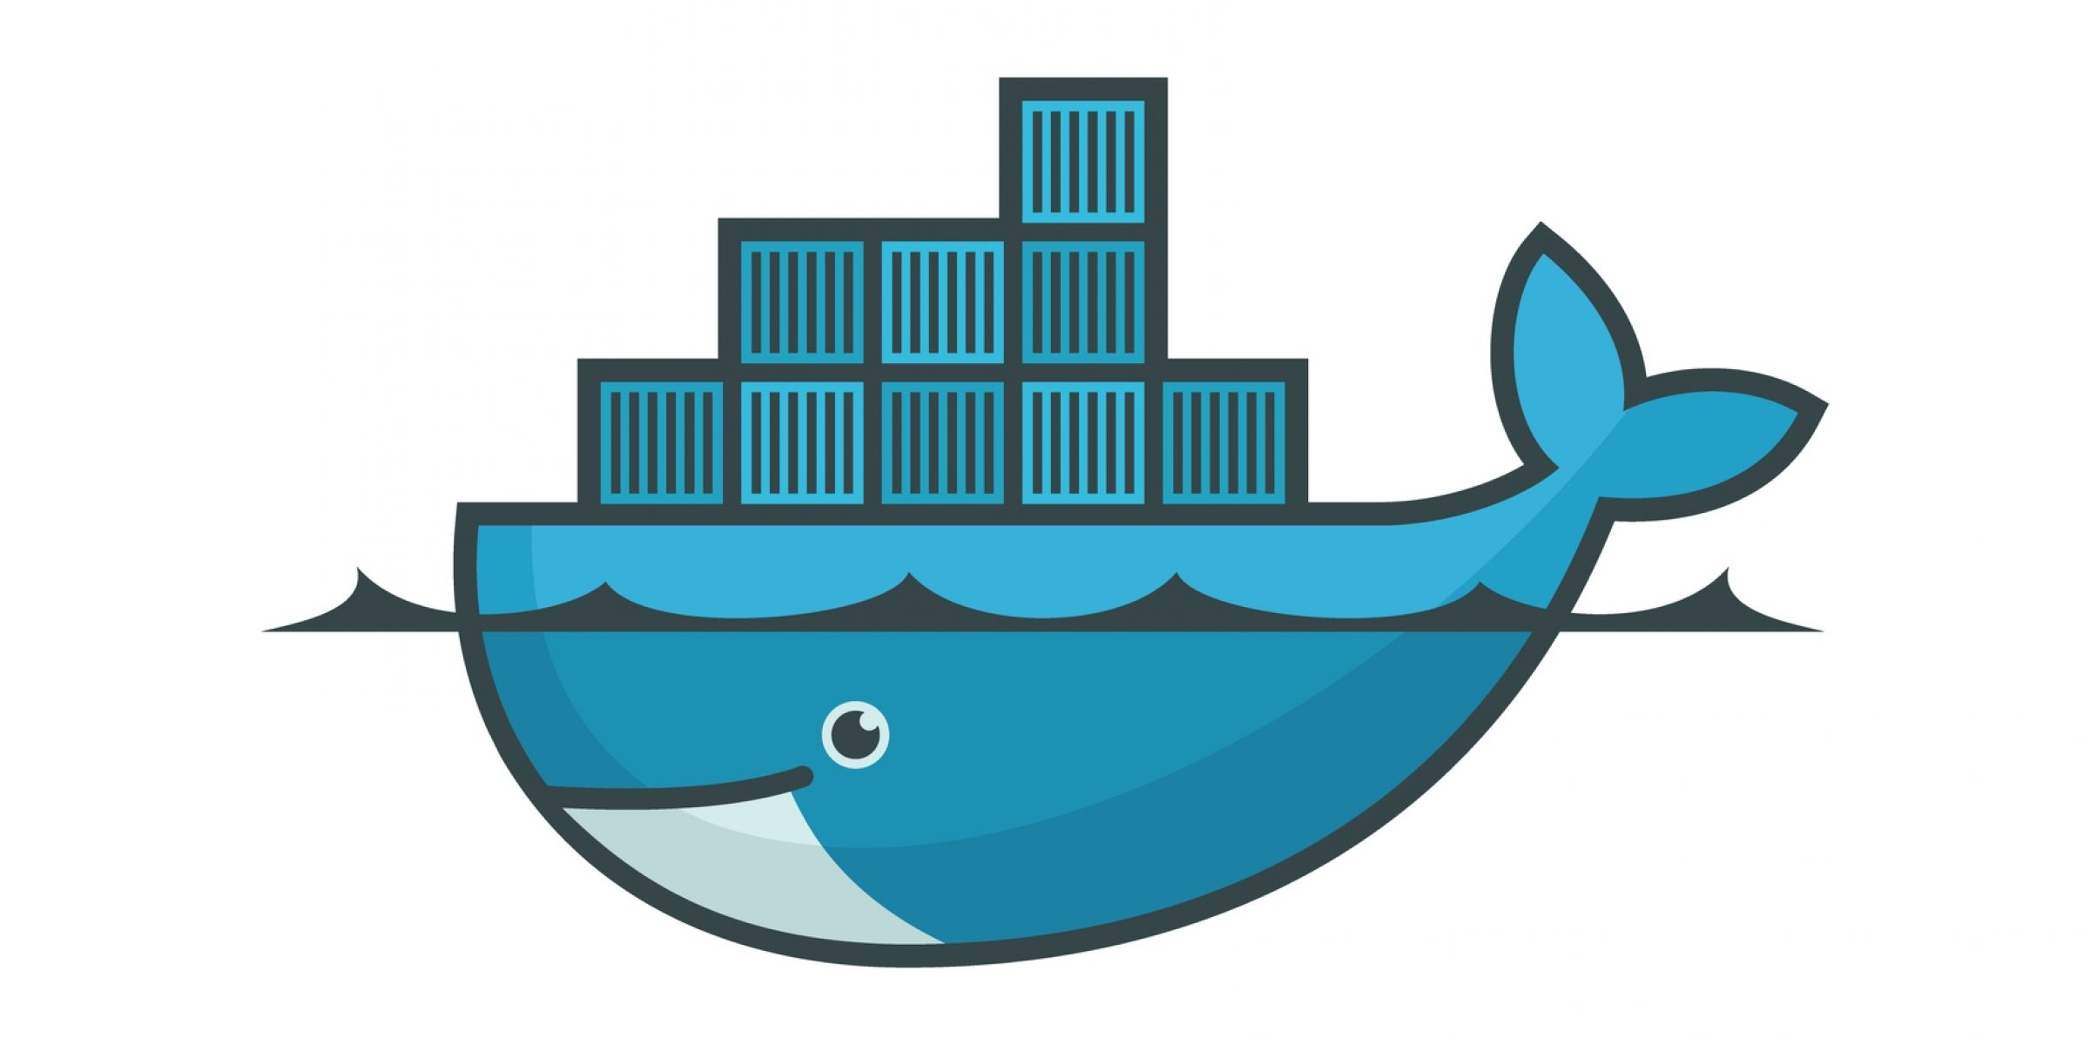
Docker
Developed by Solomon Hykes
Release in 2013
Use OS-level virtualization to deliver software in packages called containers
Fast, Easy and portable application development
Docker’s comprehensive end to end platform includes UIs, CLIs, APIs and security

Slide 8
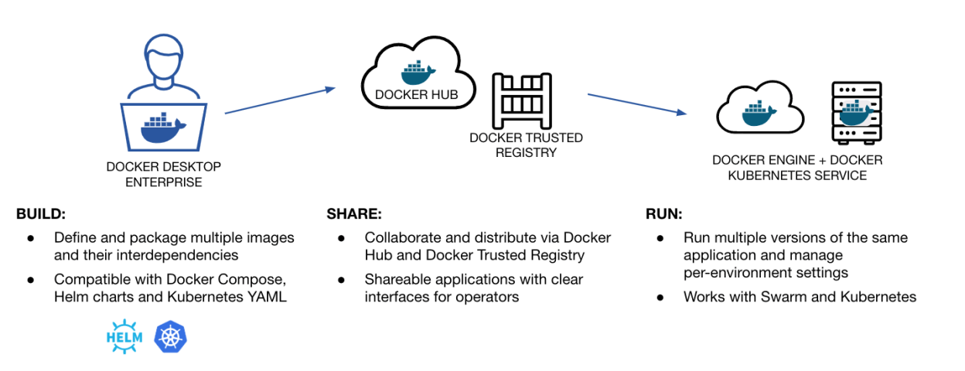

Slide 9
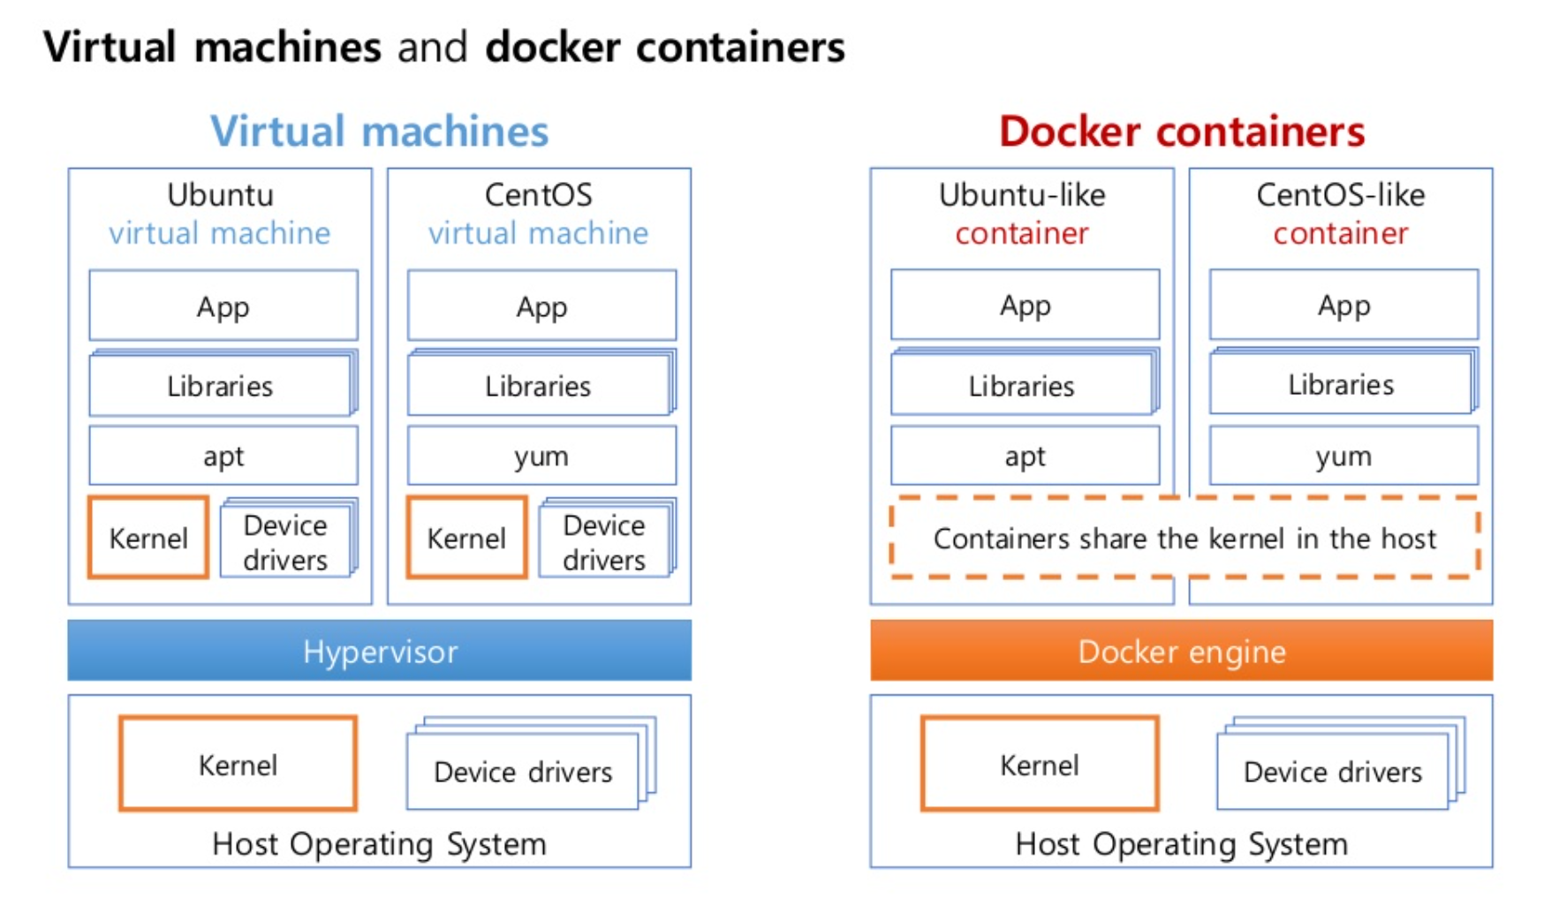

Slide 10
Kubernetes
Developed by Google
Release in 2014
Written in Go
Open Source container orchestration
Manage hybrid cloud and multicloud deployments
Deliver applications faster
Make developers more productive

Slide 11
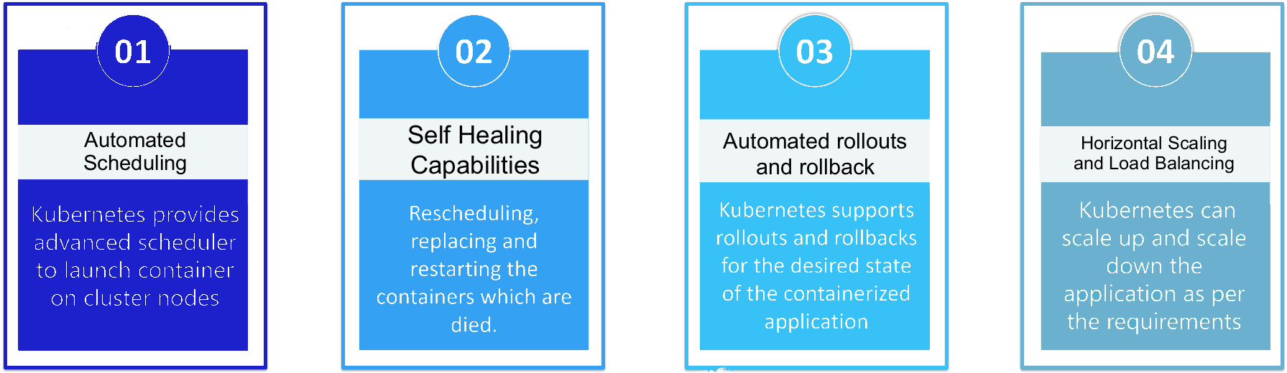
Kubernetes Features

Slide 12
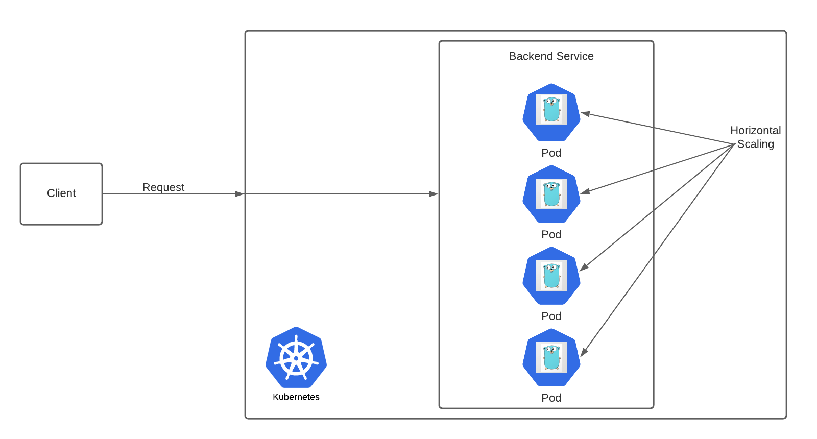
System Architecture

Slide 13
Implementation
High performance http server that handles requests for internal processing using a worker queue.
We used the net/http library (ListenAndServe function) for building an http server
In order to maximize the performance we build our worker queue using goroutines and channels for communication among them.

Slide 14
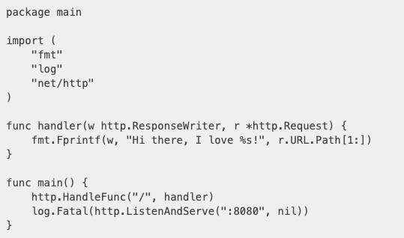
Simple Http Server

Slide 15

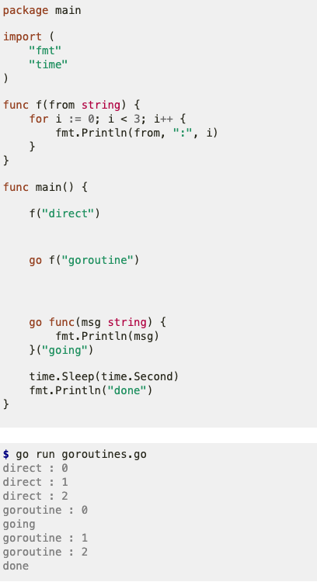
Goroutines Example

Slide 16
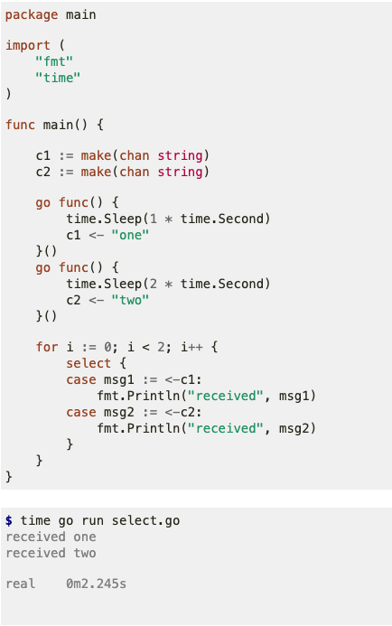
Channels Example

Slide 17
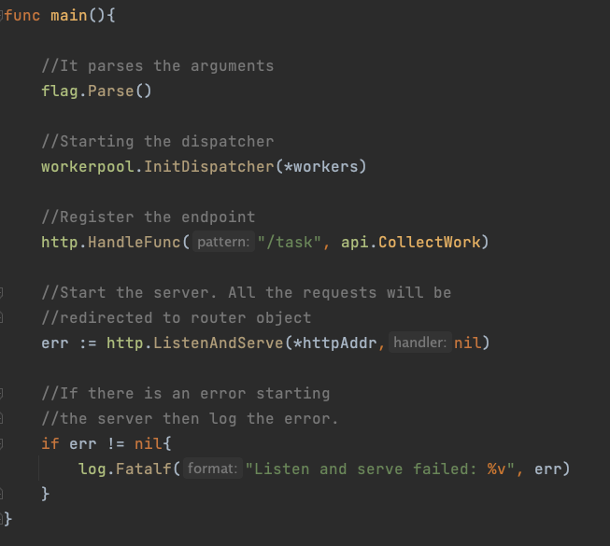
Implementation- Http Server
Initialize the dispatcher which starts our workers.
Each time a client make a request a new goroutine spawns
The requests is been handled by the Collector function

Slide 18
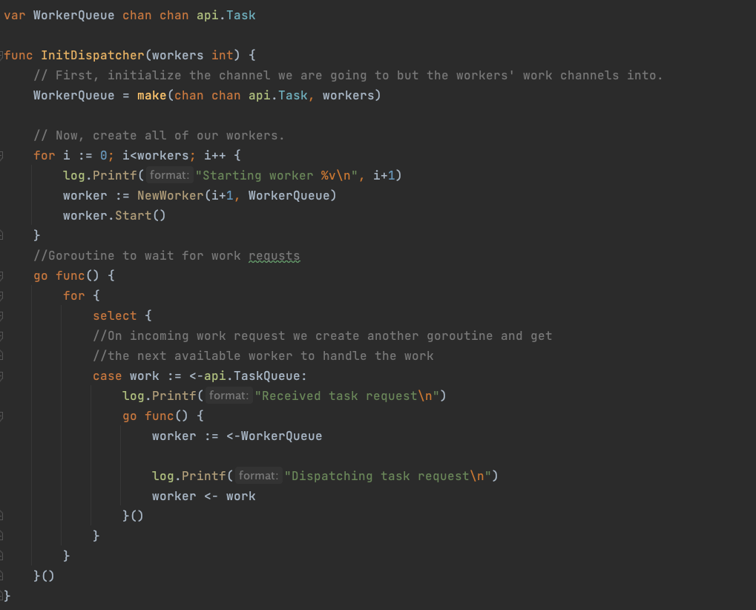
Init Dispatcher
Create the workers and starts them
Spawns a new goroutine to wait for incoming tasks
When task is received new goroutine is spawn and gets the next available worker to do the task

Slide 19
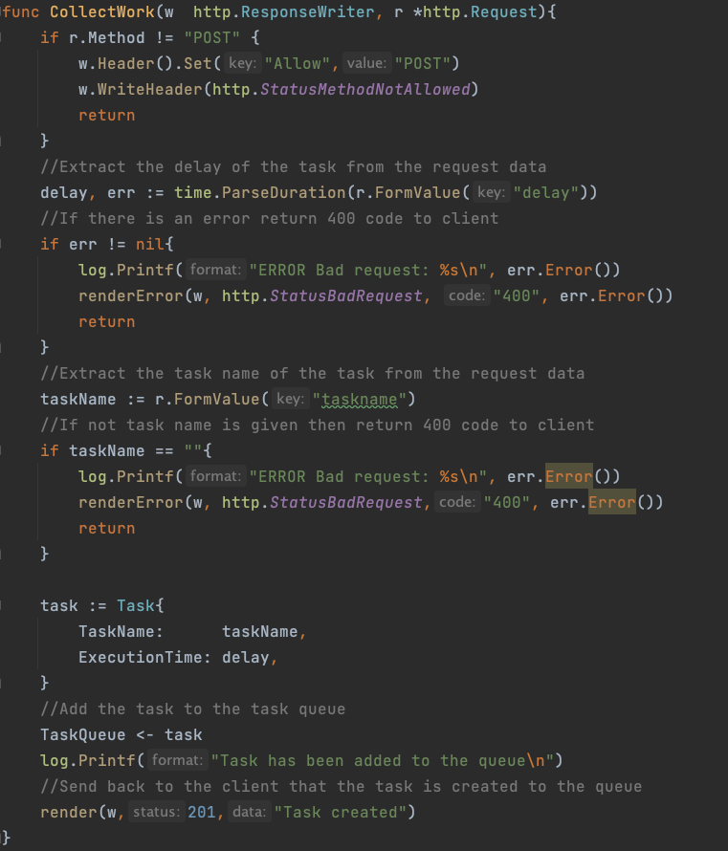
Collect Work
When client makes a request for a task this function is been called
Extracts the parameters of the request
It creates a new Task structure and add it to the Task Queue
Return back to the client that the task has been created to the queue and it will be processed

Slide 20

Demo

Slide 21
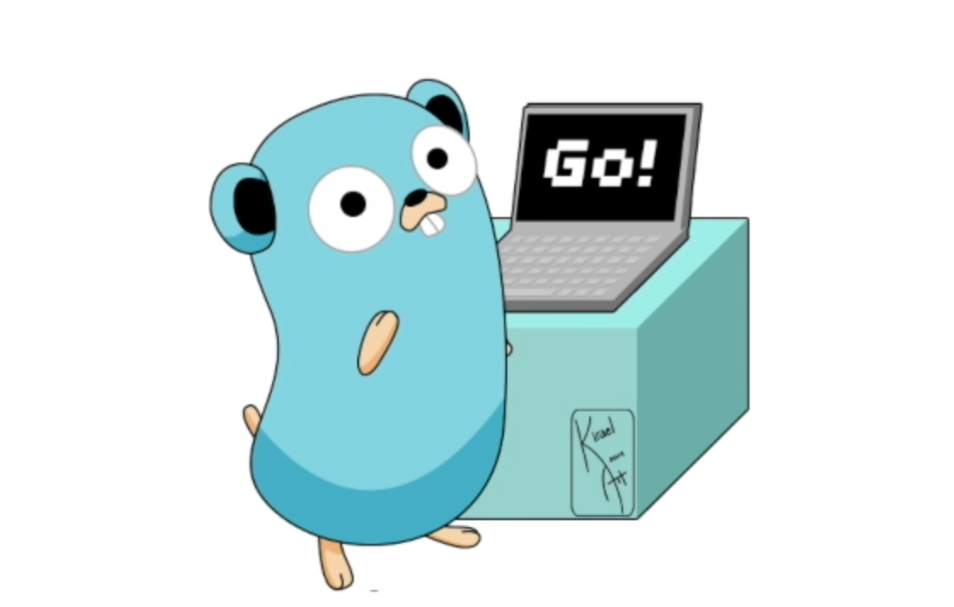
Thank you for your attention!

