Slide 1
Android Game Development Libraries
Charis Marangos

Slide 2
Games versus Most Applications
Technical implementation is hard
  Real-time and responsive (at least 25 frames per second)
  Hungry for Battery and other Resources
  Dynamic experience (many objects to draw and update)
Logic implementation
  Must be separate from technical implementation
Quality of content
  Story
  Graphics
  Sound
Fun to play!

Slide 3
Supported Graphics for Android
Canvas and Drawables
  Easier to work with
  Other SDK features may be used easily (Text, AlertDialogues, etc)
  Only for 2D
OpenGL (ES 1.x, ES 2.0)
  Supports 3d graphics
  Much faster
  Hardware acceleration

Slide 4
Game Libraries
Less time spent in technical details
  Less native calls exposed
  Handling of devices
  Loading and handling resources
More time available for:
  Game-specific logic programming
  Developing content
Helps with portability
  Hardware abstraction
  Platform abstraction

Slide 5
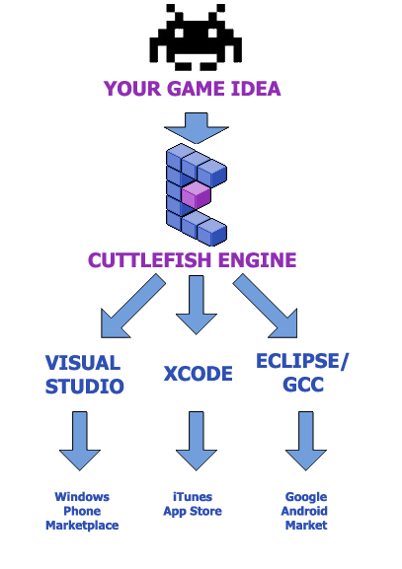
Cuttlefish Engine
Cross-platform 2D Engine
  Windows, Mac
  iOS, Android
The Engine is open-source
Designer
  Not free! ($100 per year)
  Tile-based Level Editor with Layer support
  Particle Effects
Language: Cuttlescript
  Similar to C#
  Compiles to native code
box2D physics
Support for native code
Still doesn’t support many devices
  Only 20% of Android devices

Slide 6
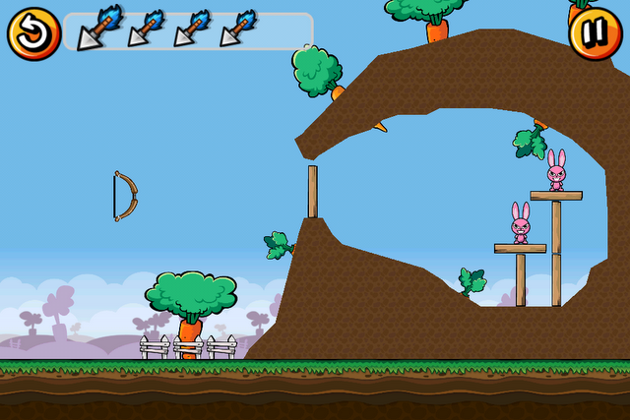
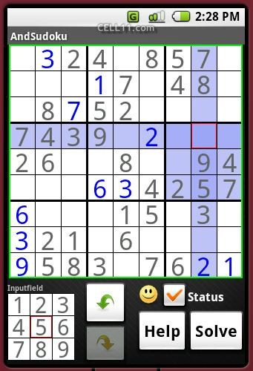
AndEngine
2D abstraction layer for OpenGL
Android only
  Built on top of the Android SDK
  Fully open-source
Fast
Box2D Physics
Games:
  Bunny Shooter

Slide 7
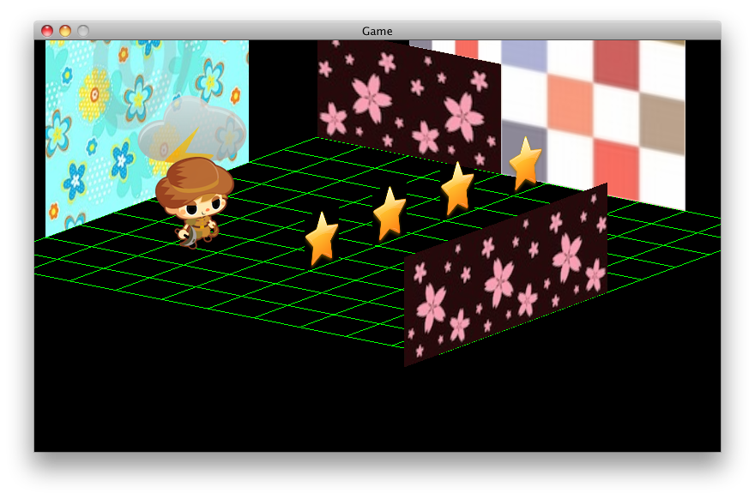
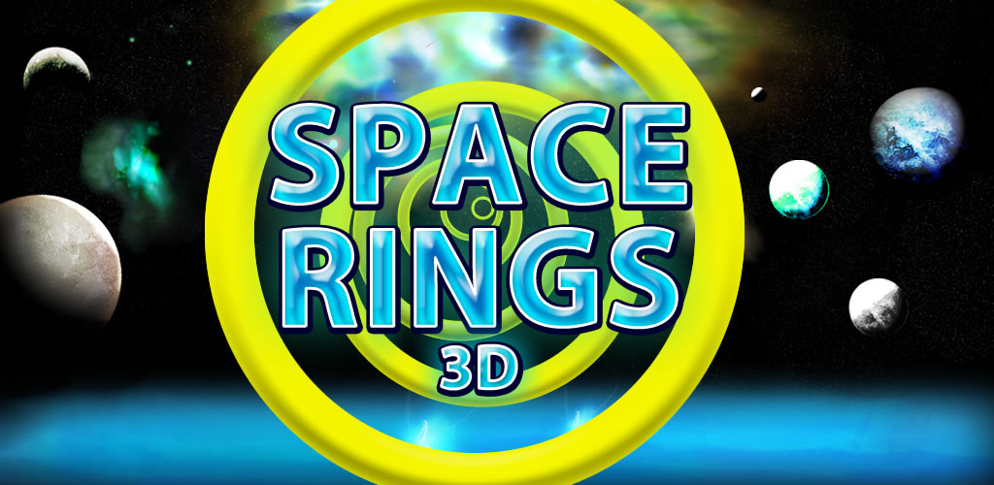
LibGDX
Cross-platform
  Windows, Linux, Mac
  Android, iOS
Free and fully open-source!
A Complete framework, but not a game engine
Low-level 3D with OpenGL
High-level 3D
High-level 2D
Physics with box2D
Math classes for 3D
Utilities, Tools & Extensions
Language: Java
Games
  Newton
  Space Rings 3D

Slide 8
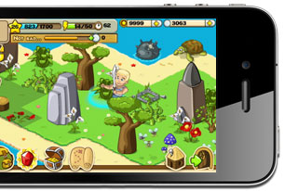
Corona
For Android and iOS
2D games only
Free to use, but requires subscription ($350 per year) to publish games
Similar to Flash, geared for Flash developers
  Includes Tools which help with the reuse of Flash assets
Games
  The Lost City
  Shovel heroes

Slide 9

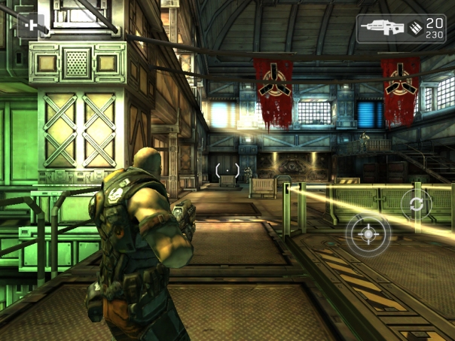
Unity 3D
Cross-platform
  Windows, Mac and (soon, but not yet) Linux
  Web (requires plugin), Flash
  Android, iOS
  Xbox360, PS3 and Wii
Many versions
  Standard version is free for Windows and Mac
  Pro license: $1,500
  Android: $400
  iOS: $400
Languages: C#, UnityScript (similar to JavaScript), Boo (similar to Python)
  It is possible to use all 3 languages in the same project
  Compiles to Mono
  Slight overhead
Extremely easy to use
Very powerful, with a plethora of features
Not recommended for 2D games
Games
  Shadowgun
  Angry Viking

Slide 10
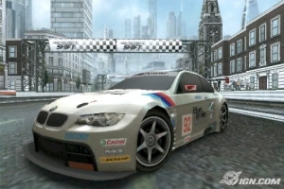
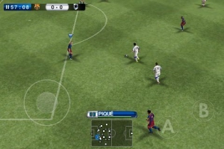
Marmalade
Cross-platform
  Android, iOS
  Symbian
  Windows, MacOS
Application and Game SDK
Mature product, good support
Powerful 3D pipeline
  Optimal performance geared for specific devices
  Full access to OpenGL ES 2.0
Language: C++
  Visual Studio
  Xcode
  Compiles natively (uses NDK for Android)
  Supports ASM instructions
Games
  Need for Speed Shift
  Pro Evolution Soccer 2011

Slide 11
Standard Android OpenGL vs LibGDX!
Drawing text in standard Android SDK:
// Create an empty, mutable bitmap
Bitmap bitmap = Bitmap.createBitmap(256, 256, Bitmap.Config.ARGB_4444);
// get a canvas to paint over the bitmap
Canvas canvas = new Canvas(bitmap);
bitmap.eraseColor(0);
// get a background image from resources
// note the image format must match the bitmap format
Drawable background = context.getResources().getDrawable(R.drawable.background);
background.setBounds(0, 0, 256, 256);
background.draw(canvas); // draw the background to our bitmap
// Draw the text
Paint textPaint = new Paint();
textPaint.setTextSize(32);
textPaint.setAntiAlias(true);
textPaint.setARGB(0xff, 0x00, 0x00, 0x00);
// draw the text centered
canvas.drawText("Hello World", 16,112, textPaint);
//Generate one texture pointer...
gl.glGenTextures(1, textures, 0);
//...and bind it to our array
gl.glBindTexture(GL10.GL_TEXTURE_2D, textures[0]);
//Create Nearest Filtered Texture
gl.glTexParameterf(GL10.GL_TEXTURE_2D, GL10.GL_TEXTURE_MIN_FILTER, GL10.GL_NEAREST);
gl.glTexParameterf(GL10.GL_TEXTURE_2D, GL10.GL_TEXTURE_MAG_FILTER, GL10.GL_LINEAR);
//Different possible texture parameters, e.g. GL10.GL_CLAMP_TO_EDGE
gl.glTexParameterf(GL10.GL_TEXTURE_2D, GL10.GL_TEXTURE_WRAP_S, GL10.GL_REPEAT);
gl.glTexParameterf(GL10.GL_TEXTURE_2D, GL10.GL_TEXTURE_WRAP_T, GL10.GL_REPEAT);
//Use the Android GLUtils to specify a two-dimensional texture image from our bitmap
GLUtils.texImage2D(GL10.GL_TEXTURE_2D, 0, bitmap, 0);
//Clean up
bitmap.recycle();

Slide 12
Standard Android OpenGL vs LibGDX!
Drawing text in LibGDX:
BitmapFont font;
SpriteBatch batch;
public void create() {
font = new BitmapFont();
batch = new SpriteBatch();
}
public void render() {
Gdx.graphics.getGL10().glClear(GL10.GL_COLOR_BUFFER_BIT);
batch.begin();
font.draw(batch, "Hello World!", 10, 10);
//..rest of drawing code for other elements
batch.end();
}

Slide 13
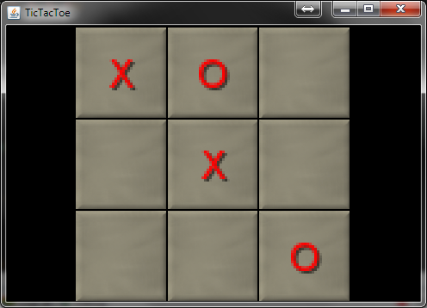
Tic Tac Toe
My implementation of the tic tac toe game, using LibGDX

Slide 14
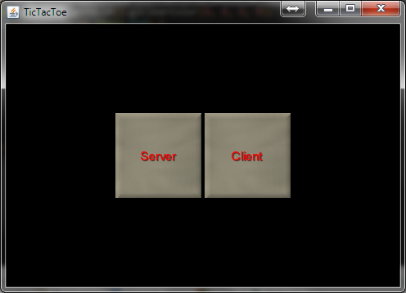
Tic Tac Toe

Slide 15
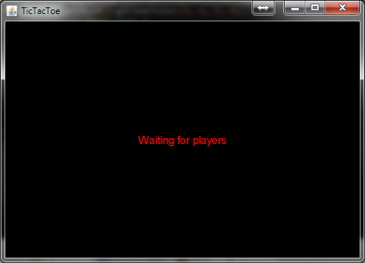
Tic Tac Toe

Slide 16
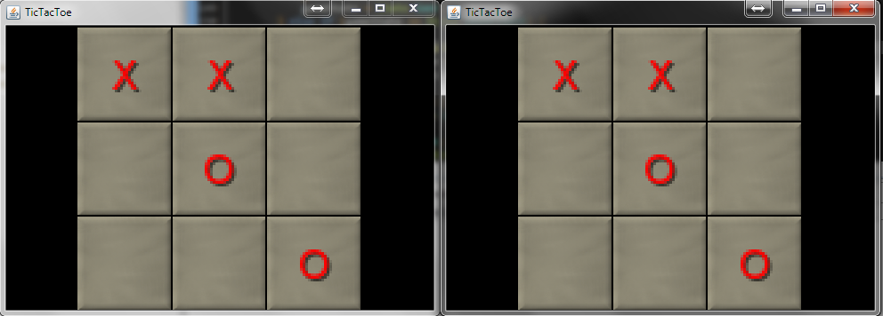
Tic Tac Toe

Slide 17
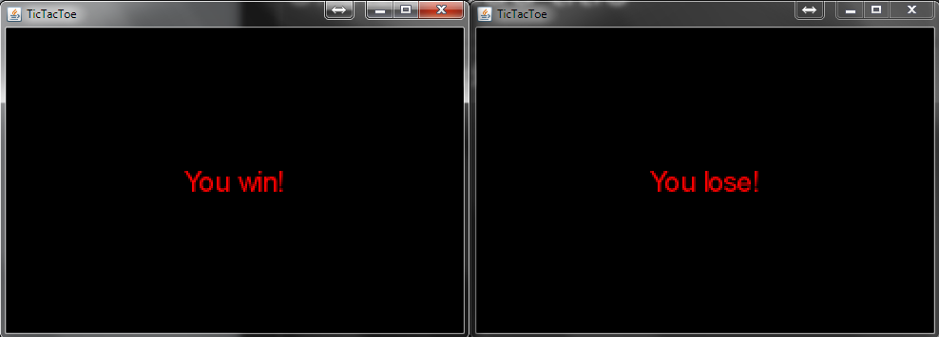
Tic Tac Toe

Slide 18
Thank you!

