Slide 1

Επεξεργασία Επερωτήσεων k Πλησιέστερων Γειτόνων Όλων των Αντικειμένων σε Κατανεμημένη Κύρια Μνήμη
Γεώργιος Χατζημηλιούδης∗, Κωνσταντίνος Κώστα∗,
Δημήτρης Ζεϊναλιπούρ∗, Wang-Chien Lee‡, Ευαγγελία Πιτουρά§
∗
‡
§
University
of Ioannina
Δημοσίευση: "Distributed In-Memory Processing of All k Nearest Neighbor Queries", Georgios Chatzimilioudis, Constantinos Costa, Demetrios Zeinalipour-Yazti, Wang-Chien Lee and Evaggelia Pitoura, IEEE Transactions on Knowledge and Data Engineering (TKDE'16), IEEE Computer Society, Vol. 28, Iss. 4, pp. 925-938, 2016.
+ Poster at IEEE ICDE’16, Helsinki, Finland.
14o Ελληνικό Συμπόσιο Διαχείρισης Δεδομένων (ΕΣΔΔ'16)
28 Ιουλίου - 29 Ιουλίου 2016, Αθήνα, Ελλάδα

Slide 2






Motivation
Rayzit: a crowd messaging system that instantly forms a dynamic social network based on user proximity
  Not location-based app but kNN-based!
Rayzit was funded by the Appcampus Program (Microsoft, Nokia & Aalto, Finland) in 2013.
  Ranked among 5 best apps of the program from 3500 apps.
  Few thousand downloads and active users after their marketing!
Research Problem: Big Data AkNN Query Processing
http://rayzit.com/

Slide 3
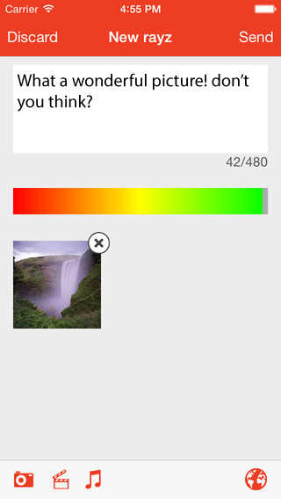
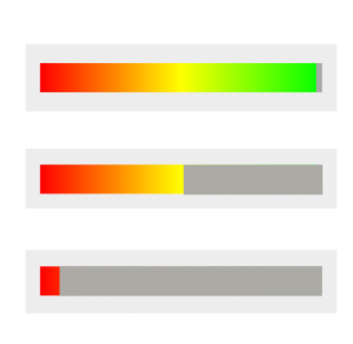
The Rayzit Application
A user can post a new Rayz (text, audio, video – shown as attachment).
To minimize spamming, each user has a powerbar that decreases on every action:
  Rayz, reply, re-rayz, power+/-
  When empty no more actions are possible until it gradually reloads.
  To reload faster, we provide the incentive to provide useful answers that will be starred by others.
A message can be bounded to a certain distance (kNN is default)
  0.5, 5, 50, 500, 5000 km

Slide 4
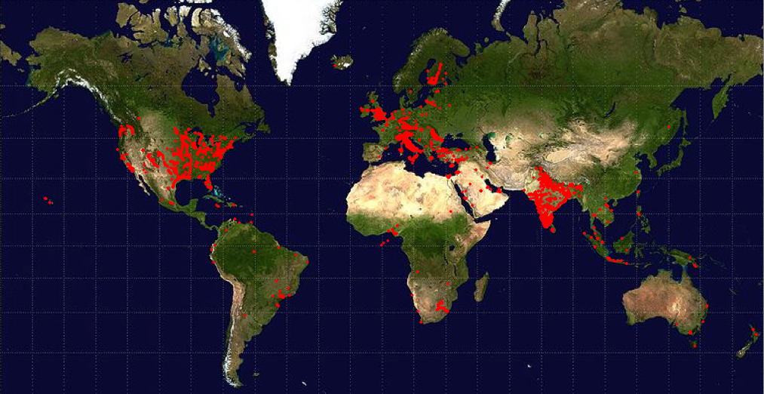
AkNN Motivating Scenario
Rayzit User Map
How to compute the kNN for millions of mobile users every few seconds?

Slide 5
AkNN Query Definition
Find kNN for all objects in O!
AkNN(O): Given objects o_{a}≠ o_{b}≠ o_{c},
∀o_{b}∈ kNN(o_{a,}O) and ∀o_{c}∈ O - kNN(o_{a,}O)
it holds that dist(o_{a},o_{b}) ≤ dist(o_{a},o_{c})
o₂
O
o₁
AkNN = kNN Self-Join
kNN Self-Join Definition:
O ⋈ _{kNN} O =
{(o_{a}, o_{b}) | o_{a}, o_{b} ∈ O and o_{b} ∈ kNN(o_{a}, O)}
O(n²)-time search cost
o₈
o₃
o₇
o₅
o₄
o₆
o₉
o₁₁
o₁₀
Notes:
A left outer join B = { (a,b) | include al

Slide 6
Outline
Introduction
Distributed AkNN
Spitfire Solution
Experimental Comparison
Conclusions

Slide 7
Distributed AkNN: Issues
2NN
s₁
o₂
s₂
Let us partition
11 objects over
4 servers {s₁,…,s₄}
o₁
o₃
Problems:
A) Communication Overhead
O₁: 2NN(o₁) are located on adjacent nodes s1 and s2
=> We need to minimize the replication (f) of objects among nodes!
B) Load Balancing
s₄: 15 distances among 6 objects (i.e., n(n-1)/2)
s_{3:} only 3 distances!
=> We need to yield a fair space partitioning!
o₈
o₅
o₇
o₄
o₆
o₉
o₁₀
o₁₁
s₃
s₄

Slide 8
Distributed AkNN
T: time needed to compute AkNN centrally
n: number of objects for the AkNN
m: number of servers available
Speedup for any distributed solution:
T_{distr} = load_balance * T/m + communication
  load_balance = [1,m] denotes how many times heavier than n/m the size of the heaviest server is
  communication denotes the extra time needed in order to guarantee correct results in a distributed env.

Slide 9
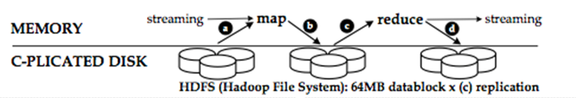
Hadoop Map Reduce
Map-Reduce (MR): a programming model for processing large data sets.
  Google paper @ USENIX OSDI’04
  Hadoop: Apache's open-source MR software.
  Commodity Hardware: 2-3 failures/1000 nodes/day
  ➔ Data Sharding (Data blocks replicated to 3 disks)
TACHYON Main Memory Caching
Processing Facts:
  1 TB on 1 PC = 2 hours!
  1 TB on 100 PCs = 1 min!
I/O tasks can be turned into Main-Memory (Tachyon)

Slide 10
H-NJ Algorithm
[1] Lu et al. VLDB’12
Hadoop Naïve kNN Join [1]:
  Map-job 1: Transfer O (|O|=n) to each server s_{i} (|S|=m) with n/m objects marked as subset O_{i} (disjoint subsets of O containing n/m objects)
  Reduce-job 1:
  execute O_{i} ⋈_{kNN} O on each s_{i}
  Distributed Brute Force (n²) solution
  Optimal Load Balancing = 1
  Speedup achieved = 1 * n² /m + m *n ☹
O
O₁ ⋈_{kNN} O
O₂ ⋈_{kNN} O
m
O₃ ⋈_{kNN} O
Replication Factor f_{H-NJ}=m
O₄ ⋈_{kNN} O

Slide 11
H-BNLJ Algorithm
[2] Zhang et. al EDBT’12
H. Block Nested Loop kNN Join [2]:
  Map1: Partition O to √m sets yielding m pairs (O_{x},O_{y})
  Reduce1 (Local kNN): Each pair is mapped to single server s_{i}, which computes O_{x}⋈_{kNN}O_{y}
  Map2 (Merge Local kNN): Map results
  of each object o to the same server
  Reduce2 (Global kNN): top-k per object
  Distributed Brute Force (n²)
  Optimal Load Balancing = 1
  Speedup = 1 * n² /m + 2√m *n
  (each of the m server receives 2n/√m objects)
  ☹
MR1
MR2
(O_{x},O_{x})
o_{a}={ … }
o_{a}={ … }
O
(O_{y},O_{x})
o_{a}={ … }
…
m
O_{x}
O_{y}
(O_{x},O_{y})
√m
(O_{y},O_{y})
all
combos
Replication Factor: f_{H-BNLJ}= 2√m
o_{a}={ … }
…

Slide 12
H-BRJ Optimization
[2] Zhang et. al EDBT’12
H. Block R-tree Nested Loop kNN Join [2]:
  Optimizes Local kNN computation (Reduce-job1) in previous algorithm (H-BNLJ) by building an R-tree on O_{i}
  Distributed R-tree kNN ( n√mlog(n/√m) )
  Optimal Load Balancing = 1
  Speedup =
  1 * n√mlog(n/√m) /m + 2√m *n
MR1
MR2
(O_{x},O_{x})
o_{a}={ … }
o_{a}={ … }
O
(O_{y},O_{x})
o_{a}={ … }
…
m
O_{x}
O_{y}
(O_{x},O_{y})
√m
Replication Factor remains
f_{H-BRJ}= 2√m
(O_{y},O_{y})
all
combos
o_{a}={ … }
…
Notes:
Know how to compute the cpu time here nmlog(n/m)

Slide 13
PGBJ Algorithm
[1] Lu et al. VLDB’12
Partition Group Block kNN Join [1]:
  Preproc.: Scatter √n pivot points in space - O(√n)
  Map1: Map each object to its nearest “pivot” and store
  min and max dist -- O(n√n/m)
  Midstep: √n groups into m clusters O_{i} (balancing) -- O(n)
  Map2: Compute candidates F_{i} for O_{i} (correctness) -- O(n)
  Reduce2: O_{i}⋈_{kNN}F_{i} locally -- O(f_{PGBJ}n²/m²)
√n
pivots &
statistics
only
O₁
O
O₂
m
O’₁
O’₂
O’₃
O’_{m}
O_{m}
O₃
geo-clustering

Slide 14
PGBJ Algorithm
[1] Lu et al. VLDB’12
Partition Group Block kNN Join [1]:
  Preproc.: Scatter √n pivot points in space - O(√n)
  Map1: Map each object to its nearest “pivot” and store
  min and max dist -- O(n√n/m)
  Midstep: √n groups into m clusters O_{i} (balancing) -- O(n)
  Map2: Compute candidates F_{i} for O_{i} (correctness) -- O(n)
  Reduce2: O_{i}⋈_{kNN}F_{i} locally -- O(f_{PGBJ}n²/m²)
  Near-optimal Load Balancing
  Speedup = load_balancing_{PGBJ} * f_{PGBJ}n²/m /m + f_{PGBJ} *n
Replication Factor: f_{PGBJ}
(depends on distribution)

Slide 15
Theoretical Comparison
Map-job 1

Slide 16
Presentation Outline
Introduction
Distributed AkNN
Spitfire Solution
Experimental Comparison
Conclusions

Slide 17
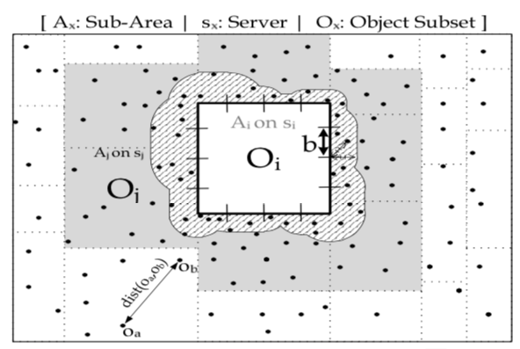
The Spitfire Algorithm
Execution Phases
  Partition problem space onto servers with load balancing
  Replicate border candidates minimally among servers
  Execute locally optimized AkNN
Distributed algorithm implemented in MPI
“Distributed In-Memory Processing of All k Nearest Neighbor Queries, Georgios Chatzimilioudis, Costantinos Costa, Demetrios Zeinalipour-Yazti, Wang-Chien Lee, Evaggelia Pitoura, IEEE TKDE’15

Slide 18
Spitfire - Outline
Partitioning (Geographical) – O(n)
  m disjoint, appr. equally populated subareas (balancing)
  using hash-based equi-depth histograms
Replication -- O( √nn/m )
  s_{i} computes external candidates EC_{ij} for server s_{j}
  transmit EC_{ij} from s_{i} to s_{j}
Local Refinement -- O( f_{Spitfire} n²/m² )
  correct candidates for s_{i} EC_{i} = ∪EC_{ij}
  s_{i} executes locally O_{i} ⋈_{kNN} (O_{i}∪EC_{i}) using optimizations
Note: servers communicate in one single round
j

Slide 19
Spitfire - Partitioning
Partitioning (Geographical) – O(n)
  m disjoint, appr. equally populated subareas (balancing)
  using hash-based equi-depth histograms
Steps:
Hash into equi-width buckets on x-axis
Group x-buckets into √m
approx. equi-depth groups
For each x-group do step 1 and 2 on y-axis
Result:
m appr. equi-depth groups
O(n) → assuming that number of buckets is less than √n

Slide 20
Spitfire - Replication
Replication -- O( √nn/m )
  s_{i} computes external candidates EC_{ij} for server s_{j}
  transmit EC_{ij} from s_{i} to s_{j}
Given a segment b between o₁ and o₃ and k objects closer to b than o₁ and o₃, then o₁ is guaranteed NOT to be a kNN of o₃ and vice versa.
Therefore on each server s_{i} it suffices to search in O_{i} for the kNNs to each border segment and transmit them to the neighboring server s_{j} as the external candidate kNN set EC_{ij}

Slide 21
Spitfire - Replication
Replication -- O( √nn/m )
  s_{i} computes external candidates EC_{ij} for server s_{j}
  transmit EC_{ij} from s_{i} to s_{j}
s_{i}
EC_{ij}
assume k=2
b
k closest objects to b
θ
to s_{j}
kth closest
upper bound distance θ between kth closest and border
θ

Slide 22
Spitfire - Replication
Replication -- O( √nn/m )
Steps:
  Divide borders into √n segments to minimize candidates
  Compute candidates for each segment b:
    Floyd Min Heap H from O_{i} based on mindist to b -- O(n/m)
    Determine the kth closest object to b by popping H k times f
    Compute maxdist between kth closest and b called θ
    Scan O_{i} for objects that are closer than θ to border b
  Generate EC_{ij} from union of candidates for each neighboring s_{j}

Slide 23
Spitfire - Replication
Replication -- O( √nn/m )
  each server s_{i} will have all the needed candidates
  EC_{i} = ∪EC_{ij} to compute O_{i} ⋈_{kNN} (O_{i}∪EC_{i}) locally
j

Slide 24
Spitfire - Refinement
Local Refinement -- O( f_{Spitfire} n²/m² )
  execute locally O_{i} ⋈_{kNN} (O_{i}∪EC_{i}) using optimizations
s_{i}
  Same intuition:
  Partition using a grid
  Find candidates per cell
  Refinement per cell
⋈_{kNN}
EC_{i}

Slide 25
Presentation Outline
Introduction
Distributed AkNN
Spitfire Solution
Experimental Comparison
Conclusions

Slide 26
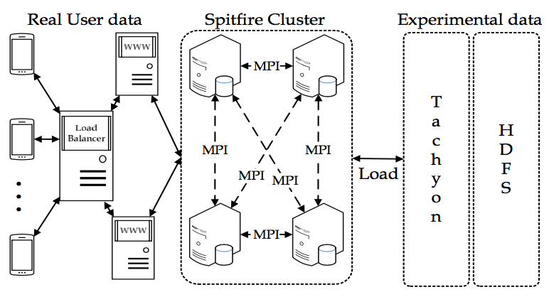
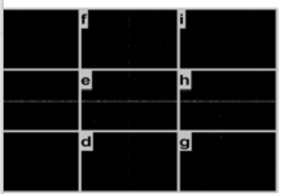
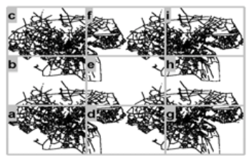
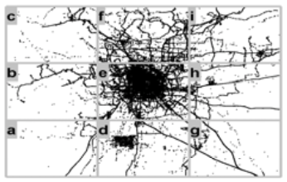
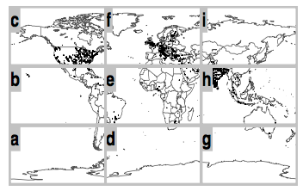
Evaluation Testbed
9 computing nodes
8 GB RAM
2 CPUs@2.40GHz
MapReduce overTachyon (memory-centric file system)
Datasets:
  Random (synthetic) – uniform distribution
  Oldenburg (realistic) – skewed distribution
  Geolife (realistic) – very skewed distribution
  Rayzit (real) – skewed distribution up to 2*104 users

Slide 27
Experimental Evaluation
Plot for most skewed dataset. Others have similar results
Spitfire outperforms
Spitfire and PGBJ scale better than H-BNLJ and H-BRJ
who run out of memory

Slide 28
Experimental Evaluation
Spitfire partitioning is much faster than PGBJ
PGBJ is growing exponentially
H-BNLJ and H-BRJ do not partition geographically → suffer in refinement
Same response times for all datasets → partitioning independent of dataset

Slide 29
Experimental Evaluation
Plot for most skewed dataset. Others have similar results
f_{Spitfire} outperforms (optimal value for f is 1)
f_{Spitfire} drops as n increases (scalability)
f_{H-BNLJ} and f_{H-BRJ} = 2m^{0.5}, independent of n
Replication factor offers clear comparison independent of implementation

Slide 30
Experimental Evaluation
Spitfire outperforms
Spitfire scales much better as k increases, almost linearly
due to much smaller replication factor (not shown)

Slide 31
Experimental Evaluation
Spitfire outperforms
Spitfire scales much better as m increases
→ greater speed-up achieved as computational resources are added

Slide 32
Presentation Outline
Introduction
AkNN Query Processing
Spitfire Solution
Experimental Comparison
Future Work

Slide 33
Future Work
Temporal extension to answer continuous AkNN queries (e.g., streaming data)
Provide an approximate AkNN version
Develop online geographic hash-based partitioning

Slide 34
Επεξεργασία Επερωτήσεων k Πλησιέστερων Γειτόνων Όλων των Αντικειμένων σε Κατανεμημένη Κύρια Μνήμη
Ευχαριστώ! Ερωτήσεις;
Γεώργιος Χατζημηλιούδης¹, Κωνσταντίνος Κώστα¹,
Δημήτρης Ζεϊναλιπούρ¹, Wang-Chien Lee², Ευαγγελία Πιτουρά³
University
of Ioannina
14^{ο} Ελληνικό Συμπόσιο Διαχείρισης Δεδομένων
28-29 Ιουλίου 2016, Αθήνα
“Distributed In-Memory Processing of All k Nearest Neigbhor Queries”, in IEEE Transactions on Knowledge and Data Engineering (TKDE '16), Volume 28, Pages: 925-938, 2016

