Slide 1
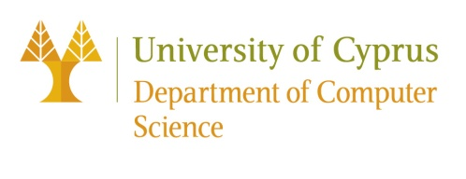
OligoArchive: Using DNA in the DBMS storage hierarchy
EPL646: Advanced Topics in Databases
OligoArchive: Using DNA in the DBMS storage hierarchy. Appuswamy, Raja; Lebrigand, Kevin; Barbry, Pascal; Antonini, Marc; Madderson, Olivier; Freemont, Paul; McDonald, James; Heinis, Thomas, CIDR 2019, Biennal Conference on Innovative Data Systems Research, January 13-16, 2019, Asilomar, California, USA.
By: Pedro Silva (psilva01@cs.ucy.ac.cy)
Catarina Carvalho (cpatri01@cs.ucy.ac.cy)
Joanna Georgiou (jgeorg02@cs.ucy.ac.cy)

Slide 2
Presentation Outline (Indicative)
Introduction
Background
OligoAarchive Architecture
Dna Data Storage
In - Vitro Query Processing
Experimental Evaluation
Conclusions / Future Work

Slide 3
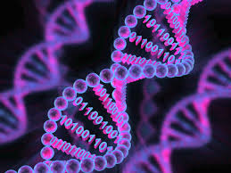
Introduction
Driven by the promise of data analytics, enterprises have started gathering vast amounts of data from diverse data sources.
DNA possesses four key properties that make it relevant for archival storage.
Extremely dense threedimensional storage medium that has the theoretical ability to store 455 Exabytes in 1 gram;
DNA can last several centuries when stored at standard temperature in an anoxic, anhydrous atmosphere;
It is very easy, quick, and cheap to perform in-vitro replication of DNA;
The difference in Kryder’s rate. The Kryder’s rate for DNA is theoretically zero given that the density of DNA is biologically fixed.

Slide 4
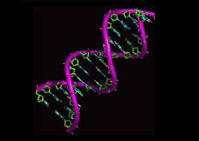
Introduction
In this paper, we investigate the implications of integrating DNA in the DBMS storage hierarchy. We present OligoArchive, an architecture for using a DNA-based storage system as the archival tier of a relational DBMS.
Database schema awareness can be used to improve density during the encoding process, and assist in identifying errors during the decoding process;
SQL operations that are traditionally executed by the DBMS in-silico can be translated into biochemical techniques that can be executed in-vitro;

Slide 5
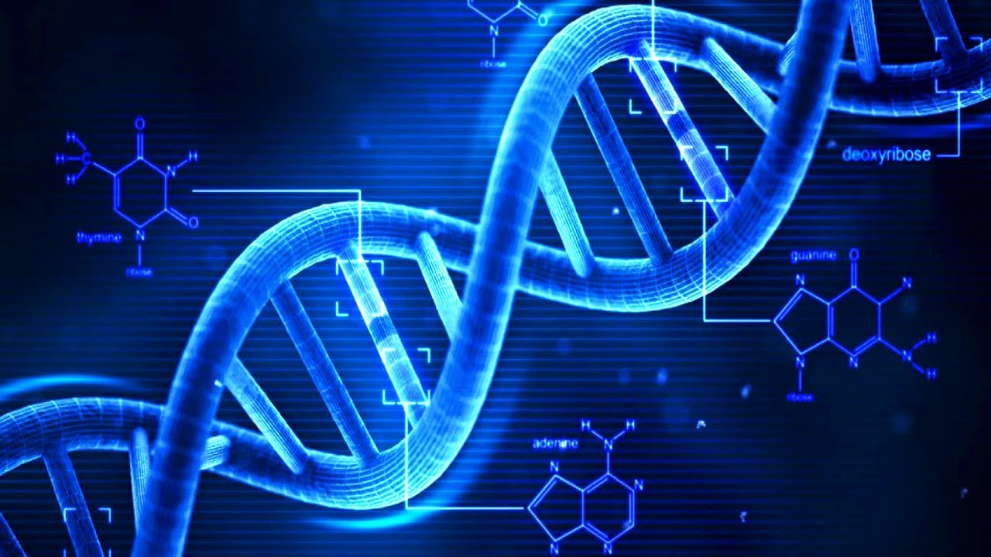
Background
DNA (Deoxyribo Nucleic Acid): Macro-molecule carries genetic code required for functioning of all living organism.
Nucleotides: Small blocks of DNA.
(A) Adenine , (C) Cytosine, (G) Guanine, (T) Thymine
Oligonucleotide (oligo): A single stranded sequence of nucleotides used for data storage; is synthesized one nucleotide at a time.
To read encoded nucleotide sequence: By sequencing oligos.
Polymerase Chain Reaction (PCR): First step of sequencing;
constraining of DNA.
PCR Input: a template DNA strand, a polymerase enzyme,
sequencing primers, and individual nucleotides.

Slide 6
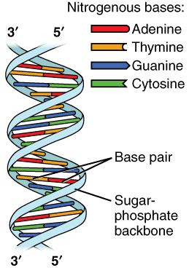
Background
Sequencing By Synthesis: synthesizes a double stranded DNA from the single-stranded template, similar to PCR.
Fluorescent Nucleotides: each nucleotide emits a different color.
Paired-end Sequencing:
As the polymerase assembles nucleotides, fluorescent microscopy is used to record the emitted color.
Each nucleotide is recognized through software.
Often preferred to single-end sequencing due to the ability to recover from sequencing errors due to higher coverage.

Slide 7
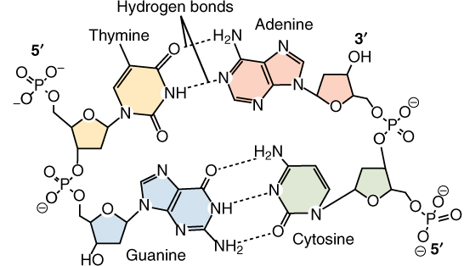
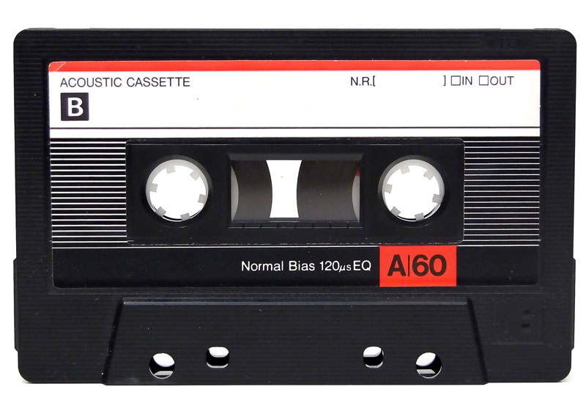
Background
Assumption: DNA storage will become cost effective.
DNA synthesis costs approximately 1% to 10% of a cent per nucleotide.
Maximum information capacity of a nucleotide is 2 bits.
10⁷
TIMES
Future: Promising work on new enzymatic synthesis technologies and parallel array synthesis techniques are expected to also make large-scale synthesis of oligos affordable.

Slide 8
OligoArchive Architecture
OLTP
Performance
DRAM / Flash (SSD)
OLAP
Data accessed by latency-intensitive batch analytics applications
Capacity
Hard Disk Drives
Data that are accessed very rarely
Archival
Virtual Tape Libraries (VTL)
replace
OligoArchive

Slide 9
Database Engine
OligoArchive Database: responsible for converting data back and forth between the relational on-disk data format and oligonucleotide sequences.
Maximum Length of each Oligo: few hundred to few thousand nucleotides.
Random Access: is achieved using library sequencing primers.
> 1000
oligos
Database–DNA storage division of labor: Conversion between relational data and textual representation of oligonucleotide sequences. Both synthesis and sequencing are error prone as shown by truncated, extended, and erroneous reads during a get.

Slide 10
Database Engine (Errors - Problems)
Coupling Efficiency: the probability that a nucleotide binds to the oligo during the synthesis procedure. - longer oligos, more more errors, low efficiency
Fake Oligos: oligos that do not match the synthesis input and were produced by the synthesis procedure. - during sequencing they may be covered by generating invalid data
Sequencing Errors: Substitution errors and indel errors.
Substitution Errors: The sequencer reports wrong nucleotide. - found on short-read sequencers
Indel Errors: The sequencer inserts or deletes fake nucleotides. - found on long-read sequencers
Problem: Some oligos may not be sequenced. - Solution: The encoder adds error metadata that can be used by the decoder to recover data back.
Structural Complexity: The encoder must avoid generating problematic oligonucleotide sequences.

Slide 11
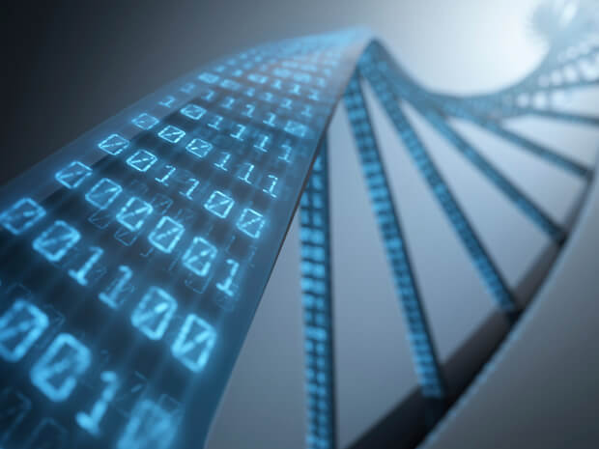
DNA Storage System
Storing Oligos: Object store. ( textfiles that contain textual representations of oligonucleotides that encode the data corresponding to a primer )
Primer: uniquely identifies a group of oligos.
Database Engine: Only encoding and decoding.
Storage System: Only sequencing and synthesizing.
Storage Device: responsible for encoding-synthesis during a put operation and decoding-requencing during a get operation.
Synthesizer: Handles a put operation by using the primer and payload oligos to generate synthetic DNA.
Sequencer: Handles a get operation by using the primer to filter and extract all DNA strands that correspond to that primer.

Slide 12
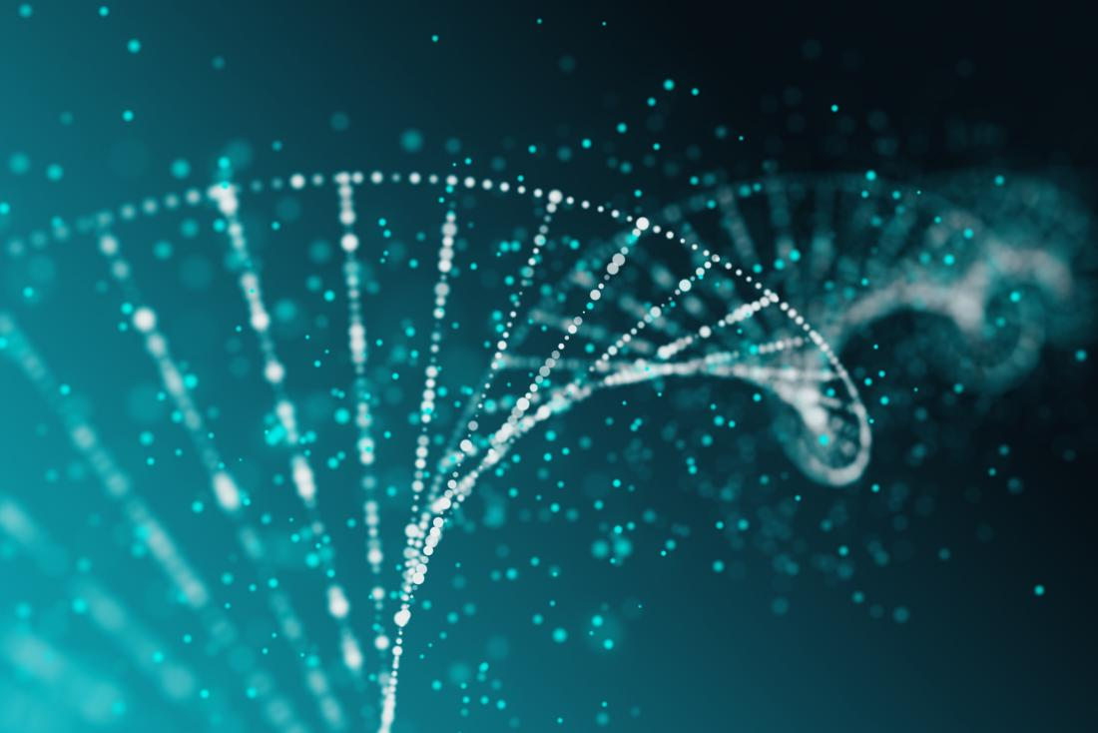
Pg_oligo_dump: Encoding data
Extraction and preprocessing: The first stage in the pipeline uses existing support functions in PostgreSQL to extract the data out of the database. Once extracted, dictionary encoding is applied to convert variable length string fields into fixed length integers. This process reduces the record length, making it possible to pack multiple records in a single oligo.

Slide 13
Pg_oligo_dump: Encoding data
DNA data representation: In this approach, relational data is ﬁrst converted using a Huffman code into a sequence of ternary digits in base3 format. Each ternary digit is then mapped to a nucleotide using a rotating code.
This figure shows how a relational tuple is encoded into oligonucleotide sequences.

Slide 14
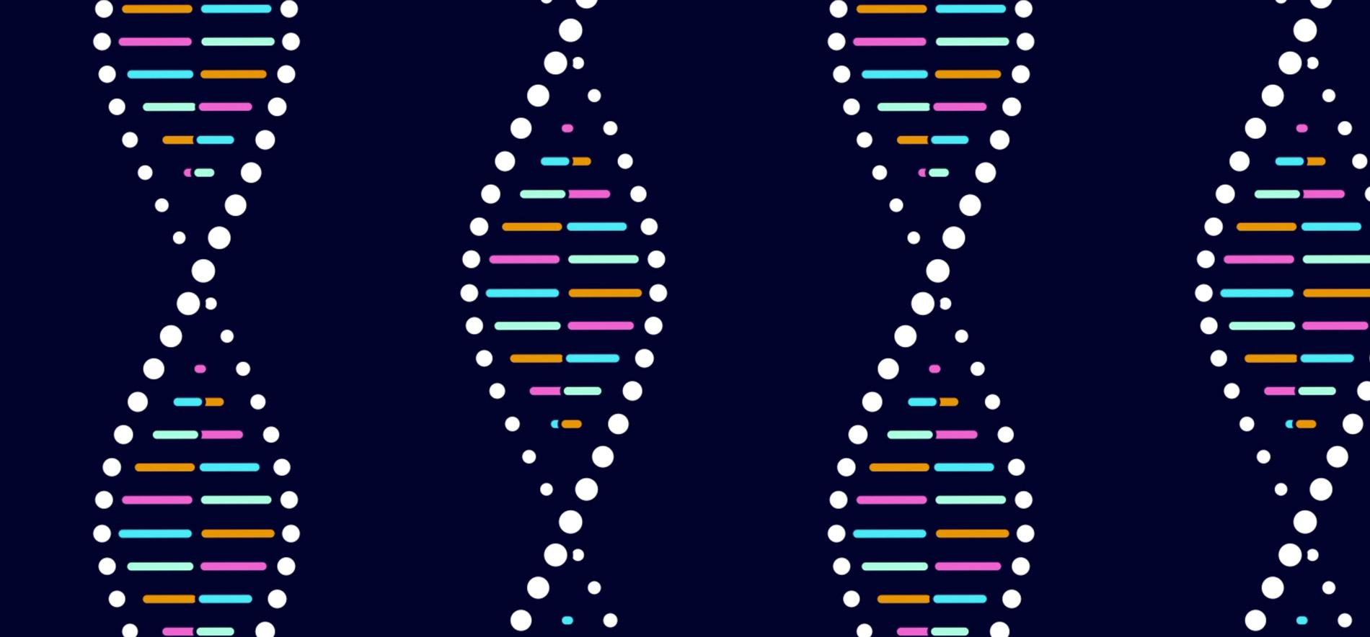
Pg_oligo_dump: Encoding data
Schema-aware encoding: All current approaches to DNA storage, including the work from Goldman et al., are application agnostic. Thus, they work on binary blobs with no inherent structure.
Each oligo is limited to a length of few hundred nucleotides due to synthesis limitations. Each blob is broken into several chunks, and each chunk is encoded in a single oligo.
Assuming 2 bits per nucleotide, if each oligo has L nucleotides, N nucleotides are reserved for storing addressing information, where N is log4K given K, the number of segments.

Slide 15
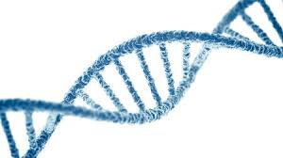
Pg_oligo_dump: Encoding data
Schema-aware encoding:
Each table in a relational database has clearly defined primary keys that can uniquely identify records. Thus, if we encode data such that each oligo maps to a record, no additional addressing information is needed as the logical information already provides structure. However, tables also vary with respect the number of columns and record sizes.
Thus, for some tables, it might be possible to encode more than one record in an oligo, while for others, a record might be too large to fit in a single oligo. Thus, our encoding scheme treats these cases separately.

Slide 16
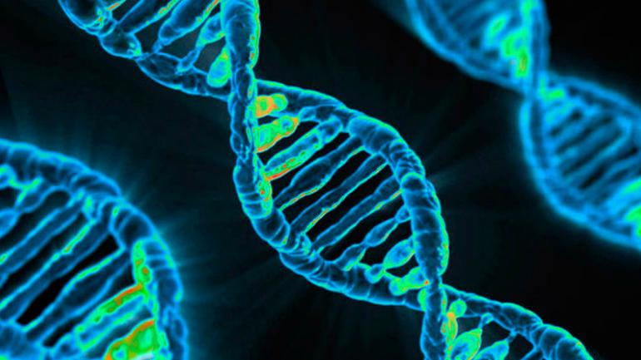
Pg_oligo_dump: Encoding data
Schema-aware encoding: Each table is assigned a unique ID which is encoded in all oligos belonging to that table using three nucleotides. We use three nucleotides as the TPC-H database we encode has nine files, namely, eight tables and one dictionary.
A record never crosses an oligo boundary and these tables do not need any further addressing information.
This encoding reduces the addressing overhead from log4K, where K is the number of segments, to log4C, where C is the table cardinality. Finally, for the dictionary, the encoder uses the traditional approach by breaking it into chunks that are explicitly indexed.

Slide 17
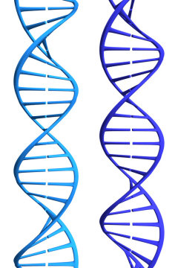
Pg_oligo_dump: Encoding data
Error correction metadata: After data has been encoded, the encoder also adds additional metadata for error correction. To recover from such errors, the encoder also mirrors each oligo by duplicating and reverse complementing it (reversing the order and switching Gs/As with Ts/Cs and vice versa).
Finally, sequencing primers are added to either end of each oligo and the oligo string is written out to a file.

Slide 18
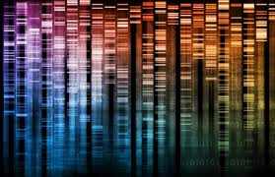
Pg_oligo_restore: Decoding data
Pg_oligo_restore starts with two files containing all the paired end reads produced by the sequencer of the DNA storage system.First, it uses well-known algorithms for merging the forward and reverse reads into a single consensus read-assembly file.
As pg_oligo_encode stores each oligo twice both in forward and reverse complemented form, pg_oligo_restore attempts to pair each oligo with its reverse complement, discarding oligos that do not have a corresponding pair,
It groups oligos into bins based on their table ID and processes each table separately depending on the type of encoding used.
Finally, pg_oligo_restore uses the dictionary to restore back the originally record with variable length string fields, and uses existing data importing facilities available in PostgreSQL to import data back into the database.

Slide 19
In-Vitro Query Processing
Extensions to the database engine were investigated for enabling encoding and decoding of data on DNA. However, DNA, and the mechanisms used to manipulate it, have also been used for computation in a handful of case studies . DNA, as a computing medium, does not provide any fundamentally new computational capability, nor is manipulation of one oligionucelotide particularly fast. Its promise, however, lies in the unprecedented parallelism, and processing data directly in the DNA storage by realizing SQL operations using molecular biology techniques. More precisely, with the help of PCR, DNA nucleases and overlap-directed DNA assembly methods, we can execute selection, projection as well as joins on the records encoded as oligos. The sensitivity of these molecular biology techniques is sufficient to perform operations on single oligos in a background of billions of irrelevant oligos.

Slide 20
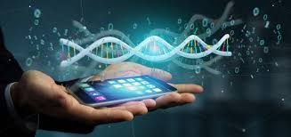
In-Vitro Query Processing
Depending on how the data is encoded as oligos, this means that PCR can find a single record of a few Bytes in a database of 46 TBThus, in the context of DNA storage and relational query processing, using DNA computing promises to perform operations orders of magnitude faster thanks to the unprecedented parallelism compared to traditional computing. Pushing down operations to DNA storage can deplete the oligos. However, using in vitro amplification methods DNA can efficiently and cheaply be replicated on a massive scale.

Slide 21
Encoding and Synthesis
The input data consists of 44 records stored across eight tables with a total size of 12KB.
After loading the data into a PostgreSQL database, we use pg_oligo_dump to generate oligos of 138 nucleotides each. Of the 138 nucleotides, data is encoded in 91 nucleotides and the remainder is used by 5’ and 3’ primers that use 26 and 21 nucleotides respectively.
In addition, we also encoded the string dictionary which generated 346 oligos, and two images (for other experimental purposes) to generate 1547 oligos.
Thus, we synthesized a total of 1941 oligos of 150 nucleotides covering 12KB of TPC-H data and two images.

Slide 22
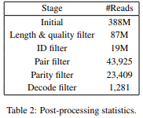
Sequencing and Restoration
At a first stage the synthesized oligos were prepared for sequencing by amplification. A platform is used for resequencing the library which produced 625 million reads. An analysis of these reads revealed that only 2 million of these reads were error free reads, indicating the existence of large number of errors in the sequencing process. On analyzing the reads there can be found the existence of low nucleotide diversity across reads, particularly in the metadata region of oligos, that contributed to an increase sequencing errors. In order to improve diversity, a spike-in sequencing was used which substantially improves the overall quality of reads. Table 2 shows statistics about each stage of the postprocessing phase for the sequencing run with spike-in. Although these reads cover the original oligos there were several erroneous reads that were minor variations of the original oligos with nucleotide substitutions. In spite of such errors, schema information was used to easily identify erroneous data and perform a full recovery and restoration of the original database automatically.

Slide 23
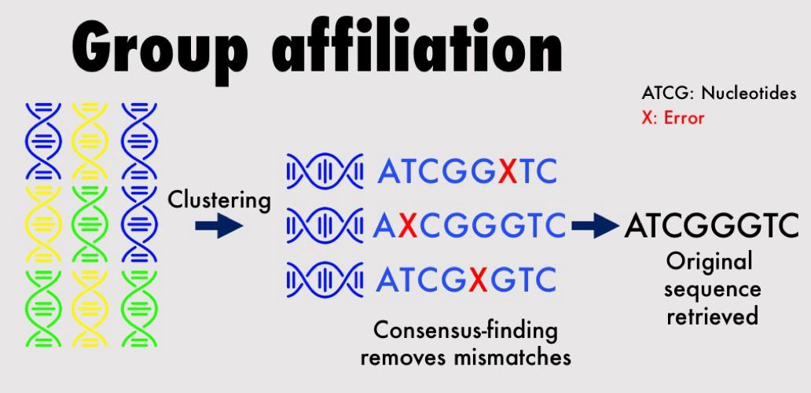
Sequencing and Restoration
Although the data was fully recovered using a decoder due to very high sequencing coverage, further analysis is required to understand the scalability of our decoding process for both larger database sizes, and lower degrees of sequencing coverage. However, such human-in-the-loop techniques do not work at scale. Thus an investigation is being done on the use of clustering algorithms for grouping oligos into similar sets and developing consensus based on approximate string matching

Slide 24
In-Vitro Query Processing
Selection: Use of two different records/oligos from the supplier table, add the high concentration to emulate the background, encode them. The resulting linear oligos are then amplified using PCR. Then a Nanopore sequencing is used to read out a specific oligo encoding the partkey attribute of the partsupp table in a background of random oligos (same length).
Join: Combine matching oligos in massive counts and increasing number of non matching ones. The initial recombining reaction was conducted using known primers that specifically anneal to each other combined in a mixture with a pool of primers with randomized bases.
Nanopore Sequencing: correctly reads out the correct join results by sequencing from the join reaction.

Slide 25
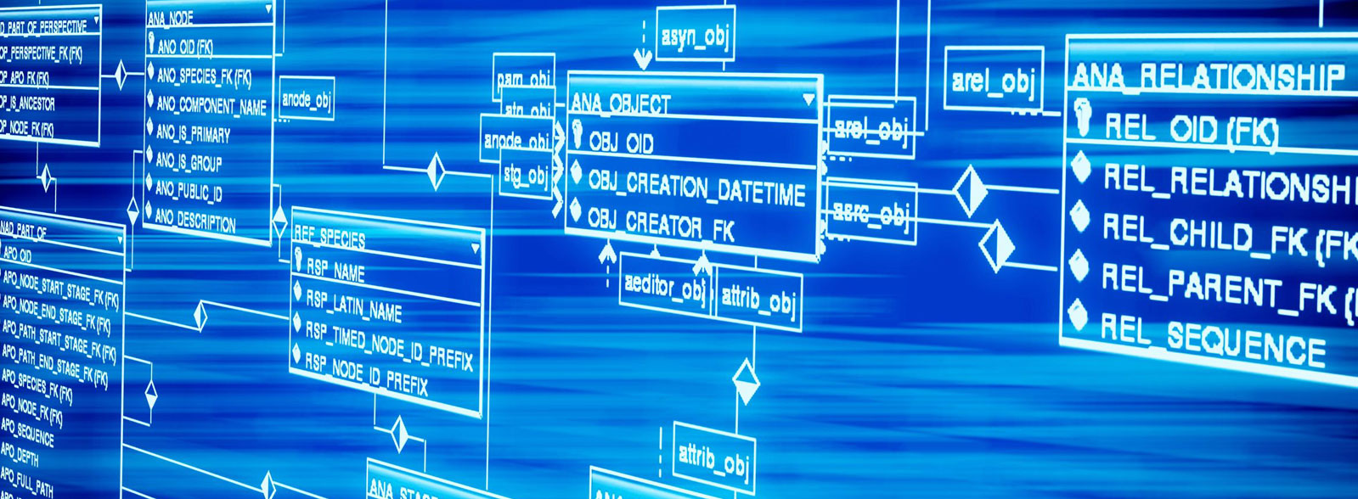
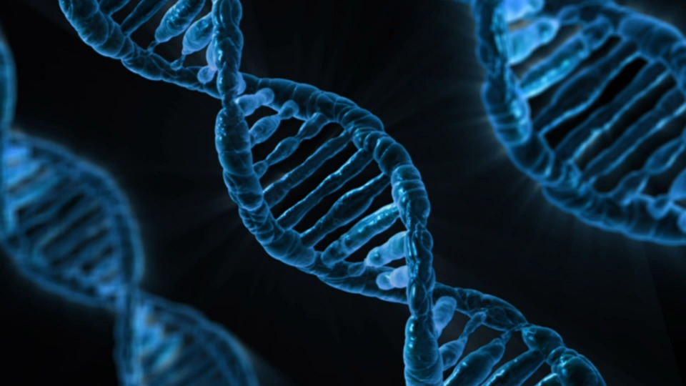
Conclusion
Driven by recent advances in the biotechnology industry, computer architects have recently argued that time has come for integrating biomolecules as an integral part of system design . In this presentation we took a look at take the first step from the perspective of data management systems towards this goal by presenting OligoArchive – an architecture for using DNA as an archive of a relational DBMS. Our paper study shows that it is not only possible to archive and restore data using synthetic DNA, but also exploit database knowledge for optimizing the encoding and decoding process, and even execute SQL operations directly over DNA. In conclusion we can define OligoArchive as a new revolutionary type of data management systems that is not just biological inspired, but biologically powered.

Slide 26
References
[1] L. Adleman. Molecular Computation of Solutions to Combinatorial Problems. Science, 266(5187), 1994.
[2] R. Appuswamy, R. Borovica-Gaji´c, G. Graefe, and A. Ailamaki. The Five-minute Rule Thirty Years Later and its Impact on the Storage Hierarchy. In ADMS, 2017.
[3] S. Balakrishnan, R. Black, A. Donnelly, P. England, A. Glass, D. Harper, S. Legtchenko, A. Ogus, E. Peterson, and A. Rowstron. Pelican: A Building Block for Exascale Cold Data Storage. In OSDI, 2014.
[4] J. M. S. Bartlett and D. Stirling. A History of the Polymerase Chain Reaction. PCR Protocols, 2003.
[5] J. Bonnet, P. Yin, M. E. Ortiz, P. Subsoontorn, and D. Endy. Amplifying Genetic Logic Gates. Science, 340(6132), 2013.

Slide 27
References
[6] J. Bornholt, R. Lopez, D. M. Carmean, L. Ceze, G. Seelig, and K. Strauss. A DNA-Based Archival Storage System. In ASPLOS, 2016.
[7] R. Borovica-Gaji´c, R. Appuswamy, and A. Ailamaki. Cheap Data Analytics using Cold Storage Devices. In VLDB, 2016.
[8] R. Carlson. Time for new dna synthesis and sequencing cost
curves. http://www.synthesis.cc/2014/02/time-for-new-cost-curves-2014.html, 2014.
[9] A. Casini, M. Storch, G. S. Baldwin, and T. Ellis. Bricks and Blueprints: Methods and Standards for DNA Assembly. Nature Reviews Molecular Cell Biology, 16(9), 2015.
[10] Y. Erlich and D. Zielinski. DNA Fountain enables a robust and efficient storage architecture. Science, 355(6328), 2017.
[11] R. Fontana. A Ten Year Storage Landscape LTO Tape Media, HDD, NAND. http://storageconference.us/2018/Presentations/Fontana.pdf, 2018.

Slide 28
References
[12] N. Goldman, P. Bertone, S. Chen, C. Dessimoz, E. M. LeProust, B. Sipos, and E. Birney. Toward Practical High-capacity Low-maintenance Storage of Digital Information in Synthesised DNA. Nature, 494, 2013.
[13] R. N. Grass, R. Heckel, M. Puddu, D. Paunescu, and W. J. Stark. Robust chemical preservation of digital information on DNA in silica with error-correcting codes. Angew. Chem. Int. Ed., 54, 2015.
[14] A. Hadian and T. Heinis. Towards Batch-Processing on Cold Storage Devices. In ICDE, 2018.
[15] Imagene. DNA Shell and RNA Shell. http://www.imagene.eu/.
[16] Intel. Cold Storage in the Cloud: Trends, Challenges, and Solutions. White Paper.
[17] S. Kosuri and G. M. Church. Large-scale de novo DNA synthesis: technologies and applications. Nature Methods, 11(5), 2014.

Slide 29
References
[18] H. H. Lee, R. Kalhor, N. Goela, J. Bolot, and G. M. Church. Enzymatic dna synthesis for digital information storage. bioRxiv, 2018.
[19] T. Notomi, H. Okayama, H. Masubuchi, T. Yonekawa, K. Watanabe, N. Amino, and T. Hase. Loop-mediated isothermal amplification of dna. Nucleic Acids Research, 28(12):e63, 2000.
[20] L. Organick, S. D. Ang, Y.-J. Chen, R. Lopez, S. Yekhanin, K. Makarychev, M. Z. Racz, G. Kamath, P. Gopalan, B. Nguyen, C. N. Takahashi, S. Newman, H.-Y. Parker, C. Rashtchian, K. Stewart, G. Gupta, R. Carlson, J. Mulligan, D. Carmean, G. Seelig, L. Ceze, and K. Strauss. Random access in large-scale DNA data storage. Nature Methods, 11(5), 2014.
[21] PCWorld. Facebook uses 10,000 blu-ray discs to store ’cold’ data. http://www.pcworld.com/article/2092420/facebook-puts-10000-bluray-discs-in-lowpower-storage-system.html.

Slide 30
References
[22] M. Perlmutter. The Lost Picture Show: Hollywood Archivists Cannot Outpace Obsolescence. https://spectrum.ieee.org/computing/it/the-lost-picture-show-hollywood-archivists-cant-outpace-obsolescence, 2017.
[23] C. Rashtchian, K. Makarychev, M. Racz, S. Ang, D. Jevdjic, S. Yekhanin, L. Ceze, and K. Strauss. Clustering billions of reads for dna data storage. In I. Guyon, U. V. Luxburg, S. Bengio, H. Wallach, R. Fergus, S. Vishwanathan, and R. Garnett, editors, NIPS. 2017.
[24] R. J. Roberts and K. Murray. Restriction Endonuclease. CRC Critical Reviews in Biochemistry, 4(2):123–164, 1976.
[25] D. Rosenthal. The Medium Term Prospects for Long Term Storage. https://blog.dshr.org/2016/12/the-medium-term-prospects-for-long-term.html, 2016.

Slide 31
References
[26] G. F. Schneider and C. Dekker. DNA Sequencing with Nanopores. Nature Biotechnology, 30:326, apr 2012.
[27] J.-J. Shu, Q.-W. Wang, and K.-Y. Yong. DNA-Based Computing of Strategic Assignment Problems. Phys. Rev. Lett., 106, May 2011.
[28] W. Yan, J. Yao, Q. Cao, C. Xie, and H. Jiang. ROS: A Rack-based Optical Storage System with Inline Accessibility for Long-Term Data Preservation. In EUROSYS, 2017.
[29] S. M. H. T. Yazdi, Y. Yuan, J. Ma, H. Zhao, and O. Milenkovic. A Rewritable, Random-Access DNA-Based Storage System. Nature Scientific Reports, 5(14318), 2015.
[30] J. Zhang, K. Kobert, T. Flouri, and A. Stamatakis. PEAR: a fast and accurate Illumina Paired-End reAd mergeR .Bioinformatics, 30(5), 2013.

