Slide 2
Introduction
Need for sports organizations and professionals to effective use the existing market opportunities
Erratic and chaotic digital transformation
Notes:
There is a real need in sports industry for a digital transformation. This transformation involves both professionals and organizations (i.e. clubs, for-profit companies, foundations, etc.).
There are dozens of instruments and technologies developed for being applied in different sports fields. However, the use and penetration of these technologies by professionals and organizations are erratic and somehow chaotic. The lack of penetration pattern, planning guidelines or needs study makes ineffective this digital transformation. Causing both professionals and organizations to wasting the existing opportunities in the market.
That’s why this project is paramount and that’s transforming the sport world was the vision of the 9 partners to develop this project

Slide 3
Project’s objectives
Further information
Objective 1. Break the barriers of fear of technology and enhance the introduction of new IT tools
Objective 2. Expand the training offer in technological for sports professionals
Objective 3. Create educational contents by promoting interdisciplinary cooperation in technology and sports science
Notes:
These are the three objectives of this project.
Press the image for further information

Slide 4
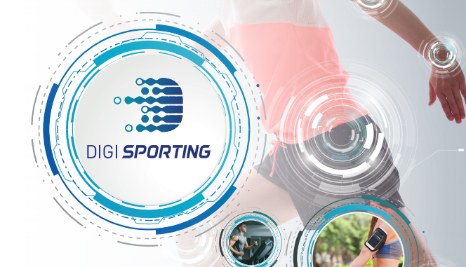
Project’s stages
Stage 1. State-of-the-art
Stage 2. Postgraduate curriculum
Stage 3. Self-diagnostic interactive tool
Stage 4. Quality seal
Notes:
The project is divided into four stages

Slide 5
Stage 1: State-of-the-art
Part 1. Literature review
Technologies for club management
Technologies for physical evaluation, physical tests, injury prevention, healthy and medical technologies
Technologies for training quantification and training activities
Technologies for data analysis, data storage and visualization
Technologies for retransmission and media
Tools from 5 areas were analysed
Notes:
Part 1. Consisted of a literature review. Dozens of sport instruments and tools were reviewed and classified into these five areas

Slide 6
Stage 1: State-of-the-art
Part 2. Expert panel
Technologies for club or entity or entity management.
Technologies for data analysis.
Technologies for reporting and visualization.
Technologies for physical evaluation, physical tests, injury prevention, healthy and medical technologies.
Technologies for training quantification. Physical monitoring.
Technologies for training quantification. Technical-tactical monitoring.
Technologies for retransmission and media.
Identified 7 groups of technologies
Notes:
An expert panel gathered the existing sport technologies into 7 groups according to their use and provided data

Slide 7
Stage 1: State-of-the-art
Part 2. Expert panel
Analytical skills.
ICT skills.
Data management skills.
Ability to make conclusions from research data.
Digital marketing and social media skills.
Skills in the digital management of Big Data
Identify the 5 main competences
Notes:
These expert panel reviewed the 72 competences for sports management and selected the 5 most significant competences to be develop by sport technologists

Slide 8
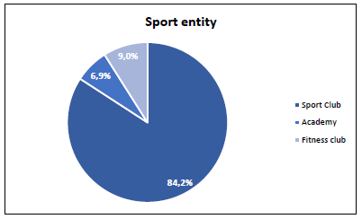
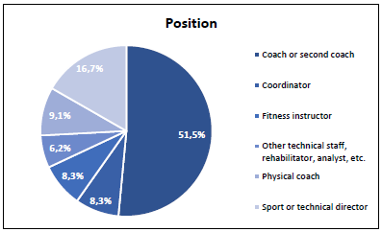
Stage 1: State-of-the-art
Part 3. Questionnaire to sports professionals
569 professionals
Notes:
569 professionals from the participants countries were inquired in order to identify the use of technology in different sports fields, the importance of technology for sports professionals’ work and the gap between the use of these technologies and their importance. Same was performed for the 5 selected competences

Slide 9
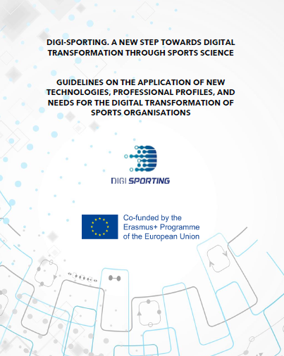
Stage 1: State-of-the-art
Part 4. Main outcomes
Further information
Notes:
These are the main results from these survey
Above Table shows the outcomes for the use, importance and gap of technologies in sport
Below Table shows the outcomes for the use, importance and gap of sports competences
Press in the image to go to https://digi-sporting.eu/wp-content/uploads/2020/07/Handbook.pdf

Slide 10
Step 2. Postgraduate curriculum
Train
To train technologist-analyst for the effective application of new technologies in exercise, sports and physical education context.
Provide
To provide the necessary knowledge to select and integrate technologies for optimization in exercise, sports and physical education context.
Attract
To attract good practical examples of the application of digital transformation technology in exercise, sports and physical education context.
Notes:
These are the main objectives for the postgraduate curriculum to be implemented in Europe universities and business school to support sport professionals in the digital transformation

Slide 11
Step 2. Postgraduate curriculum
Teaching Planning
8 Parts
From Introduction to Final Work
30 ECTS
Final Work
Students profile
Sport Sciences
Physical Education
Kinesiology
… Anyone related with sports
Using:
Digital tools,
Audiovisual contents
Virtual forums
Tutorials.
Teaching methodologies
Theoretical Sessions
Practical Sessions
Workshop and Seminars
Final Work
Notes:
These are the main characteristics of this Postgraduate curriculum

Slide 12
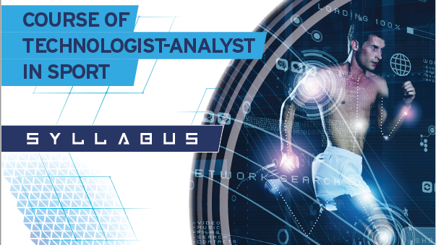

Slide 13
Stage 3. Self-diagnostic interactive tool
To define each sport organizations needs
Self-diagnostic interactive tool
To guide sport organizations in addressing their shortcomings in the digital transformation
To support sport organizations in identifying the most promising tools for covering their needs
Notes:
This self-diagnostic interactive tool will support sport organizations in these three areas

Slide 14
STEP 4. QUALITY SEAL
AT THE END OF THE PROCESS A QUALITY SEAL WILL BE GIVEN TO ALL THE PARTICIPANTS
Notes:
Sport organization will receive a seal according to the degree of digital transformation achieved

