Slide 1
A Policy Environment to build Trust in the Cloud
Mark Lange, Senior Policy Counsel

Slide 2
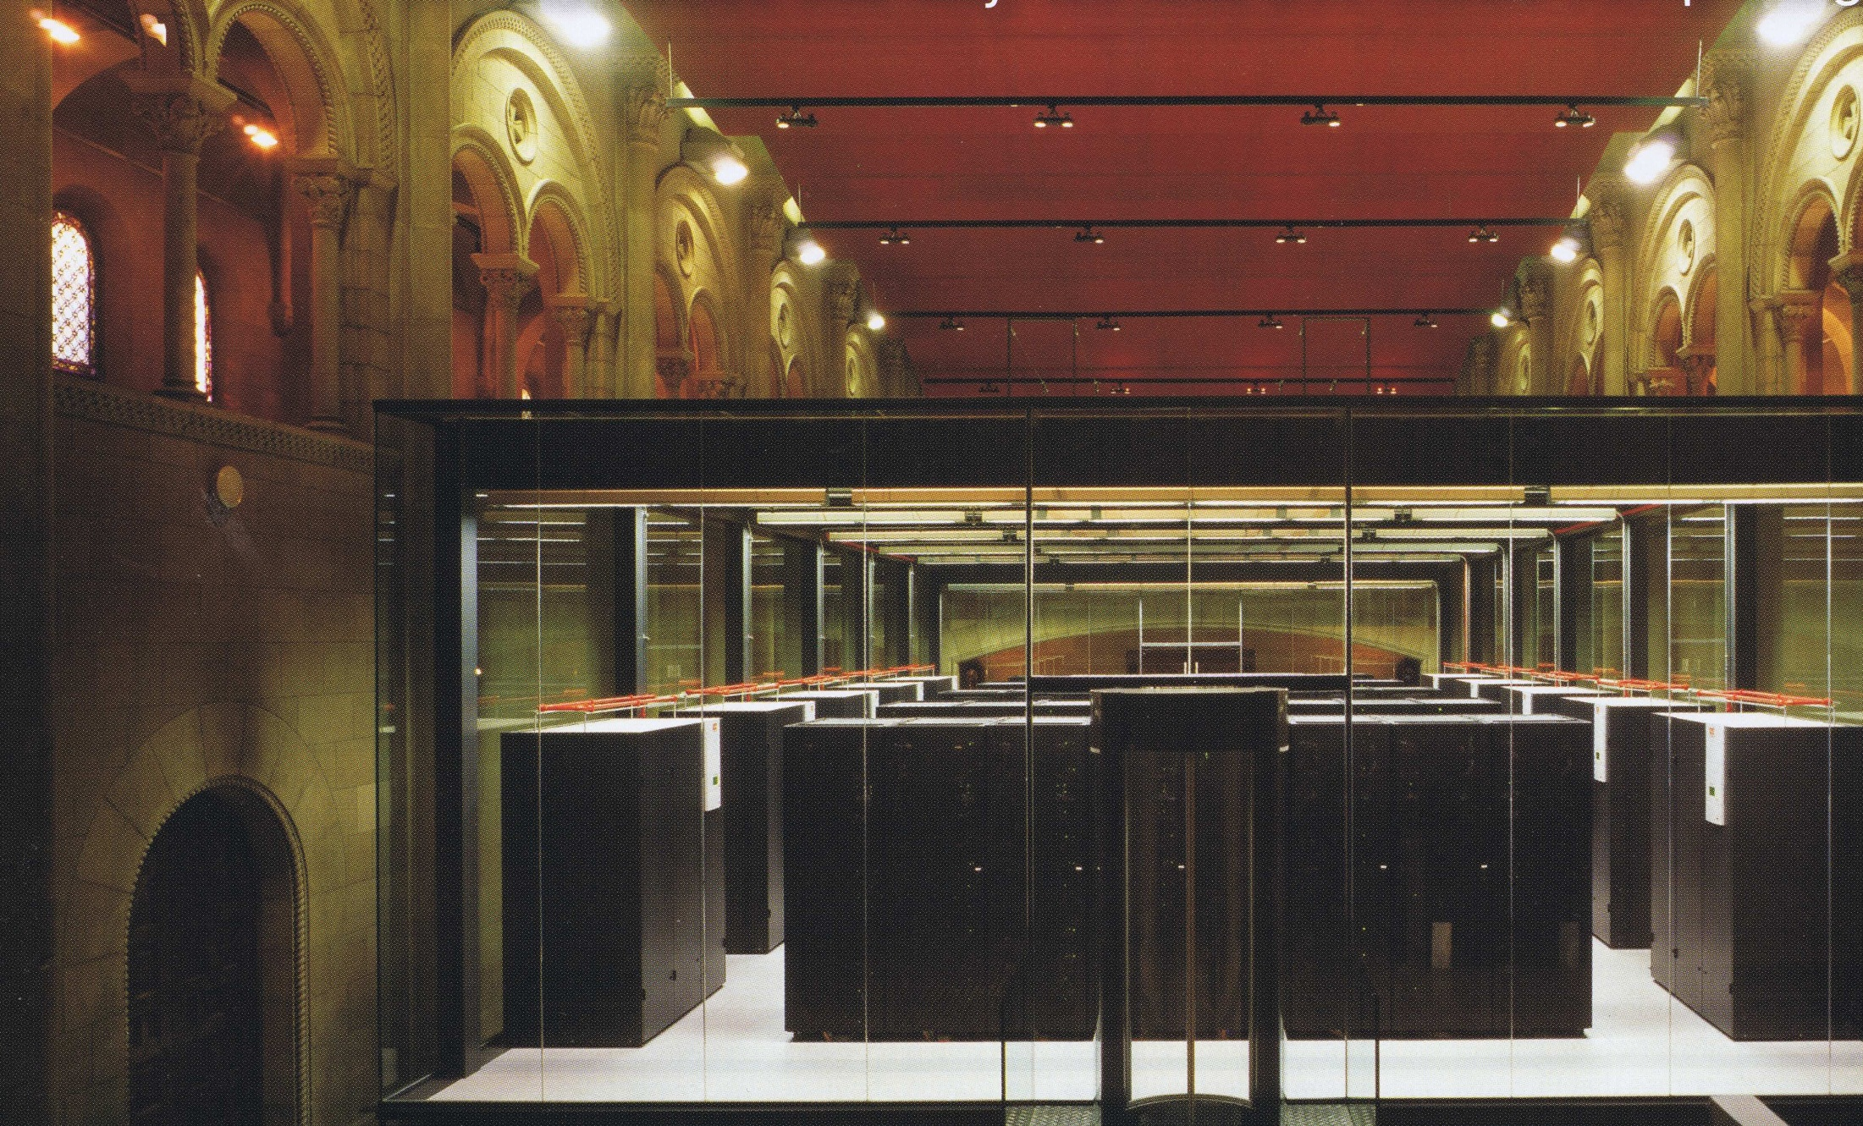
Where is the Cloud ?

Slide 3
Simplifying Cloud Computing
Efficiency
&
Choices

Slide 4
Efficiency
and economies of scale
80% TCO Reduction

Slide 5
Choices…
that interest governments
As users:
Cost savings from more efficient use of IT resources
More efficient services to citizens by scaling up at times of need (e.g., seasonal demand, emergency services)

Slide 6
Choices…
that interest governments
As policymakers:
to promote cloud computing in order to capture benefits for national/regional economies
to protect citizens, users from potential harms

Slide 7
Good for Europe: Cloud and Jobs
Latest IDC study on impact of cloud computing:
Over 1 million net new jobs by 2015
in non-tech sectors using cloud services
only 8 EU countries surveyed
Denmark | 12,185
France | 189,196
Germany | 254,562
Italy | 152,136
Netherlands | 40,741
Poland | 29,261
Spain | 133,961
Sweden | 23,624
United Kingdom | 226,864
Total | 1,062,530
Source: IDC White Paper: “Cloud Computing‘s Role in Job Creation“, March 2012 http://www.microsoft.com/presspass/download/features/2012/IDC_Cloud_jobs_White_Paper.pdf

Slide 8
Good for Europe: Innovative SMEs
European SMEs are creating cloud services to:
manage the load of an EU presidency (Huddle.com)
speed up breast cancer research in Finland (Techila.fi)
open public data for reuse in France (CaptainDash.com)
clean streets in London (bbits.co.uk)
Working with European startups:
>7,500 tech startups in Microsoft BizSpark program
The mutually beneficial ecosystem to grow the overall economic pie

Slide 9
Cloud policy choices
US: “Cloud First”
EU: to announce “Cloud Active” strategy
UK: “G-Cloud” and “cloud first”
France and Germany: national clouds?
Ireland: Cloud a pillar of “Smart Economy” initiative
The Netherlands: examining “cloud first”
Variations:
Walloon Region of Belgium: targets for moving public data to cloud
Denmark: agency devoted to raising awareness/adoption among SME users

Slide 10
Challenges
Some familiar IT policy challenges:
Broadband
Data protection
Security
Interoperability
New context, new urgency
Shift to cloud services accentuates need to address these issues, to enhance reliability, trust
Extent of cross-border data flows requires more coordinated international solutions to reduce barriers
Potential benefits are attractive, economic competitiveness at stake

Slide 11
The EU Policy Discussion

Slide 12
What’s good for Europe?
EU Commissioner Reding in 2009
“Europe's digital economy should be opened up to small businesses. . . Cloud computing…[is] the medicine needed for our credit squeezed economy. . . However, today these new services are nearly all US-owned and US-based. Once again, the US has started to exploit a business model before Europe has managed to do so. We cannot let this continue.”

Slide 13
What’s good for Europe?
EU Vice President Kroes in 2012
Q: much of the technology behind cloud is foreign. Is that a problem? Would you like to see more European cloud technology before uptake here?
A: “What matters much more than where a company originates is whether it gives European companies and citizens services they need and want and that they have access to an overall environment which lets them support jobs in Europe….
We aren't picking winners; we are just creating an environment where there can be more winners.”

Slide 14
What’s good for Europe Germany?
German Consumer Protection Minister Aigner in 2012
“Cloud Computing ‘Made in Germany’ Claim Stirs debate at CeBIT”
“German Consumer Protection Minister Ilse Aigner said that the country's strict laws on data protection ‘could be a competitive advantage.’"

Slide 15
What’s good for Europe?
Justin Pirie, Mimecast
(fast-growing European SME)
“A single market is vital for Cloud Computing to succeed in Europe.
Because there isn’t one and data issues remain, Mimecast is prioritising the US over Europe as our key growth market”

Slide 16
EU Cloud Computing Strategy
VP Kroes announced “cloud active” approach January 2011:
Throughout 2011, extensive consultations
European Cloud Partnership announced January 2012
Initial step: to produce common requirements/specifications for public sector
Communication outlining full Strategy: expected summer 2012

Slide 17
Security and Privacy: EU Data Protection Reform update
Patchwork of regulation is a worldwide problem, slowing cloud adoption
→ Need for EU harmonization is the tip of the iceberg
Commission proposal for comprehensive reform of data protection regime
Positive: Regulation rather than Directive, the One stop shop approach
Concerns: Too prescriptive, new burdens for industry, few incentives
Overall position: Microsoft welcomes government efforts to strengthen and harmonize data protection regime.
Text

Slide 18
Security and Privacy: Responsible and transparent practices
Privacy by Design – development practices
EU Model Clauses – contractual obligations
Office 365 Trust Center - transparency
Private/Hybrid Scenarios - options for all needs
Text

Slide 19
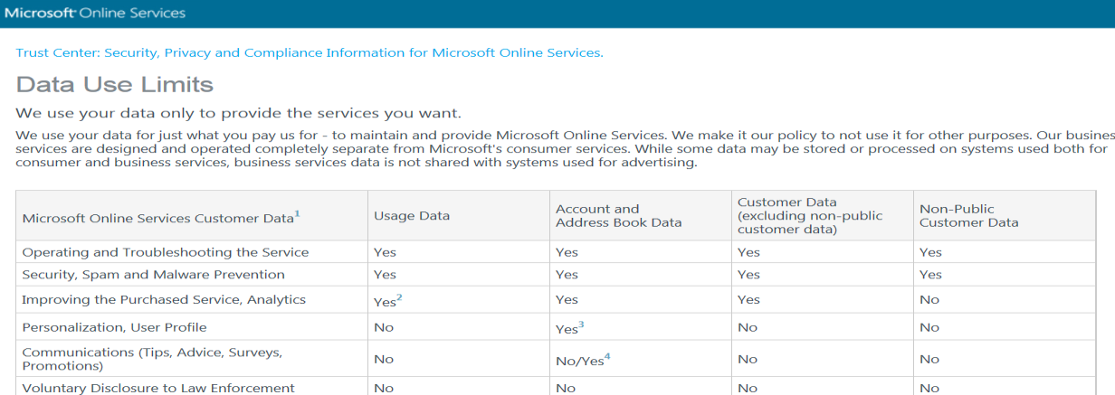
Increasing transparency:
Trust Center

Slide 20
Law Enforcement Access to Data
Law enforcement, anti-terrorism investigations
National approaches
and international agreements: European Cybercrime Convention
Balancing interests with data protection, international trade, national sovereignty
Need greater international cooperation, understanding of mutual objectives, strict limits on data access

Slide 21
Interoperability and
Data Portability
Continuous concern about, and intolerance of, lock-in
Emphasize efforts to increase options and choices, not decrease them
Interoperability Elements of a Cloud Platform
Data portability, Standards, Ease of Migration & Deployment
Developer Choice
It’s Your Data !
Text

Slide 22
Getting smart about data
Data governance encompasses many elements
“Open data” efforts of governments
Which data to protect, which to share
How to protect, how to share
Transparency and accountability of government management of data
Transparency and accountability of vendor practices
Trust and predictability

Slide 23
A Proactive Cloud Policy
Envision the benefits
for government as user
for economy as a whole
Realistically assess risks and challenges
address, eliminate barriers
Promote use of cloud
as element of economic policy
participate in EU strategies to harmonize rules
seek efficiency benefits
make the Single Market work for you

Slide 24
Q&A

Slide 25
Resources

Slide 26
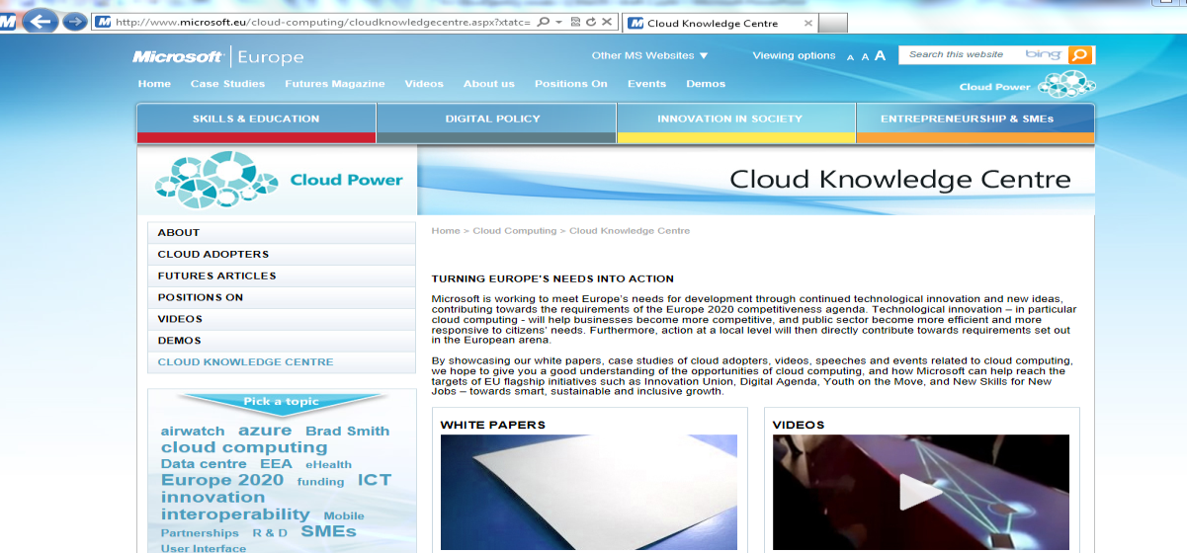
www.microsoft.eu

Slide 27
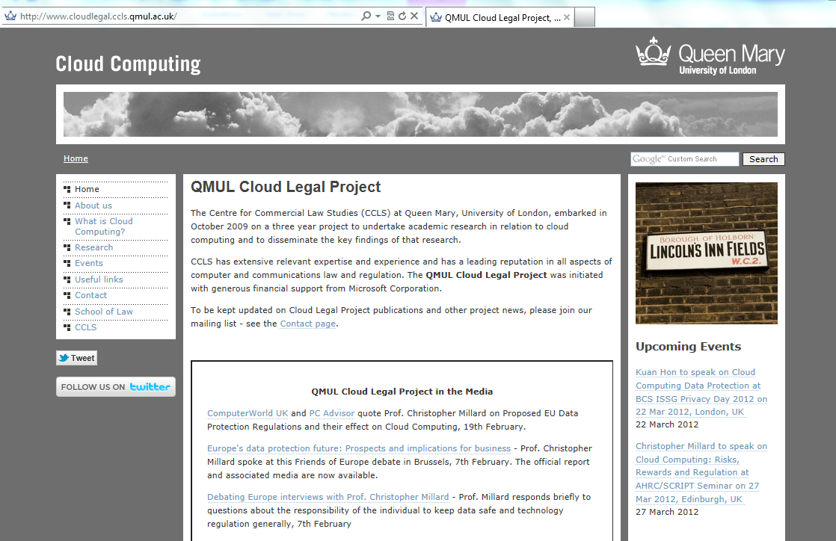
http://www.cloudlegal.ccls.qmul.ac.uk/Research/index.html

Slide 28
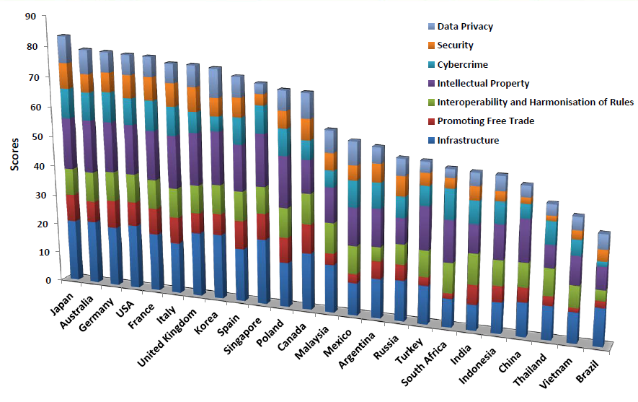
BSA Cloud Computing Scorecard

