Slide 1

Provenance-based Trustworthiness Assessment in Sensor Networks
Elisa Bertino
CERIAS and Department of Computer Science, Purdue University, USA
(Joint work with Hyo-Sang Lim and Yang-Sae Moon)

Slide 2
Data Streams Everywhere
New computing environments
  Ubiquitous/mobile computing, embedded systems, and sensor networks
New applications
  Traffic control systems monitoring data from mobile sensors
  Location based services (LBSs) based on user's continuously changing location
  e-healthcare systems monitoring patient medical conditions
  Real-time financial analysis
What are we interested in?
  Data is originated by multiple distributed sources
  Data is processed by multiple intermediate agents
  Assessing data trustworthiness is crucial for mission critical applications
  Knowing where the data comes from is crucial for assessing data trustworthiness
data trustworthiness
= how much we can trust a data item to be correct
where the data comes from
= data provenance

Slide 3
What is Provenance?
In general,
the origin, or history of something is known as its provenance.
In the context of computer science,
data provenance refers to information documenting how data came to be in its current state - where it originated, how it was generated, and the manipulations it underwent since its creation.

Slide 4
Focus of Our Work
Data Trustworthiness
assessed with
Data Provenance
in Data Stream Environments
(especially, in sensor networks)

Slide 5
Sensor Networks
Sensor networks collect large amounts of data that can convey important information for critical decision making.
  e.g., traffic monitoring, healthcare monitoring, environment/habitat monitoring, SCADA (supervisory control and data acquisition) systems, …
In near future,
  a large number of cheap and tiny sensor nodes will be deployed everywhere
  (e.g., Smart Dust project (UC Berkeley) to create grain-of-sand sized sensors)
  there can be multiple sensor nodes monitoring a same event
  (e.g., mobile sensors deployed in vehicles which are moving in a same street)
Data trustworthiness problems
  Sensor nodes deployed in hostile environments can be manipulated by enemies.
  Sensing accuracy can be temporally dropped due to environmental changes such as severe weather.
  Malfunction, low battery, …

Slide 6


An Example Senor Network:
Battlefield Monitoring Sensor Network
Region A
Region B
Region C

Slide 7
What Makes It Difficult to Solve?
Data stream nature
  Data arrives rapidly → real-time processing requirement → high performance processing
  Unbounded in size → not possible to store the entire set of data items → only can sequentially access data provenance
  Dynamic/adaptive processing
  Sometimes, only approximate (or summary) data are available
Provenance nature
  Annotation → increased as it is transmitted from the source to the server (i.e., snowballing effect)
  Interpretation semantics differ from usual data
Sensor network nature
  Provenance processing in the intermediate node
  (e.g., provenance information can be merged/separated/manipulated)
  Hierarchical structure for network and provenance

Slide 8
Our Solution:
A Cyclic Framework for
Assessing Data Trustworthiness

Slide 9
Modeling Sensor Networks and Data Provenance
A sensor network be a graph, G(N,E)
  N = { n_{i}|n_{i} is a network node of which identifier is i } : a set of sensor nodes
    a terminal node generates a data item and sends it to one or more intermediate or server nodes
    an intermediate node receives data items from terminal or intermediate nodes, and it passes them to intermediate or server nodes
    a server node receives data items and evaluates continuous queries based on those items
  E = { e_{i,j} | e _{i,j} is an edge connecting nodes n_{i} and n_{j}.} : a set of edges connecting sensor nodes
A data provenance, p_{d}
  p_{d} is a subgraph of G
server node
intermediate nodes
terminal
nodes
(a) a physical network
(b) a simple path
(c) an aggregate path
(d) an arbitrary graph

Slide 10
A Cyclic Framework for
Computing Trust Scores
Trust scores : quantitative measures of trustworthiness
  [0, 1] : 0 means totally untrustworthy, 1 means totally trustworthy
  We use 0.5 as an initial trust score since it means uncertain
  provides an indication about the trustworthiness of data items/sensor nodes and can be used for comparison or ranking purpose
Two types of trust scores
  Data trust scores : indicate about how much we can trust the correctness of the items
  Node trust scores : indicate about how much we can trust the sensor nodes to collect correct data
Interdependency between data and node trust scores
The trust score of the node affects
the trust score of the data created by the node
Node Trust Scores
Data Trust Scores
data arrives incrementally
in data stream environments
The trust score of the data affects
the trust score of the sensor nodes that created the data

Slide 11
A Cyclic Framework for
Computing Trust Scores
6
Current trust scores
of nodes ( )
1
Current trust scores
of data items ( )
A set of data items of the same event
in a current window
2
Next trust scores
of nodes ( )
5
Intermediate trust
scores of data items ( )
+
+
3
Intermediate trust
scores of nodes ( )
4
Next trust scores
of data items ( )
Trust score of a data item d
  The current trust score of d is the score computed from the current trust scores of its related nodes.
  The intermediate trust score of d is the score computed from a set (d ∈) D of data items of the same event.
  The next trust score of d is the score computed from its current and intermediate scores.
Trust score of a sensor node n
  The intermediate trust score of n is the score computed from the (next) trust scores of data items.
  The next trust score of n is the score computed from its current and intermediate scores.
  The current trust score of n, is the score assigned to that node at the last stage.

Slide 12
Intermediate Trust Scores of Data
(in more detail)
6
Current trust scores
of nodes ( )
1
Current trust scores
of data items ( )
A set of data items of the same event
in a current window
2
Next trust scores
of nodes ( )
5
+
Intermediate trust
scores of data items ( )
+
3
Intermediate trust
scores of nodes ( )
4
Next trust scores
of data items ( )
Data trust scores are adjusted according to the data value similarities and the provenance similarities of a set of recent data items (i.e., history)
  The more data items have similar values, the higher the trust scores of these items are
  Different provenances of similar data values may increase the trustworthiness of data items
 | Similar Data Value | Different Data Value
Similar Provenance | score ↑ | score ↓↓↓ (conflict)
Different Provenance | score ↑↑↑ (cross checked) | score ↓

Slide 13


Using Data Value and Provenance Similarities
Initiating with data value similarities
  with the mean μ and variance σ² of the history data set D, we assume the current input data follow a normal distribution N (μ, σ²)
  because the mean μ is determined by the majority values in D,
    if x is close to the mean, it is more similar with the other values;
    if x is far from the mean, it is less similar with the other values.
  with this observation, we obtain the initial intermediate score of d (whose value is v_{d}) as the integral area of f(x)
a probability density function , where x is the data value of a data item d
)

Slide 14
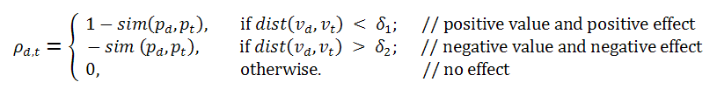
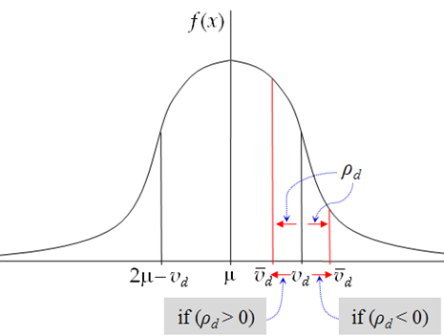

Using Data Value and Provenance Similarities
Adjusting with provenance similarities
  we define the similarity function between two provenances p_{i}, p_{j} as sim(p_{i}, p_{j})
    sim(p_{i}, p_{j}) returns a similarity value in [0, 1]
    it can be computed from the tree or graph similarity measuring algorithms
  from the observation of value and provenance similarities,
  given two data items d, t ∈ D, their values v_{d}, v_{t} , and their provenances p_{d} , p_{t}
  (here, notation ‘∼’ means “is similar to”, and notation ‘∼’ means “is not similar to”)
    if p_{d} ∼ p_{t} and v_{d} ∼ v_{t}, the provenance similarity makes a small positive effect on ;
    if p_{d} ∼ p_{t} and v_{d} ∼ v_{t}, the provenance similarity makes a large negative effect on ;
    if p_{d} ∼ p_{t} and v_{d} ∼ v_{t}, the provenance similarity makes a large positive effect on ;
    if p_{d} ∼ p_{t} and v_{d} ∼ v_{t}, the provenance similarity makes a small positive effect on ;
  then, we first calculate the adjustable similarity between d and t,
    where dist(v_{d}, v_{t}) is a distance between two values, δ₁ is a threshold that v_{d} and v_{t} are treated to be similar; δ₂ is a threshold to be not similar
  with the sum of adjustable similarity of d, we adjust v_{d} to

Slide 15
Computing Next Trust Scores
The next trust core is computed as
  c_{d}s_{d} + (1- c_{d})
  Where c_{d} is constant ranging in [0,1]
  If c_{d} is small trust scores evolve fast
  If c_{d} is large trust scores evolve slowly
  In the experiments we set it to 1/2

Slide 16
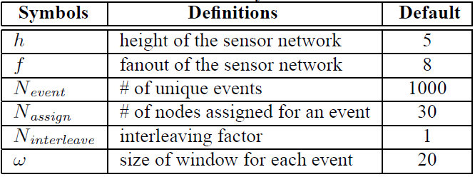
Experimental Evaluation
Simulation
  Sensor network as an f-ary complete tree whose fanout and depth are f and h, respectively
  Synthetic data that has a single attribute whose values follow a normal distribution with mean μ_{i} and variance σ_{i}² for each event i (1 ≤ i ≤ N_{event})
  Data items for an event are generated at N_{assign} leaf nodes and the interval between the assigned nodes is N_{interleave}
  The number of data items in windows (for evaluating intermediate trust scores) is ω
  < notation and default values >
Goal of the experiments:
  showing efficiency and effectiveness of our cyclic framework

Slide 17
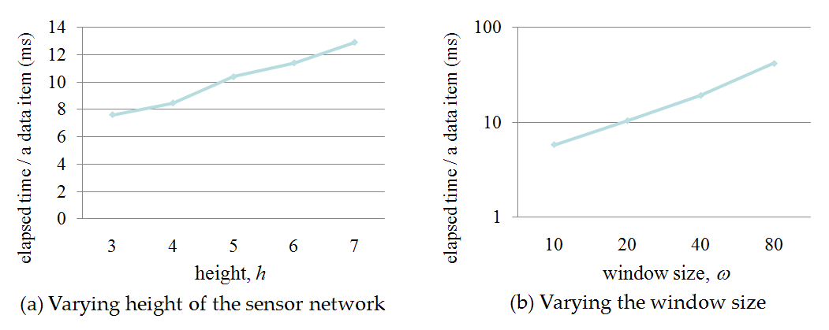
Experiment 1
Computation Efficiency of the Cyclic Framework
Measure the elapsed time for processing a data item with our cyclic framework
For showing scalability, we vary
1) the size of sensor networks (i.e., h) and
2) the number of data items for evaluating data trust scores (i.e., ω)
The results show a reasonable computation overhead and scalability both with the size of sensor network and the number of data items in windows

Slide 18
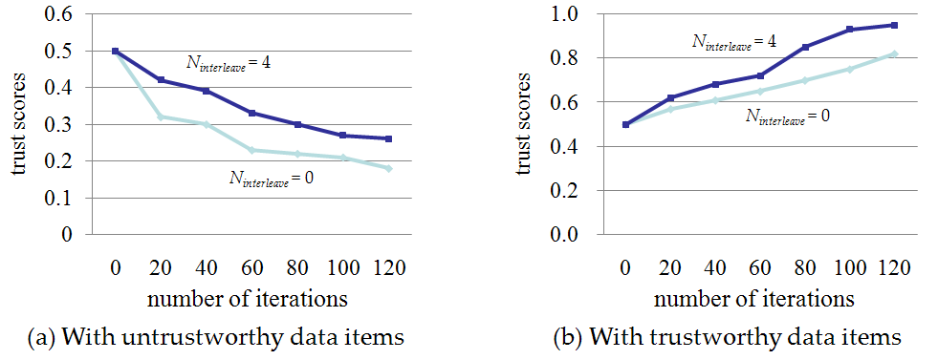
Experiment 2
Effectiveness of the Cyclic Framework
Inject incorrect data items into the sensor network, and then observed the change of trust scores of data items
For observing the effect of provenance similarities, we vary the interleaving factor (i.e., N_{interleave}) → if N_{interleave} increases, the provenance similarity decreases
Figure (a) shows the changes in the trust scores when incorrect data items are injected, and Figure (b) shows when the correct data items are generated again
In both cases, we can see that our cyclic frame evolves trust scores correctly
The results also show that our principles
  different values with similar provenance result in a large negative effect
  similar values with different provenance result in a large positive effect are correct

Slide 19
Conclusions
We address the problem of assessing data trustworthiness based on its provenance in sensor networks
We propose a solution providing a systematic approach for computing and evolving the trustworthiness levels of data items and network nodes
Future work
  more accurate computation of trust scores
  secure delivery of provenance information
  trust scores for aggregation and join in sensor networks

